Slide 1
How Do We Know The Age of The Earth?

Slide 2
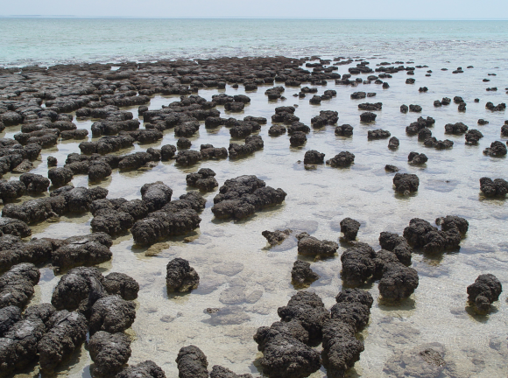
How Do We Know When Events In Earth’s History Occurred?
Like photosynthesis…
First organisms, like blue-green algae, began producing oxygen.
Iron dissolved in the oceans bonded with the oxygen and eventually formed banded iron formations.
Once the iron was used up in the oceans, oxygen began accumulating in the atmosphere (about 2.4 billion years ago).
Stromatolites: Early blue-green algae formed these rocks
Banded-iron Formation: oxygen locked up in rock formations
Notes:
We know that Earth has changed over time both physically and chemically (e.g., composition of the atmosphere), but how do we figure out WHEN these changes occurred? That’s what we are going to be exploring over the next few lessons.
More reference: http://www.bbc.co.uk/science/earth/earth_timeline/first_life

Slide 3
How Old Is the Kitten in the Middle?
Notes:
One answer is that it is older than the kitten to the left and younger than the kitten to the right. The other is that its absolute age is 12 weeks.
Ask students: Which is the relative date and which is the absolute date?

Slide 4
Relative Versus Absolute Dating
Relative Dating: science of determining the relative order of past events (i.e., the age of an object in comparison to another)
Absolute Dating: science of assigning a specific, or absolute, number to past events. May include an actual date or a range of dates.
Notes:
In this lesson, we will focus on relative dating. In the next unit about Life on Earth, you will learn more about absolute dating and using radioactive decay to date elements within layers of rocks.

Slide 5
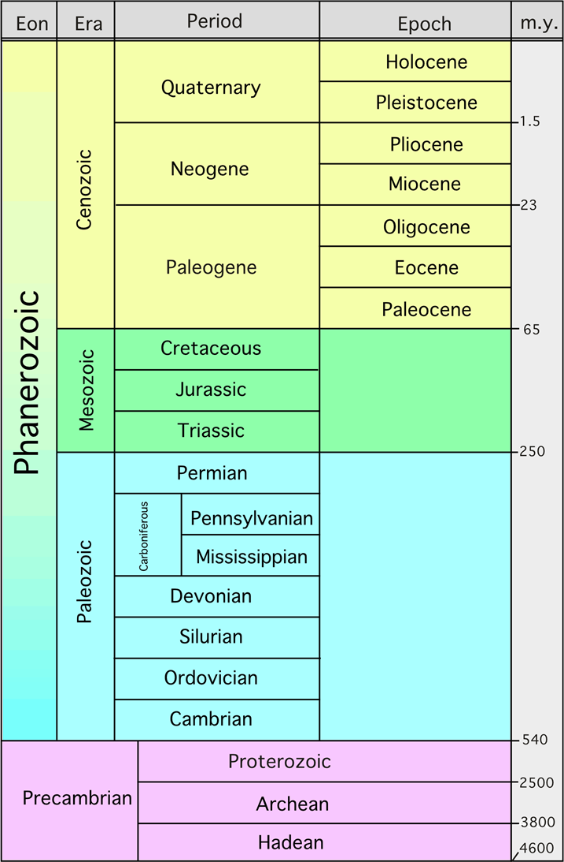
Geologic Time Scale (simple)
Scientists use both absolute and relative dating to establish charts like this.
Notes:
Scientists use both relative and absolute dating to determine the chronology (in order sequence) of the geologic time scale. You created part of the time scale for an eon or era in the previous two lessons.
Note: The time scale is millions of years ago (m.y.) So this graph starts 4,600 million years ago, or 4.6 billion years ago.

Slide 6
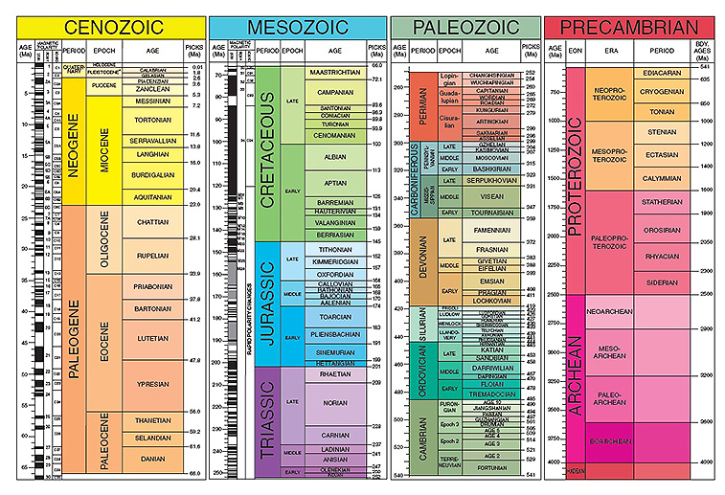
Geologic Time Scale (complex)
Notes:
This is the geologic time scale used by scientists. You can see Earth’s history is broken down even farther into epoch and ages based upon geological events like sea level rise, mountain-building, depositional events and also biological events like the appearance, abundance and extinction of certain life forms.
You can show this graph and marvel with your students about the detail that exists in the Earth’s history. You could zoom into one part and show students some of the detail, but it’s really to highlight the detail that science goes into to understand our Earth’s history.

Slide 7
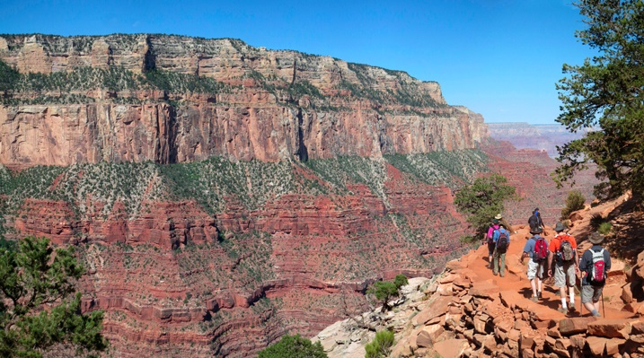
The Grand Canyon
Notes:
In this lesson, you are going to practice relative dating. Scientists use direct evidence from observations of rock layers to help determine their age.
One principle geologists use is the law of superposition. Let’s do a quick activity to illustrate it.
Quickly find three other students close to you and sit or stand in a circle. Have one student reach their hand into the middle of the circle, the second student put their hand on top of it, then a next student placing their hand on top of the previous students and so on until all eight hands are stacked on top of each other. Ask students which hand was put down first, or the oldest in that order. The hand on the bottom was put down first.
Have students go back to their seats. Use another analogy about a laundry hamper. Tell them you’ve been throwing your clothes in it for the last few days, say Monday, Tuesday and Wednesday. Which clothes have been in the hamper the longest? The clothes thrown in there on Monday.

Slide 8
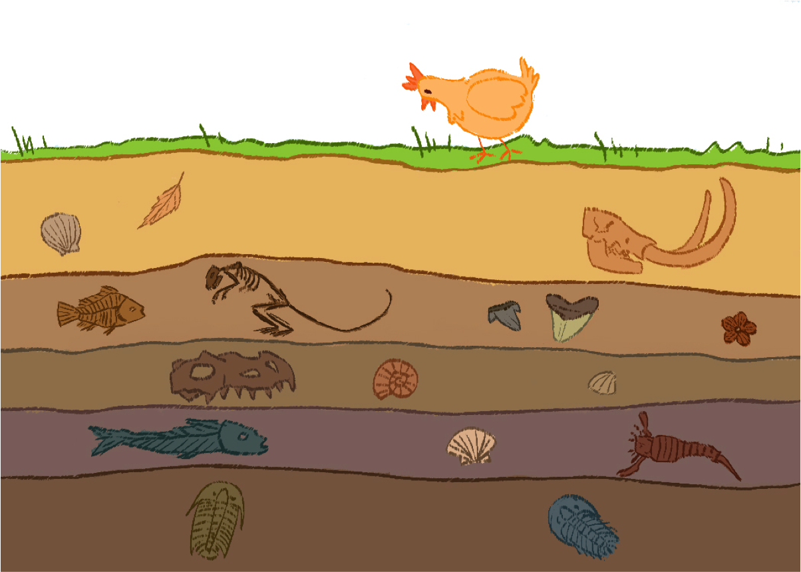
Law of Superposition
Youngest
Oldest
Notes:
So the law of superposition states that in any undisturbed sequence of rocks deposited in layers, the youngest layer is on top and the oldest on bottom, each layer being younger than the one beneath it and older than the one above it. Referring to rocks as “older” or “younger” is relative dating. If this law is true, which layer of rocks in the photo of the Grand Canyon is the oldest? (The one on the bottom.)

Slide 9
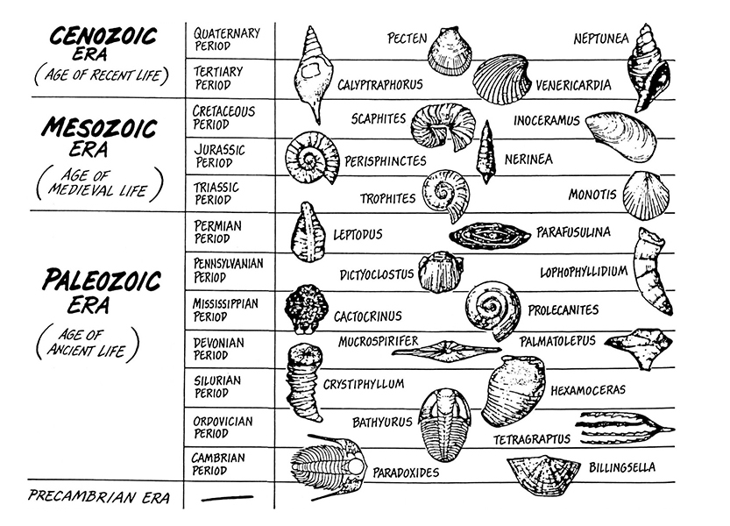
Index Fossils
Notes:
Another way scientists relatively date rock layers is by using index fossils. As you learned in constructing Earth’s history and a geological time scale, certain living things are found during certain time periods. Certain fossils are only found in a particular rock unit yet found in many places worldwide. This makes them useful for determining the age of undated strata, or rock layers.

Slide 10
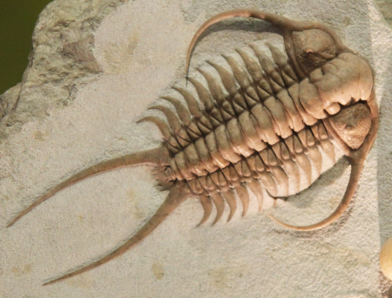
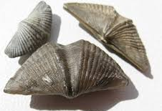
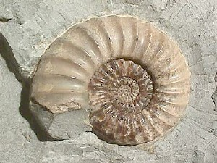
Index Fossil Characteristics
distinctive
widespread
abundant
limited in geologic time
Trilobite
Ammonite
Brachiopods
Notes:
Here are some examples.

Slide 11
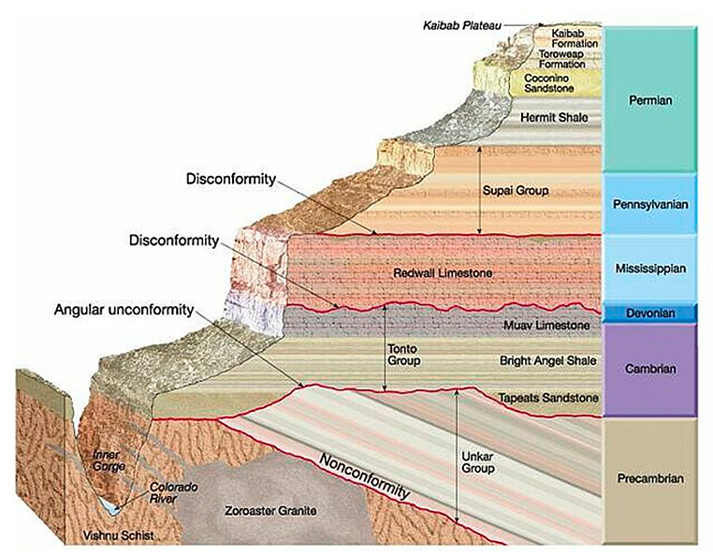
Stratigraphy=Interpreting Layers of Rock
Notes:
Here is a cross-section of the Grand Canyon. Let’s practice relative dating. Which layer is the oldest? How do you know? What else does this illustration make you wonder or think of?

Slide 12
Relative Dating: Sequencing Shapes
Which is older, the heart or the rectangle?
If the cards represented Earth layers, how might you explain the parallelogram and L-shape?
Describe the age of the circle and rectangle card? (It will be relative to other cards.)
Was this easy or difficult? Why?

Slide 13
Relative Dating: Sequencing Index Fossils
Which layer is the oldest? Youngest? How do you know?
Which organisms could be used as index fossils and why?
Which are not good candidates for index fossils and why?
Explain how this activity illustrates the Law of Superposition?
How might this activity compare to scientists relatively dating earth layers?
Any other thoughts or questions?

