Slide 1
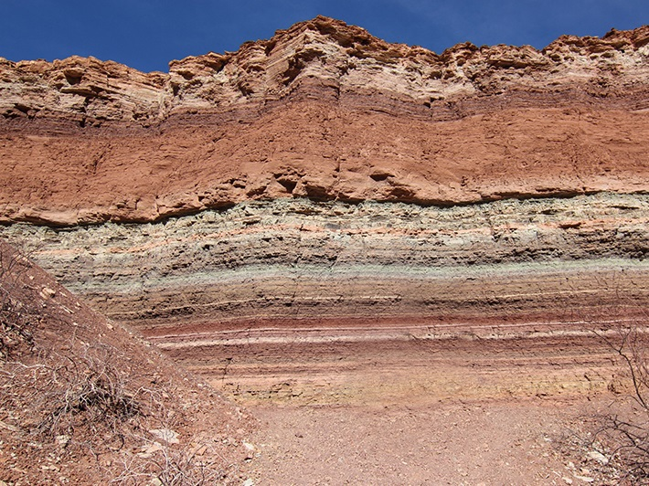
Core Sample Challenge
What lies beneath?

Slide 2
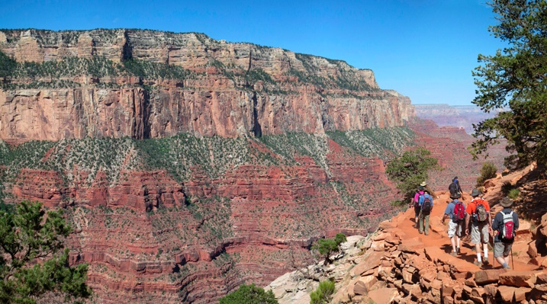
Aging the Earth
Notes:
We saw in previous lessons how scientists construct the history of the Earth by using stratigraphy-the interpretation of layers of sediment. The Grand Canyon is a great visual of stratigraphy-here you can see various layers. Rocks exposed in the Grand Canyon have been dated back to 2 billion years ago.

Slide 3
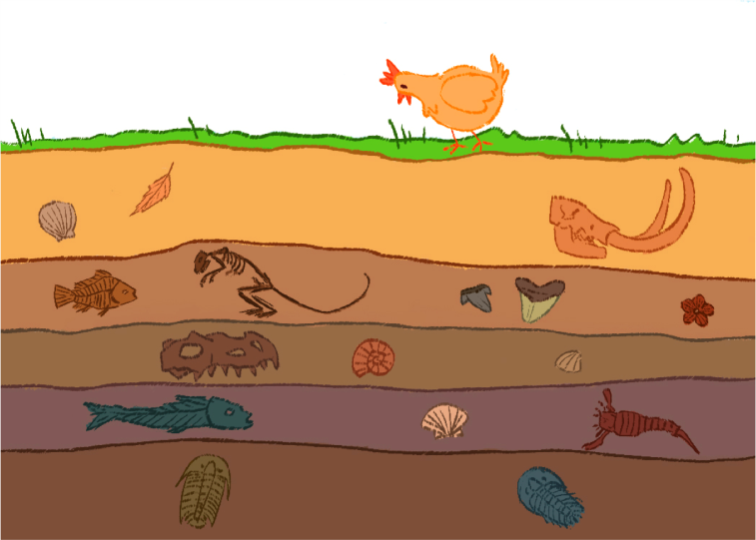
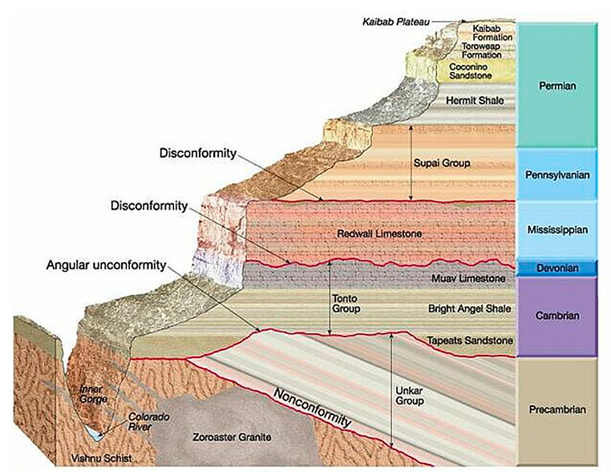
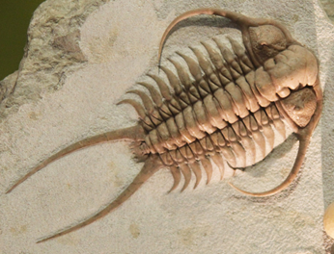
Using Stratigraphy to Recreate Earth’s History
Youngest
Oldest
Law of Superposition
Trilobite-An Index Fossil
Notes:
REVIEW AND CONTEXT FOR LESSON Scientists, geologists, paleontologists, paleomagnetists, and others, use relative and absolute methods to age various layers. One way is using the law of superposition (oldest layer deposited first and on “bottom”) and index fossils (widespread, abundant fossils that signify a particular time span). Knowing the age of the layer as well as it’s composition of sediment type and fossils, help scientists understand what Earth was like at that particular time in history. The geologic time scale is a result of evidence of particular time spans (eons, eras, periods, epochs, ages).

Slide 4
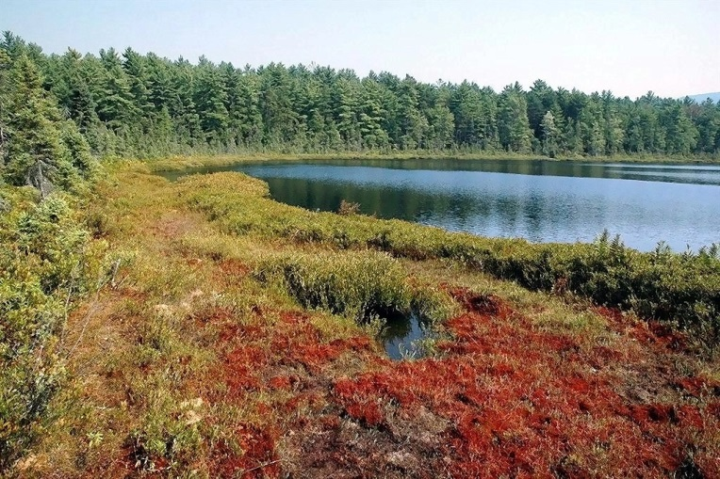
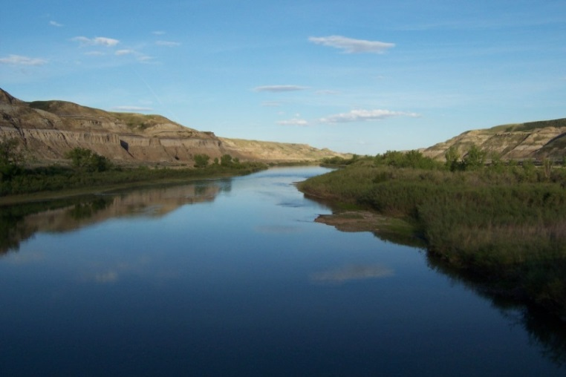
What if the layers of Earth are not exposed by erosion?
Bogs and Lakes
Ocean Floor
Rivers
Notes:
But what do scientists do when layers haven’t been exposed by erosion and weathering? For example, the sediment under the ocean floor, bogs and lakes and rivers.
Think-Pair-Share

Slide 5
Core Sample Challenge
You are scientists challenged to relatively age and examine all the rock layers in order to interpret the history of your site.
To do this, first:
1. Consider a geologic story you want to tell
2. Create a geologic site in a small group and
exchange with another group
3. Take core samples and interpret your new geologic site
Notes:
You are going to have a chance to answer that question in this lesson.
You will work in pairs to first create a geological site with layers of different sediment.
Then exchange that site with another pair and then work to determine the order of layers and determine which are oldest relative to other layers.
Note: You can now show them the materials and review worksheet.

Slide 6
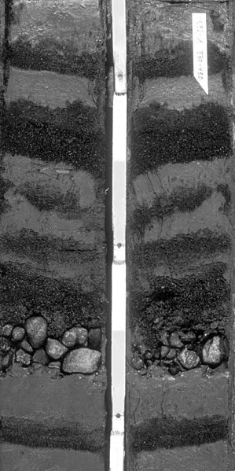
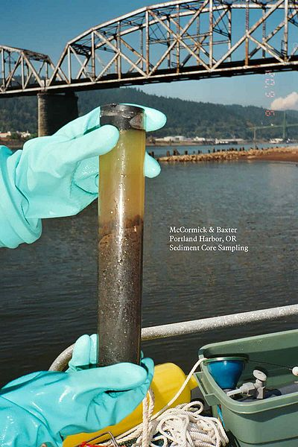
What is a Core Sample?
A cylindrical section of (usually) a naturally occurring substance.
Most core samples are observed by drilling with special drills into the substance, for example, sediment or rock, with a hollow steel tube called a core drill.
Sediment core with gravel and sand layers from the Antarctic continental slope
From the Columbia River in Oregon
Notes:
A core sample is a cylindrical section of (usually) a naturally occurring substance. Most core samples are obtained by drilling with special drills into the substance, for example sediment or rock, with a hollow steel tube called a core drill.

