Slide 1
Sediment Core Story
A Case Study

Slide 2
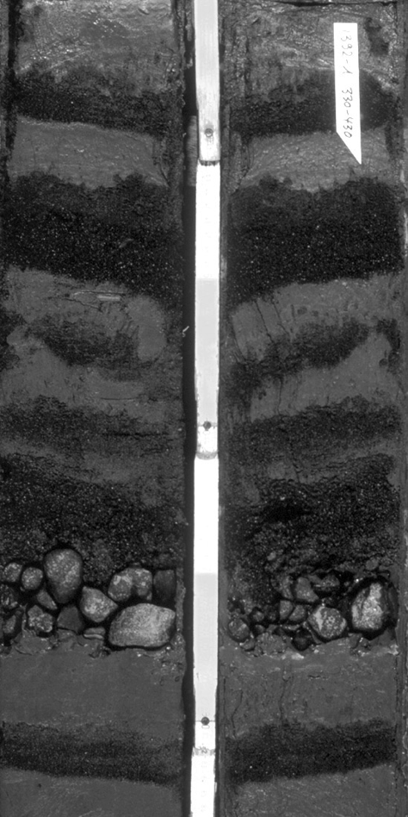
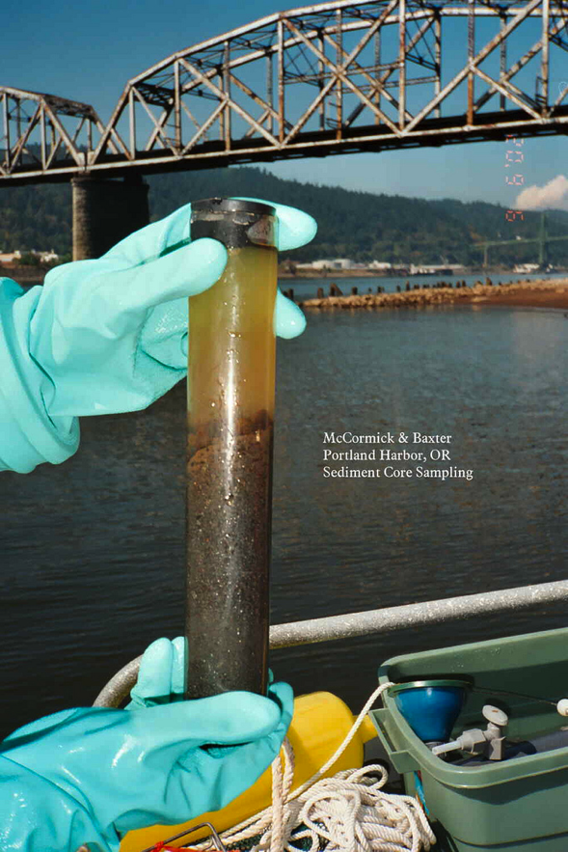
What is a Core Sample?
A core sample is a cylindrical section of (usually) a naturally-occurring substance.
Most core samples are obtained by drilling with special drills into the substance. For example, sediment or rock is obtained with a hollow steel tube called a core drill.
Sediment core with gravel and sand layers from the Antarctic continental slope
From the Columbia River in Oregon

Slide 3
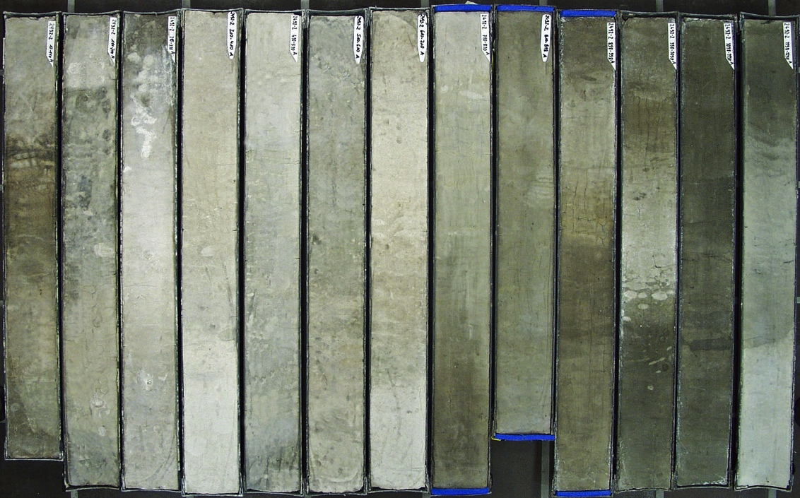
Different layers of sediments and fossils tell different stories.
Why the different colors?
They represent changing conditions and Quaternary climate cycles.
Lighter colors indicate a higher number of microfossils and are related to warmer periods that, in this record, span the last 800,000 years.
South Atlantic Sediment Core (taken in 4,207-meter-deep water)
Notes:
Ask students the question before continuing.

Slide 4
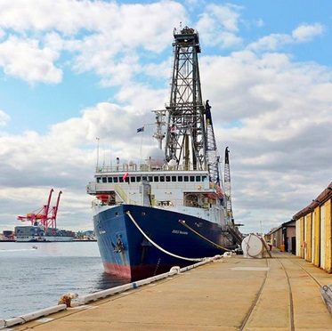
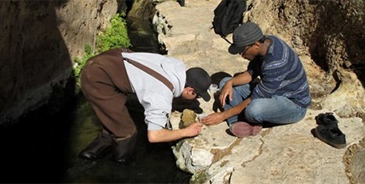
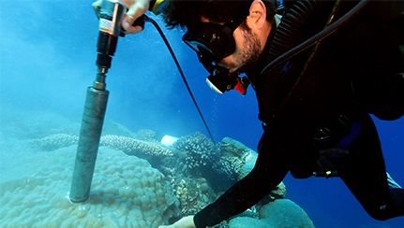
Who Takes Core Samples?
Students take core samples.
JOIDES Resolution’s mission is to sample sediments from the bottom of the world’s oceans.
Divers also take core samples.
Notes:
Ships go on expeditions specifically to collect core samples. Students take core samples in their local environments, and divers take core samples in shallower water.
Think-Pair-Share: What might core samples tell them?

Slide 5
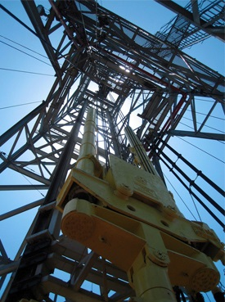
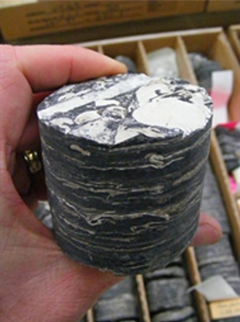
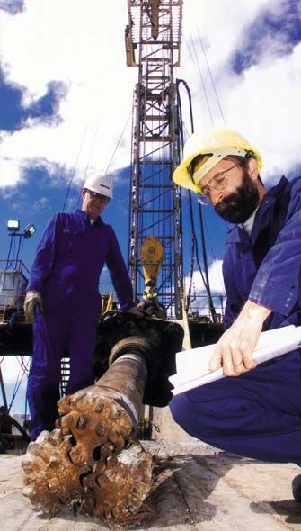
How Deep is a Sample?
JOIDES Resolution is capable of drilling holes over 2,100 meters (6,890 feet) below the sea floor in water up to 8,000 meters (26,000 feet) deep.
Drilling Derrick
Retrieved Core
Drill Bit
Notes:
Depth varies; however, with a drilling ship, samples can be quite deep.

Slide 6
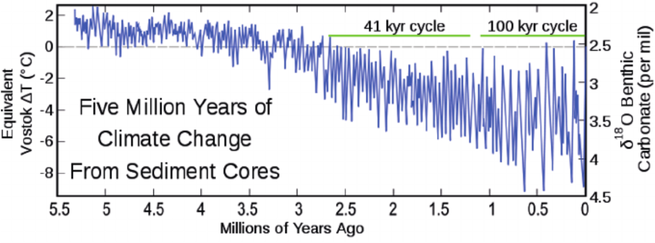
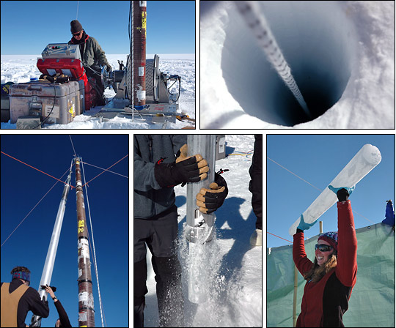
How Are Core Samples Used?
To recreate past ecosystems and climates
NASA uses sediment and ice cores like these to recreate past climates.

Slide 7
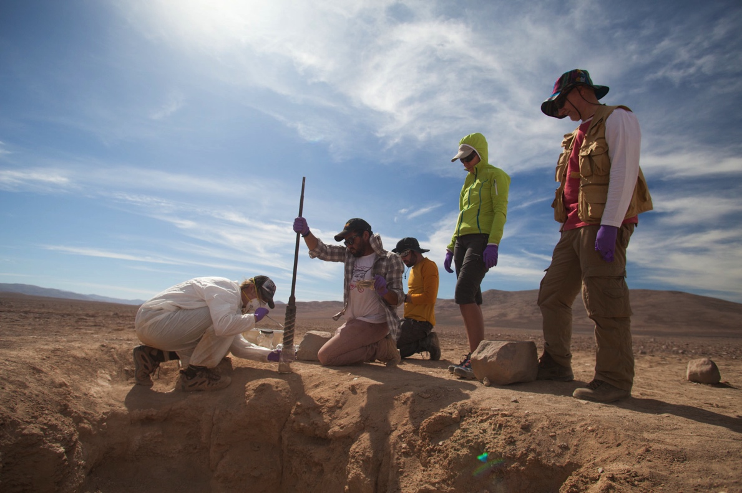
How Are Core Samples Used?
To detect evidence of past life
These NASA scientists are practicing drilling in Argentina’s Atacama Desert.
This terrain is much like the terrain of Mars, where scientists will eventually drill.

Slide 8
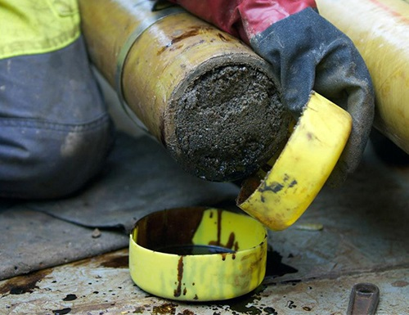
How Are Core Samples Used?
To discover fossil fuels
Core samples are often used by the gas and oil industry to find and evaluate fuel reserves.

Slide 9
Mystery Core
Obtained by JOIDES Resolution
350 miles east of Florida
128 meters (427 feet) below the ocean floor
Includes sediment from over 65 million years ago!
Notes:
Note: STOP HERE and pass out photos of the core.
Students will now assume the roles of scientists and analyze the photograph of a core sample taken by the JOIDES Resolution.
After students analyze the mystery core, project this slide again and ask the following question: Based on previous lessons, what do we know happened around 65 million years ago? (Accept all answers.)

Slide 10
Cretaceous/Tertiary Boundary meteorite impact
ODP Leg 171B, Site 1049, Core 1049A, Section 17X-2
Story of Mass Extinction
45 cm
55
65
75
TERTIARY MICROORGANISMS
Return to “normal” conditions.
FIRST REPOPULATION OF
THE “EMPTY SEAS” New life evolves from survivors.
FALLOUT BED
Devoid of almost all life. Evidence
of a few surviving microorganisms. Contains iridium anomaly and
remains of the meteorite.
IMPACT EJECTA
Debris from the impact consists
of a layer of graded, green, glassy globules, called tektites, as well
as mineral grains and rock debris apparently derived from the
Yucatan impact structure.
CRETACEOUS MICROORGANISMS
This layer contains signs of
slumping perhaps caused by
intense shock waves from the
Chicxulub meteorite impact.
Around 65 million years ago, a 10-kilometer meteorite crashed into what is now known as the Yucatan Peninsula.
A 177-kilometer-wide crater was created.
80% of species, and nearly all of the dinosaurs, disappeared from the fossil record.
Evidence in the geologic record supports this impact.
TERTIARY
CRETACEOUS
Notes:
Study this slide to see how to interpret the core with students.

Slide 11
What Happened?
Cretaceous/Tertiary Boundary meteorite impact
ODP Leg 171B, Site 1049, Core 1049A, Section 17X-2
45 cm
55
65
75
TERTIARY MICROORGANISMS
Return to “normal” conditions.
FIRST REPOPULATION OF
THE “EMPTY SEAS” New life evolves from survivors.
FALLOUT BED
Devoid of almost all life. Evidence
of a few surviving microorganisms. Contains iridium anomaly and
remains of the meteorite.
IMPACT EJECTA
Debris from the impact consists
of a layer of graded, green, glassy globules, called tektites, as well
as mineral grains and rock debris apparently derived from the
Yucatan impact structure.
CRETACEOUS MICROORGANISMS
This layer contains signs of
slumping perhaps caused by
intense shock waves from the
Chicxulub meteorite impact.
Scientists think that darkness from rock debris (from the impact) clouding the Sun led to lower photosynthesis and disruption of the food web.
Other hypotheses include high volcanic activity increasing carbon dioxide levels and creating a warmer planet, and tectonic plate movements changing the climate and contributing to extinction.
TERTIARY
CRETACEOUS

Slide 12
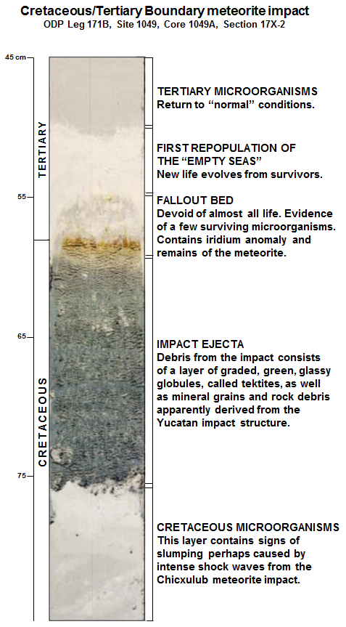
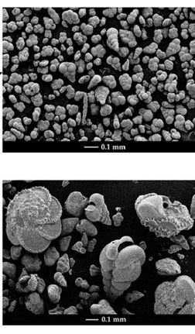
Evidence of Changing Life
Notes:
This shows microscopic images at a couple of different layers.
Facilitate a discussion with students. Sample questions include the following:
What do you still wonder or have questions about regarding core samples?
What was easy or challenging about this activity?
Where might you take a core sample in your community? Why might you take one?

