Slide 1
Collisions and Newton’s Laws of Motion
Introduction

Slide 2
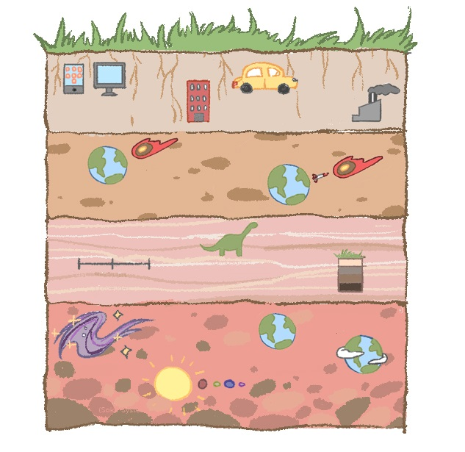
Unit Core Sample
(Buildings)
(Industries)
(e.g., smartphones, computers)
(Cars)
(Earth )
(Earth)
(Missile)
(Timeline)
Past Present Future
(Dinosaurs)
(Earth With Atmosphere)
(Galaxies)
(Earth Before Atmosphere)
(Solar Systems)
Notes:
This sequence of lessons ties the craters and formations found on the surface of the Earth with the phenomenon of how can we prevent an asteroid collision with Earth.

Slide 3
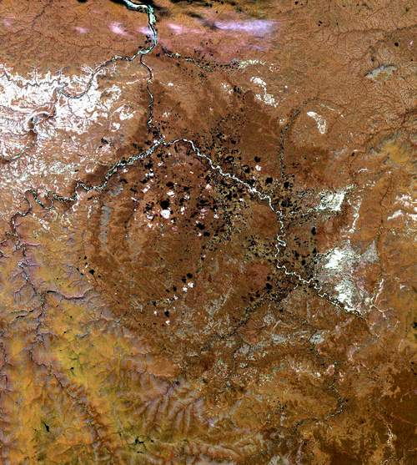
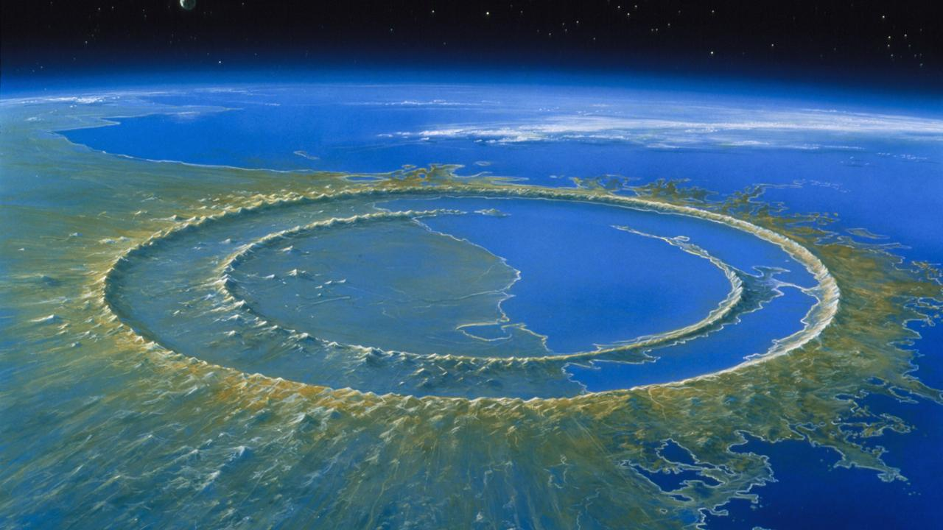
Phenomenon:
Asteroid (meteor) collisions can endanger life on Earth.
Collisions of Space Objects with Earth: Examples of the Largest Confirmed Craters
Vredefort Crater
Largest impact crater
Diameter: 300 km
Free State, South Africa
Artist Reconstruction of Chicxulub Crater, Detlev Van
“Dinosaur-killing” impact crater
Diameter: 180 km
Yucatán, Mexico
Popigai Crater
Linked to an extinction event
Diameter: 100 km
Siberia, Russia
Notes:
Earth’s atmosphere helps it support life in more than one way. It not only maintains a comfortable temperature for life to exist, but also provides physical protection to the planet. The solar system is full of debris and small particles from the creation of planets or collisions in the asteroid belt. Space debris (dust and tiny particles) strikes Earth every single day, but when it encounters the molecules that make up Earth’s atmosphere, the resulting friction destroys it (or breaks it up, in the case of larger meteors) long before it can hit the ground.

Slide 4
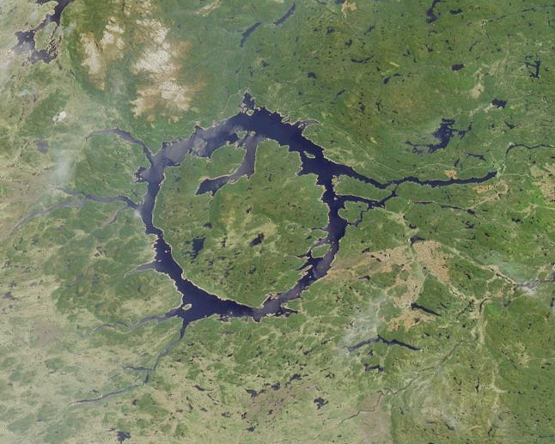
Collisions of Space Objects with Earth: Examples of Craters in North America
Meteor Crater (a.k.a. Barringer),
Source: Tsaiproject
Diameter: 1.2 km
Arizona, U.S.
Manicouagan Crater
Diameter: 100 km
Quebec, Canada

Slide 5
Newton’s Laws and the Exploration of Meteors/Meteorites
We will explore asteroid trajectory changes to understand:
Asteroids’ Path Alterations
Asteroids’ Acceleration Changes
How to Prevent Asteroids’ Impact
BUT FIRST . . .
Notes:
Tell students that they will be applying Newton’s Laws of Motion and Gravity to explore of meteors/meteorites.
The numbers in the image indicate the objects’ catalog numbers, assigned approximately in the order in which they were discovered. For example, Vesta was the fourth asteroid to be discovered, which is why it has a 4 in its name.

Slide 6
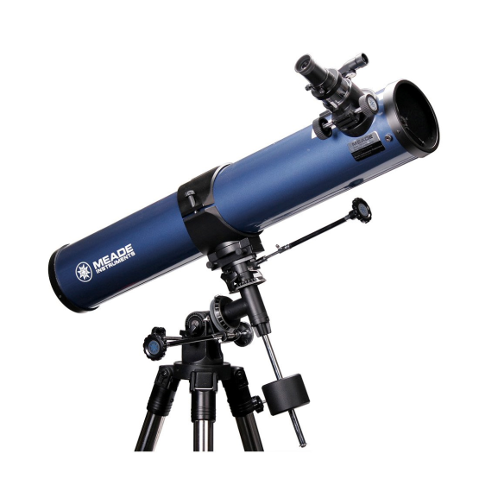
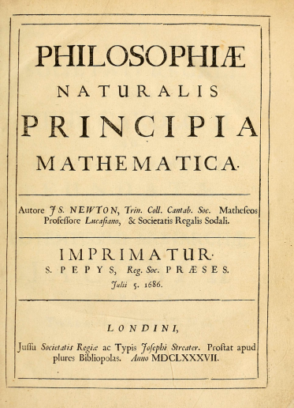
Newton’s Laws of Motion
Isaac Newton (1642-1727) had a profound impact on astronomy, physics, and mathematics.
Among his many achievements were:
the invention of the reflecting telescope (basic design behind all large telescopes used today)
the invention of the branch of mathematics known as calculus
the creation and explanation of three laws of motion
the development of the law of universal gravitation
Notes:
The equation describes the gravitational attraction between two masses.

Slide 7
Newton’s Laws of Motion
Newton’s First Law of Motion: A body at rest will remain at rest unless an outside force acts on it, and a body in motion at a constant velocity will remain in motion in a straight line unless acted upon by an outside force.
No Force = No Change in Motion
Also called the “Law of Inertia,” where inertia refers to the resistance to change the state of motion of the object.
For example: Your mom asks you to stop what you are doing and go wash the dishes. Your inertia (resistance to move and change your state) increases.
An object at rest will remain at rest . . .
. . . unless acted on by an unbalanced force.
An object in motion will continue with constant speed and direction . . .
. . . unless acted on by an unbalanced force.

Slide 8
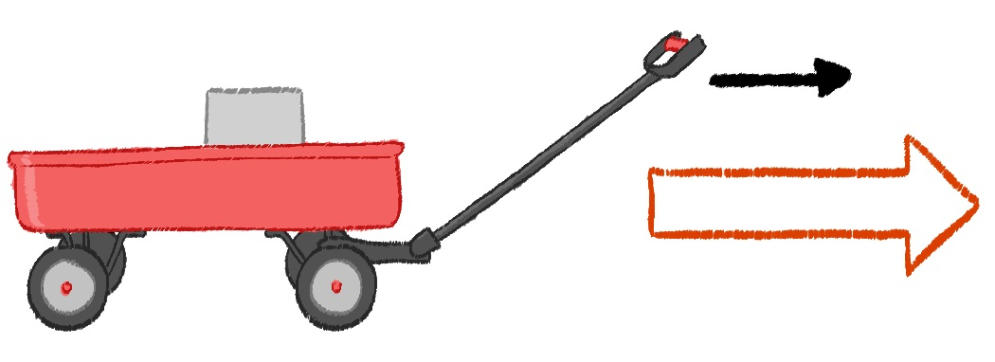
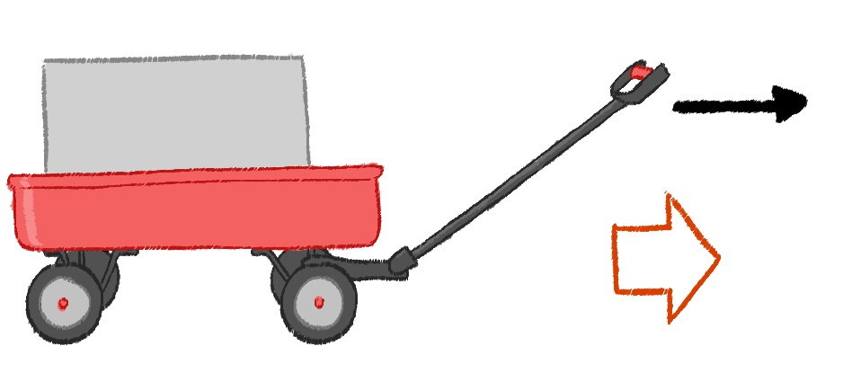
Newton’s Laws of Motion
Newton’s Second Law of Motion: If an unbalanced force acts on a body, that body will experience acceleration (or deceleration), or a change of speed.
F = ma
where F is the unbalanced force
m is the object’s mass
a is the acceleration that the force causes
F
m
a
m
F
a

Slide 9
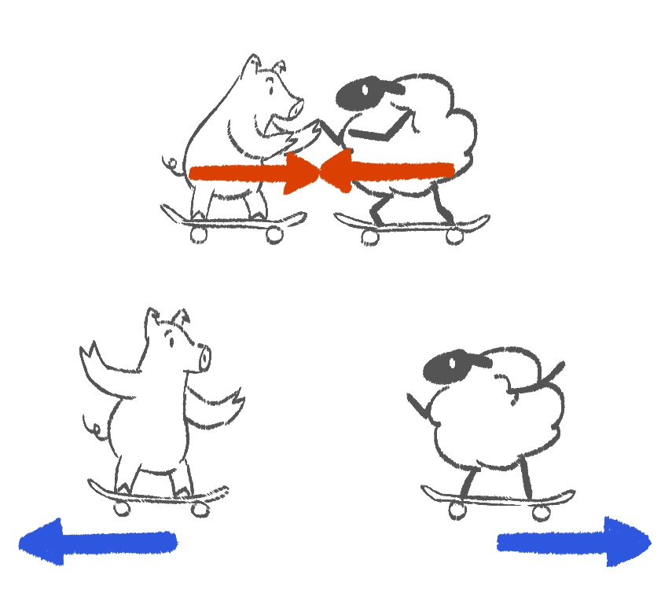
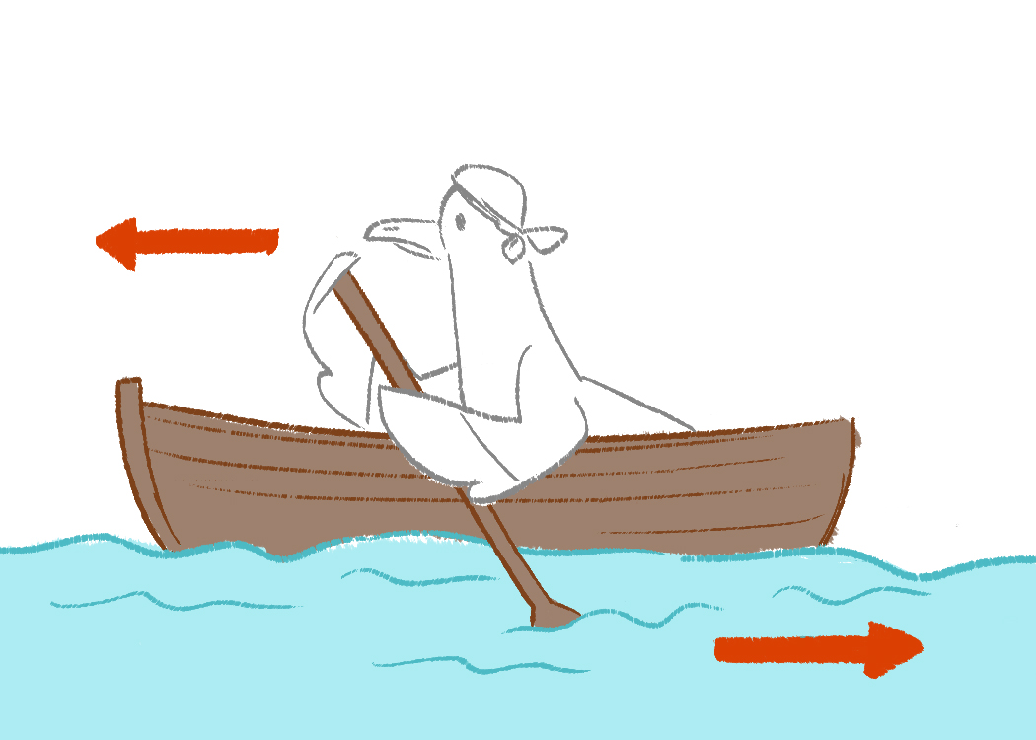
Newton’s Laws of Motion
Newton’s Third Law of Motion: For every action, there is an equal and opposite reaction.
A
B
F
A
B
F

