Slide 1
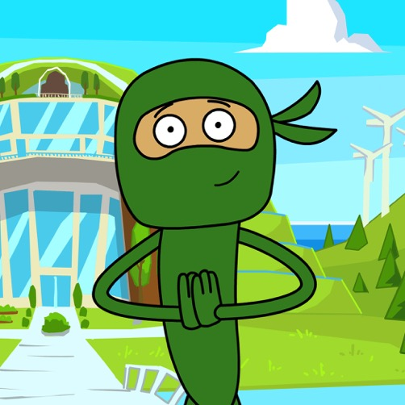
Message from Green Ninja
Hello Team!
In this year at Green Ninja, your mission is to design a more sustainable future. To make progress, we need to study both the past and present, so that we can understand how to create the kind of future we all want. In this first unit, we’ll explore the effects of Earth’s place in the solar system, how long the Earth has been around, and then at the end, look forward to what the Earth might look like in the future.
Oh – and one more thing. This year we are going to train you to develop a new special power. The power to code! As you develop and refine your programming skills, you’ll be able to do amazing things that can change the world.
Let’s get started with this video!
– Green Ninja
Notes:
The video is a quick introduction and example of how we use elements from thousands of years ago in modern times.
Hyperlink: https://ngssgreenninja.org/Green_Ninja_Show/24

