Slide 1
Non-Contact and Contact Forces

Slide 2
Non-Contact Forces
Forces that act on an object without physically coming into contact with it
Examples:
Magnetic Force
Gravitational Force
Electric Force
+
-
Attract
Particles can be positively or negatively charged.
+
+
Repel
-
-
Notes:
Note: Do not give away the definitions of the forces, as students will develop their own later.
Magnetic Force – The force of attraction or repulsion between moving, electrically-charged particles.
Gravitational Force – The force of attraction between all masses in the universe.
Electric Force – The force of attraction or repulsion between electric charges.

Slide 3
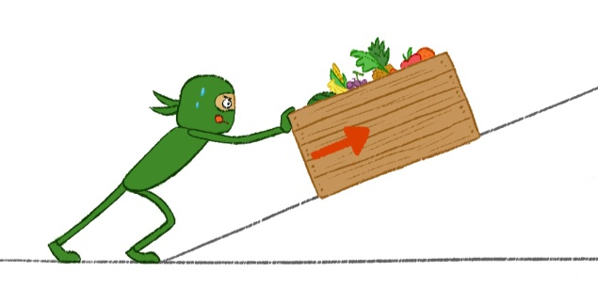
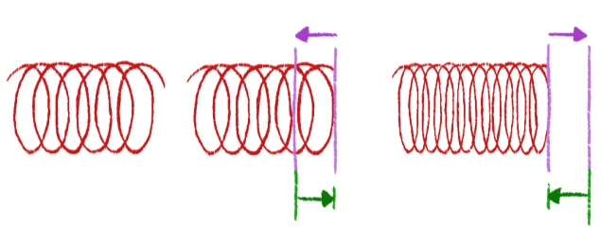
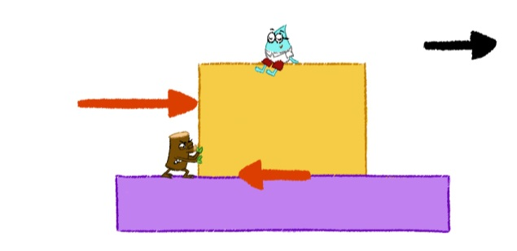
Contact Forces
Interactions between objects that touch
Examples:
Applied Force
Spring Force
Drag Force
Frictional Force
F
F
F
d
d
drag force
water surface
pushing force
motion
friction
Notes:
Note: Do not give away the definitions of the forces, as students will develop their own later.
The next five slides give examples of the different forces. As they are presented, have students brainstorm to develop a definition/explanation of each force.
Applied Force – The force that is applied to an object by a person or another object.
Spring Force – The force exerted by a compressed or stretched spring upon any object that is attached to it.
Drag Force – The force acting opposite to the relative motion of an object moving with respect to a surrounding fluid.
Friction Force – The force that opposes the motion of an object.

Slide 4
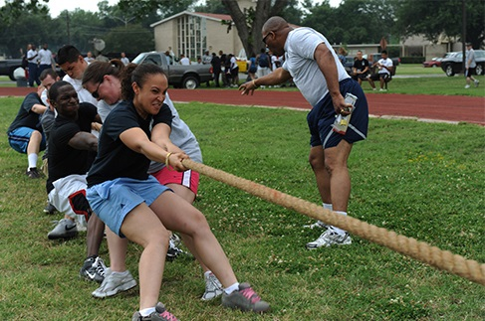
Indicate which force is shown in the image below. Explain your reasoning.

Slide 5
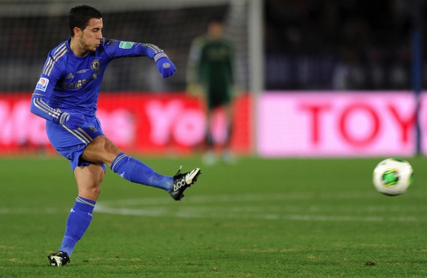
Indicate which force is shown in the image below. Explain your reasoning.

Slide 6
Indicate which force is shown in the image below. Explain your reasoning.

Slide 7
Indicate which force is shown in the image below. Explain your reasoning.

Slide 8
Indicate which force is shown in the image below. Explain your reasoning.

Slide 9
Additional Resources for Teachers

Slide 10
Indicate which force is shown in the image below. Explain your reasoning.
Contact Force: Applied Force
The players are applying force to pull the rope.

Slide 11
Indicate which force is shown in the image below. Explain your reasoning.
Contact Force: Applied Force
The soccer player applies force to the soccer ball when he kicks it.

Slide 12
Indicate which force is shown in the image below. Explain your reasoning.
Contact Forces:
Applied Force & Frictional Force
The applied force from the engine pushes the car forward.
f
f
There is friction between the road and the tires.

Slide 13
Indicate which force is shown in the image below. Explain your reasoning.
Contact Force: Drag Force
Air resistance (drag) acts in the opposite direction of the parachute moving through the air, helping it come down more slowly.
Gravity pulls the objects down towards Earth.
Non-Contact Force: Gravity

Slide 14
Indicate which force is shown in the image below. Explain your reasoning.
Non-Contact Force: Magnetic Force
The magnetic force pulls the metal objects towards the magnets.
*The force of attraction is so strong that the metal items end up sticking to the magnet.
Notes:
Take more time discussing this example since students may get confused with what seems like a contradiction of the term “non-contact force” and the image with the magnet touching all the metal items. Magnetic forces are non contact forces; they pull or push on objects without touching them. So that initial push or pull on the object was without any contact, but the force is so strong on some items that they end up “sticking” to the magnets.

