Slide 1
Deep Time: Exploring Earth’s History

Slide 2
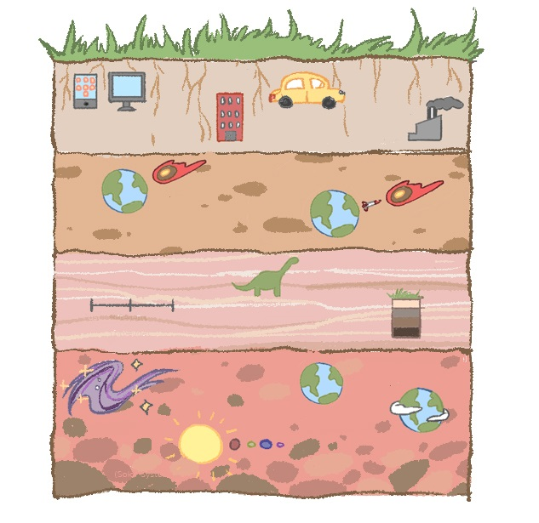
Unit Core Sample
(Buildings)
(Industries)
(e.g., smartphones, computers)
(Cars)
(Earth )
(Earth)
(Missile)
(Timeline)
Past Present Future
(Dinosaurs)
(Earth With Atmosphere)
(Galaxies)
(Earth Before Atmosphere)
(Solar Systems)
Notes:
This sequence of lessons focus on the Earth’s layers and sediments.

Slide 3
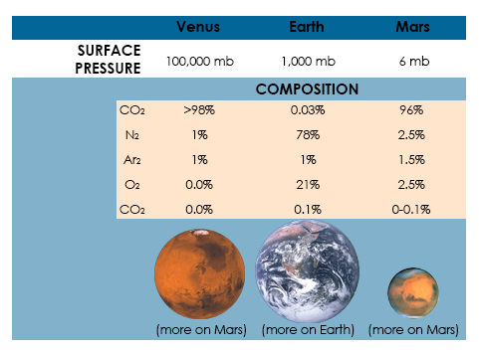
Our Atmosphere
Notes:
Image from: https://globalchange.umich.edu/globalchange1/current/lectures/Perry_Samson_lectures/evolution_atm/
As discussed in the previous lesson, different planets in our Solar System have different atmospheric compositions. To help students understand the importance of our atmosphere and the characteristics of its composition, it is best to compare it with other planets. In the image above, you can observe how Venus and Mars (which we have seen are a lot warmer than Earth) have a lot more of CO₂ than Earth. Another highlight for this image is the amount difference in the amount of oxygen. A key component of our atmosphere to sustain life. Using the following slides, introduce the phenomenon of changing oxygen in the atmosphere over time and share the artist’s depiction of a fiery, unfriendly early Earth with an atmosphere more similar to Venus’s than our present-day atmosphere.

Slide 4
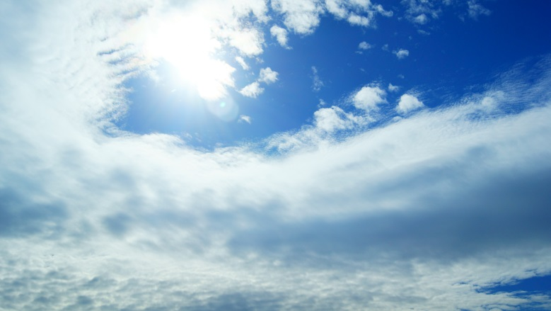
Present-Day Oxygen at 20%
At less than 15%, fires would not burn
At greater than 25%, even wet organic matter would burn freely
A balance is needed: Early organisms needed sunlight to become photosynthetic. They also needed protection from UV radiation. Likely they hid under mud, rock, and in the ocean. Now there is the ozone layer to protect us.
Notes:
For your reference: According to recently developed geochemical models, oxygen levels are believed to have climbed to a maximum of 35 percent and then dropped to a low of 15 percent during a 120-million-year period that ended in a mass extinction at the end of the Permian. Such a jump in oxygen would have had dramatic biological consequences by enhancing diffusion-dependent processes such as respiration, allowing insects such as dragonflies, centipedes, scorpions and spiders to grow to very large sizes. Fossil records indicate, for example, that one species of dragonfly had a wing span of 2 1/2 feet.
Geochemical models indicate that near the close of the Paleozoic era, during the Permian period, global atmospheric oxygen levels dropped to about 15 percent, lower that the current atmospheric level of 21 percent. The Permian period is marked by one of the greatest extinctions of both land and aquatic animals, including the giant dragonflies. But it is not believed that the drop in oxygen played a significant role in causing the extinction. Some creatures that became specially adapted to living in an oxygen-rich environment, such as the large flying insects and other giant arthropods, however, may have been unable to survive when the oxygen atmosphere underwent dramatic change.

Slide 5
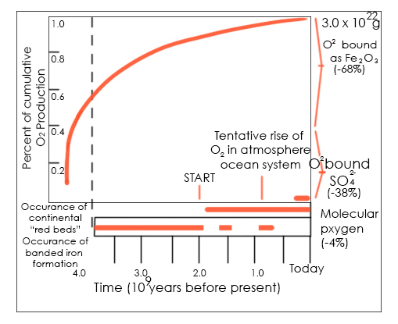
Oxygen in the Atmosphere Over Time
Cumulative history of O₂ by photosynthesis through geologic time.
Notes:
For student reference: The amount of oxygen in the atmosphere wasn’t always the same. Long ago there was very little, but slowly it grew in concentration. The growing amount of oxygen on the planet allowed or coexisted with the formation of life on the planet. It’s a pretty good design!
For your reference: According to recently developed geochemical models, oxygen levels are believed to have climbed to a maximum of 35 percent and then dropped to a low of 15 percent during a 120-million-year period that ended in a mass extinction at the end of the Permian. Such a jump in oxygen would have had dramatic biological consequences by enhancing diffusion-dependent processes such as respiration, allowing insects such as dragonflies, centipedes, scorpions and spiders to grow to very large sizes. Fossil records indicate, for example, that one species of dragonfly had a wing span of 2 1/2 feet.
Geochemical models indicate that near the close of the Paleozoic era, during the Permian period, global atmospheric oxygen levels dropped to about 15 percent, lower that the current atmospheric level of 21 percent. The Permian period is marked by one of the greatest extinctions of both land and aquatic animals, including the giant dragonflies. But it is not believed that the drop in oxygen played a significant role in causing the extinction. Some creatures that became specially adapted to living in an oxygen-rich environment, such as the large flying insects and other giant arthropods, however, may have been unable to survive when the oxygen atmosphere underwent dramatic change.

Slide 6
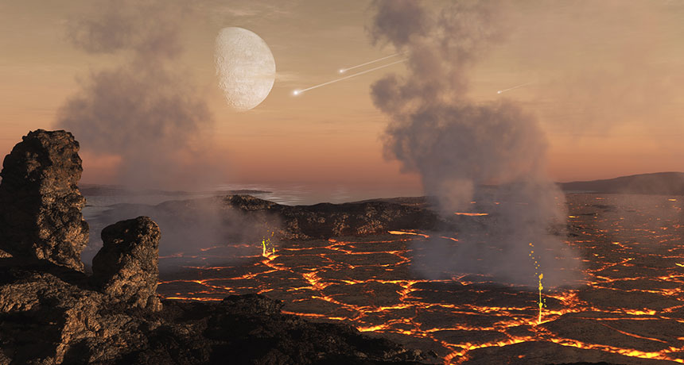
Early Earth: More Similar to Venus than Our Present Atmosphere
Artist’s depiction of early Earth

Slide 7
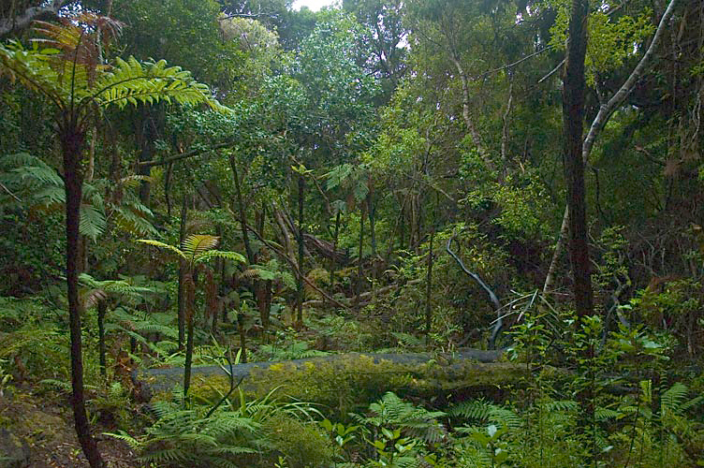
Today’s Atmosphere: A Variety of Life
What changed and when?
How do we know?

Slide 8
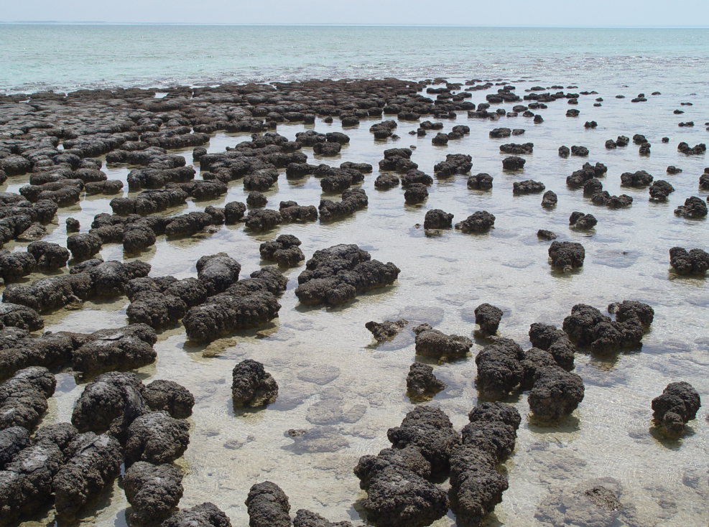
Clues in Earth’s History
Stromatolites: Early blue-green algae formed these rocks
Banded-iron Formation: oxygen locked up in rock formations
Notes:
Geology provides clues as to the Early earth, and over the last century, scientists have learned a lot from these clues.

