Slide 1
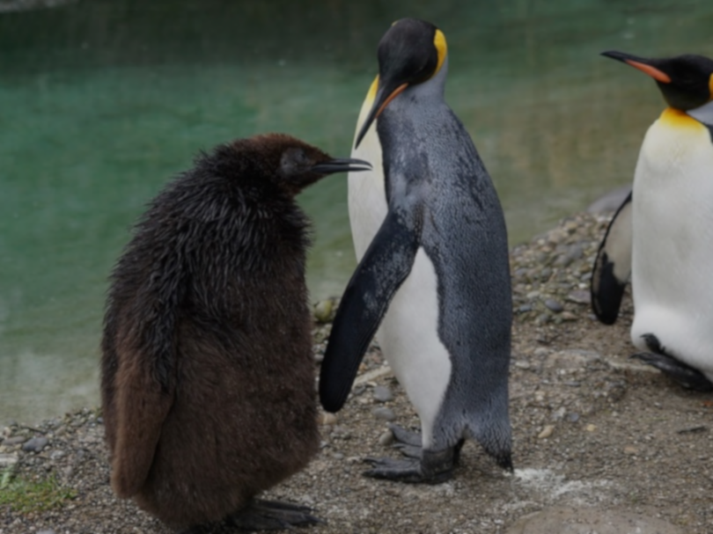
Patterns in Vertebrate Evolution

Slide 2
Existence, Diversity, and Extinction
In what ways has vertebrate life changed over time?
Notes:
This slide can be a review of the changes that students identified in their articles. This is an introductory question that could actually mean many things.
Background for Teachers
How has life changed? It has changed via the physical or behavorial adaptations of various orgranism groups (e.g., mammals having fur versus reptiles having scales).
But the more nuanced questions in macroevolution are about patterns of change.
Have some of these organism groups remained the same for an extended period of time? (Stasis)
How do we get new species from old ones? Does it happen slowly or quickly? (Speciation)
Did organism groups change over time within their own traits (i.e., do they have diverse histories as species or groups?)? (Character Change)
Did we lose a large group of species to make room for new species to evolve and take over? (Extinction)

Slide 3
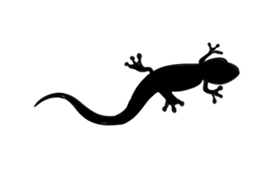
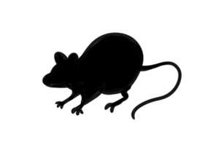
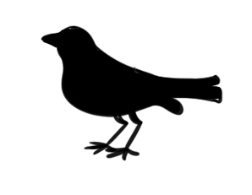
Vertebrates
Reptiles
Fish
Mammals
Amphibians
Birds
Notes:
Below are the vertebrate groups that students identified in their articles on evolutionary events.
From Invertebrates to Vertebrates – Not pictured but represented by the advent of the fish category.
Evolution of Life onto Land – The fish category represents the last big event before organisms came up onto land (ancient amphibians).
The First Amphibians
The First Reptiles
The First Birds
The First Mammals
Students should all know that these vertebrate groups all exist today. What evidence in the spindle diagram tells us that? (the top of the diagram has black representing each of the groups).
All of these groups exist today, but they didn't all evolve at the same time. Research tells us that they evolved at different times and that particular things happened to create this diversity.
Even before students wrote their articles, they may have been able to use their prior knowledge to guess at the order in which the classes of vertebrates appeared.

Slide 4
Vertebrates
Notes:
The vertebrate groups that students identified in their articles on evolutionary events.
From Invertebrates to Vertebrates – Not pictured but represented by the advent of the fish category.
Evolution of Life onto Land – The fish category represents the last big event before organisms came up onto land (ancient amphibians).
The First Amphibians
The First Reptiles
The First Birds
The First Mammals
What evidence in the diagram tells us that all of these vertebrate groups exist today? Student groups can look at their diagram. (Answer: The top of the diagram has black representing each of the groups).
All of these groups exist today, but they didn't all evolve at the same time. Research tells us that they evolved at different times and that particular things happened to create this diversity.
Even before students wrote their articles, they may have been able to use their prior knowledge to guess at the order in which the classes of vertebrates appeared.
This is still only a relative timeline and we don't know the types of evolution or patterns that occurred. Were they related? Who is the ancestor? Why or when did these species evolve?

Slide 5
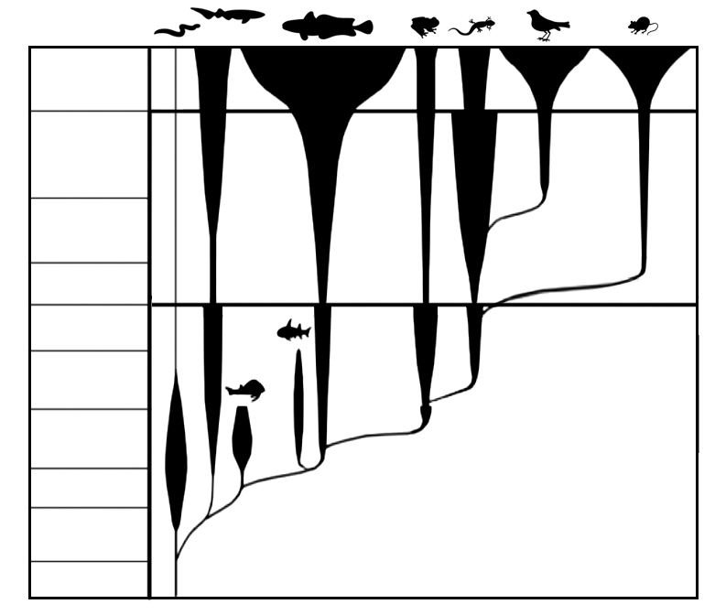
What are the Patterns?
Tertiary
Cretaceous
Jurassic
Triassic
Permian
Carboniferous
Devonian
Silurian
Ordovician
Vertebrate Diversity
Cambrian
Notes:
This spindle diagram gives a visual sense of the types of patterns found in evolution.
In their small groups, ask students to pick out 1-3 areas on the diagram in which they think represent a pattern of change across various groups of species. Give them a few minutes to work and then share responses.
Review again: Each black shape represents the diversity of that vertebrate class found over time. Students should recognize that the x-axis refers to geologic time (same as the fossil record).
Let's define some of the patterns seen in macroevolution and then try to find them within the history of vertebrate life.

Slide 6
What is the pattern?
Tertiary
Cretaceous
Jurassic
Triassic
Permian
Carboniferous
Devonian
Silurian
Ordovician
Vertebrate Diversity
Notes:
Ask students to consider what is happening at the two red circles in the diagram. First they can describe the area of the black shape (not expanding much at all). Encourage peer-to-peer discourse to elicit more nuanced responses. It is not necessary for students to come up with the correct scientific term (stasis) but their description of the pattern should resemble the detail on the following slide.

Slide 7
Patterns in Evolution
Stasis
No change over a long time
No major adaptations causing a new species to arise
Organisms in stasis can be called "living fossils"
Notes:
Stasis – This is the ”process” (or lack thereof) of an organism not changing its features or behaviors over a significant time. Organisms in stasis are often called “living fossils,” as they are a link back through the hsitory of evolution. Other species have changed, but these have stayed relatively the same over the same period of time.
Examples of vertebrates in stasis include the crocodile that came into existence 55 million years ago and the coelacanth fish, whose existence can be traced back 360 million years.

Slide 8
What is the pattern?
Tertiary
Cretaceous
Jurassic
Triassic
Permian
Carboniferous
Devonian
Silurian
Ordovician
Vertebrate Diversity
Notes:
Repeat the investigative discussion (resembling slide 6) about the patterns found in the 3 red circles. (Speciation)

Slide 9
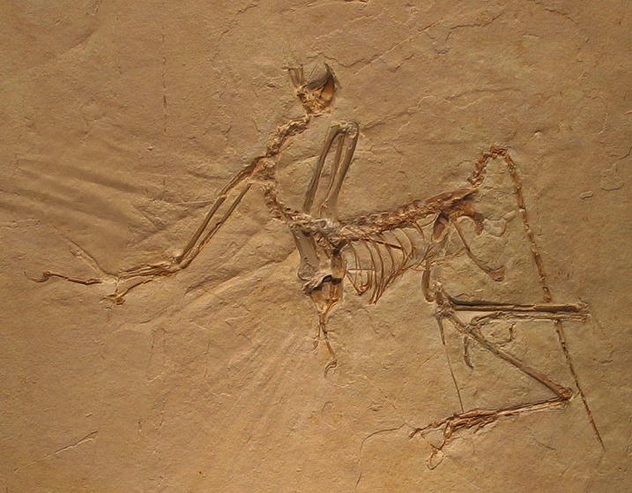
Patterns in Evolution
Speciation
Organisms develop unique genetic features that make them different from their ancestors.
These differences are significant enough that the organisms are thought of as new species.
Notes:
Speciation – Over time, as organisms develop for particular environmental niches, speciation occurs. This means that the difference between an organism's ancestor and its current form is significant enough that it is known as a new species.
In macroevolution, we look at the major divisions between groups of organisms. An example of this is the evolution of flight, which helps set birds aside as their own class. Scientists still debate the first purpose for the evolution of wings (e.g., evading predators, catching prey, migrating, gaining access to new niches).
Archaeopteryx is considered by many to be the first bird, being about 150 million years old.

Slide 10
What is the pattern?
Tertiary
v
Cretaceous
Jurassic
Triassic
Permian
Carboniferous
Devonian
Silurian
Ordovician
Vertebrate Diversity
Notes:
Repeat the investigative discussion (resembling slide 6) about the patterns found in the 7 red circles. (Extinction) Have students distinguish between the events in which diversity dropped but some species were able to survive, vs. the complete extinction of a groups lineage, where a line ends.

Slide 11
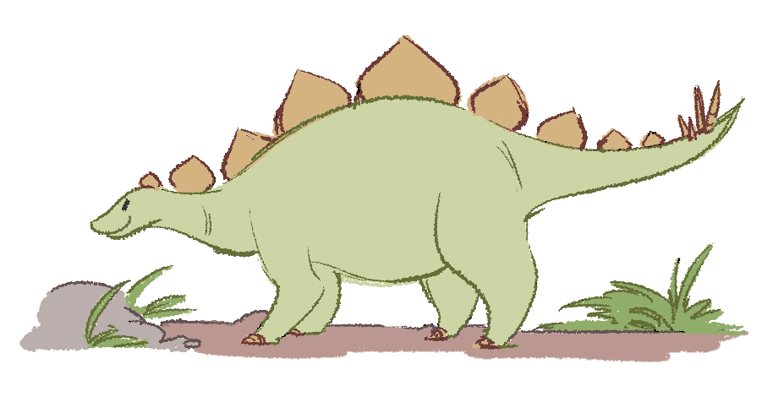
Patterns in Evolution
Extinction
Up to 99% of species in history have gone extinct.
Diversity drops but some species may survive.
This leaves room for new species to evolve and take over open niches.
There have been five major extinctions.
Notes:
Extinction – Loss of species plays an important role in the evolution of life on Earth. As some species die off, others evolve to fill the open niches. Extinction can happen on a slow and singular path or in a quick event that affects many species (a mass extinction).

Slide 12
What is the pattern?
Tertiary
Cretaceous
Jurassic
Triassic
Permian
Carboniferous
Devonian
Silurian
Ordovician
Vertebrate Diversity
Notes:
The red stars represent the largest ‘mass’ extinction events in life history. Background information is here, you may choose to share with students if engagement level demands, but it will be covered in later lessons.
Ordovician–Silurian Extinction – 439 million years ago. 86% of life on Earth was wiped out.
Late Devonian Extinction – 364 million years ago. Estimates propose that around 75% of species were lost.
Permian–Triassic Extinction – 251 million years ago. This extinction is considered the worst in all history because around 96% of species were lost.
Triassic–Jurassic Extinction – Between 199 million and 214 million years ago. As in other mass extinctions, it is believed there were several phases of species lost.
Cretaceous–Tertiary Extinction – 65 million years ago. Effectively ended 76% of life on Earth.

