Slide 1
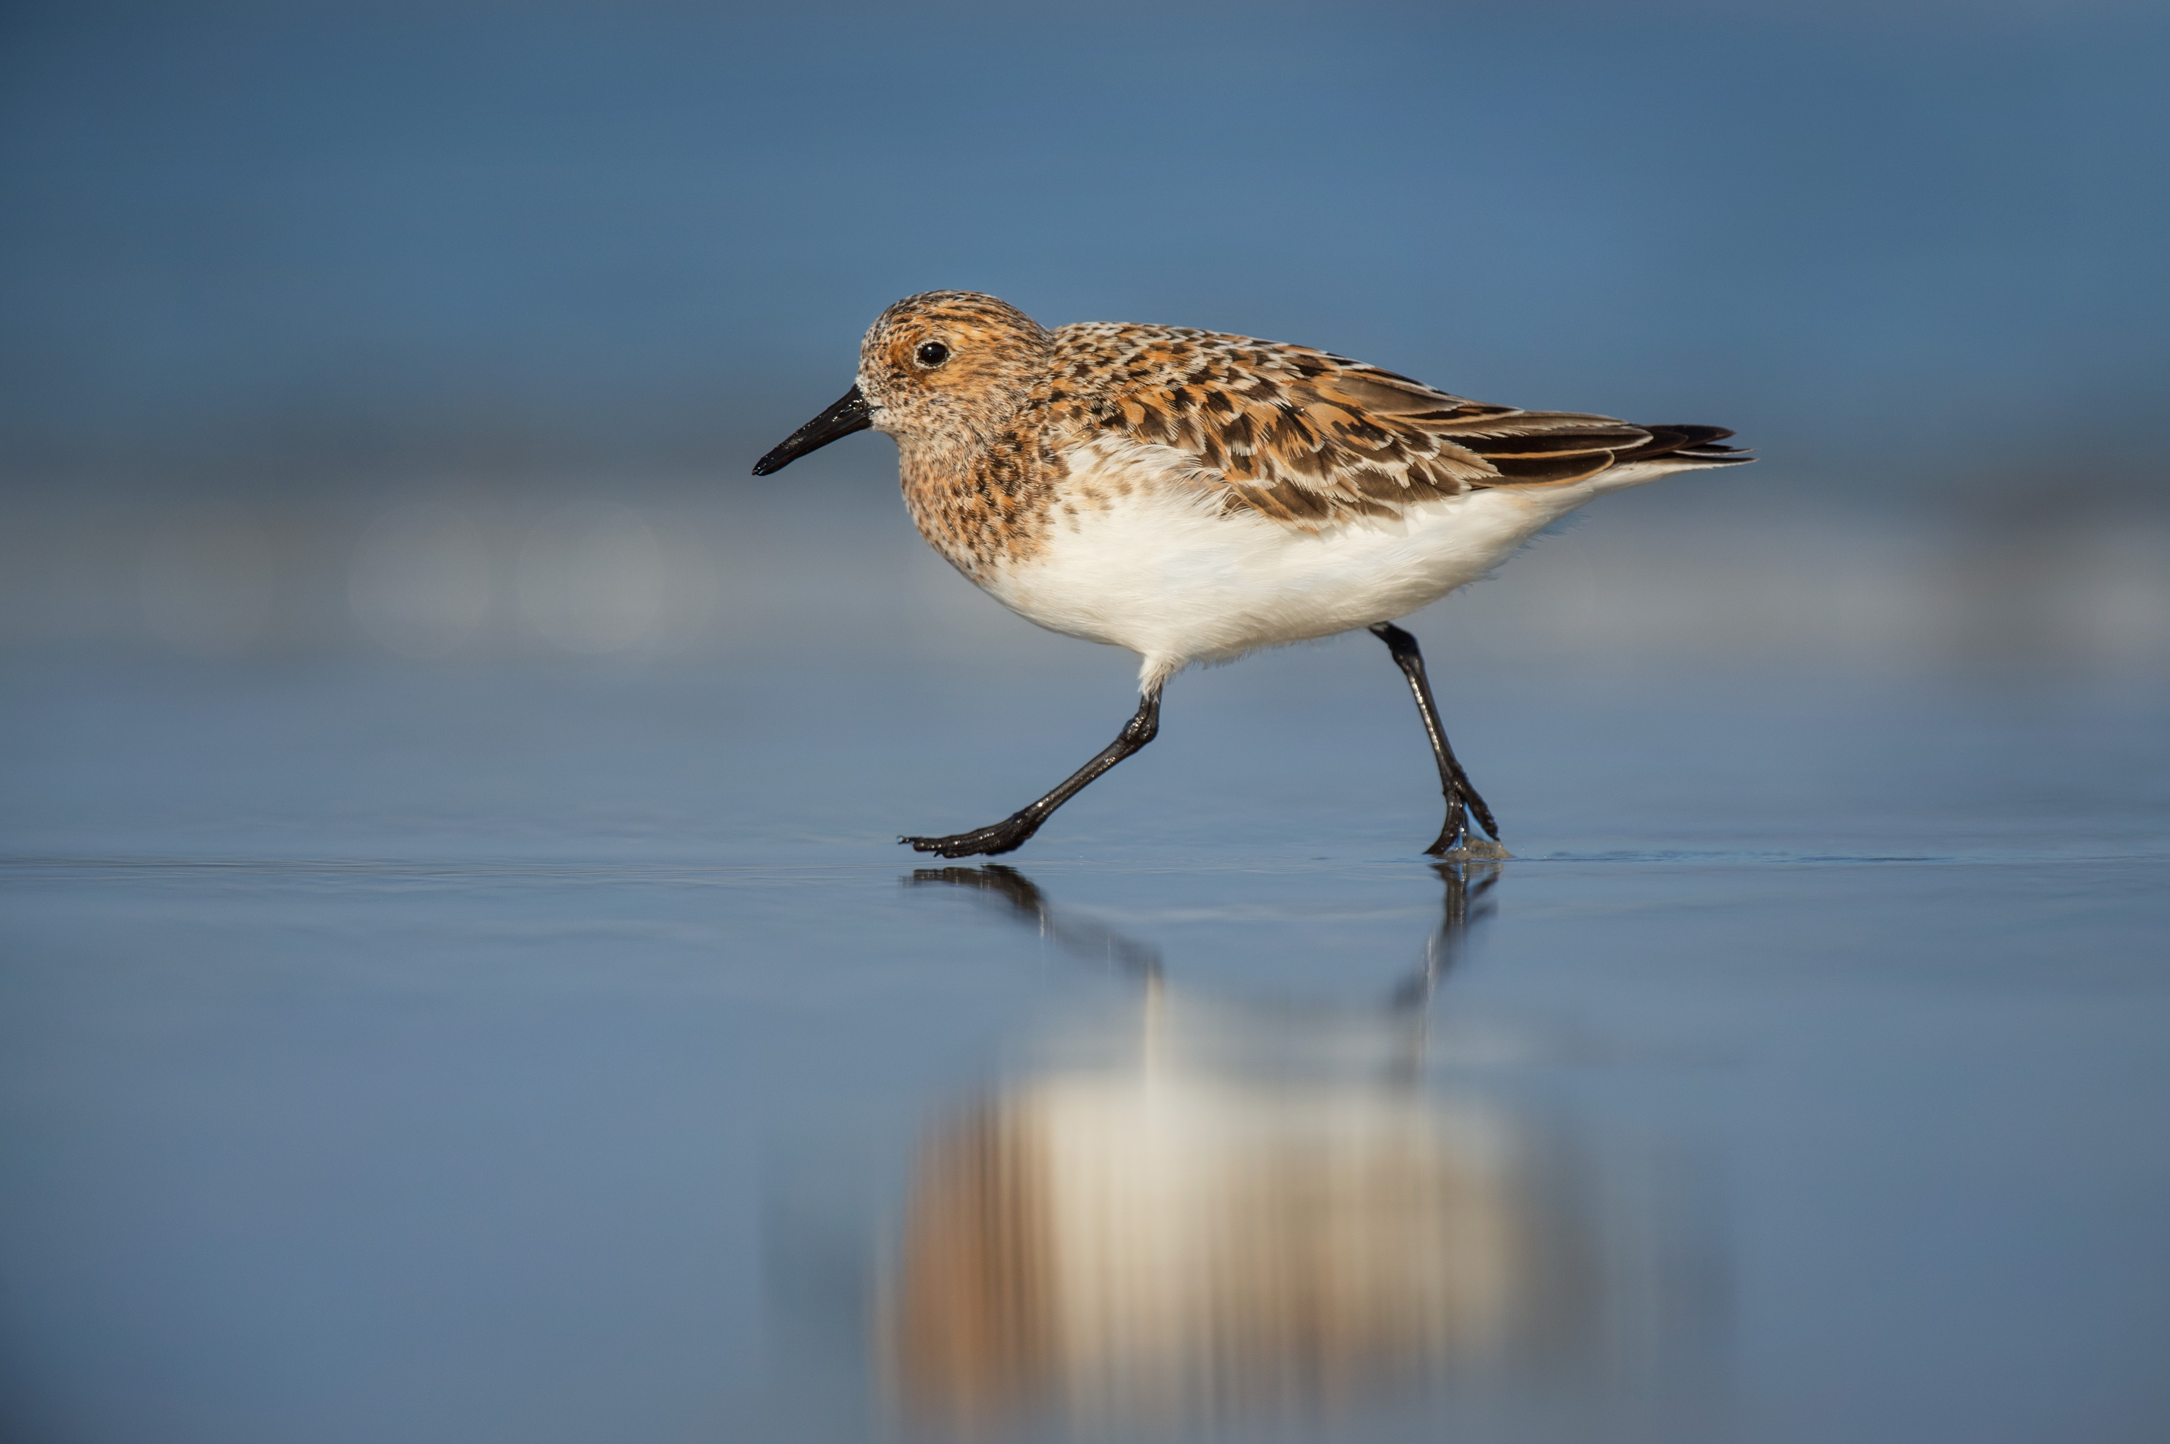
Feathered Friends
Physical Structures of Birds and Dinosaurs

Slide 2
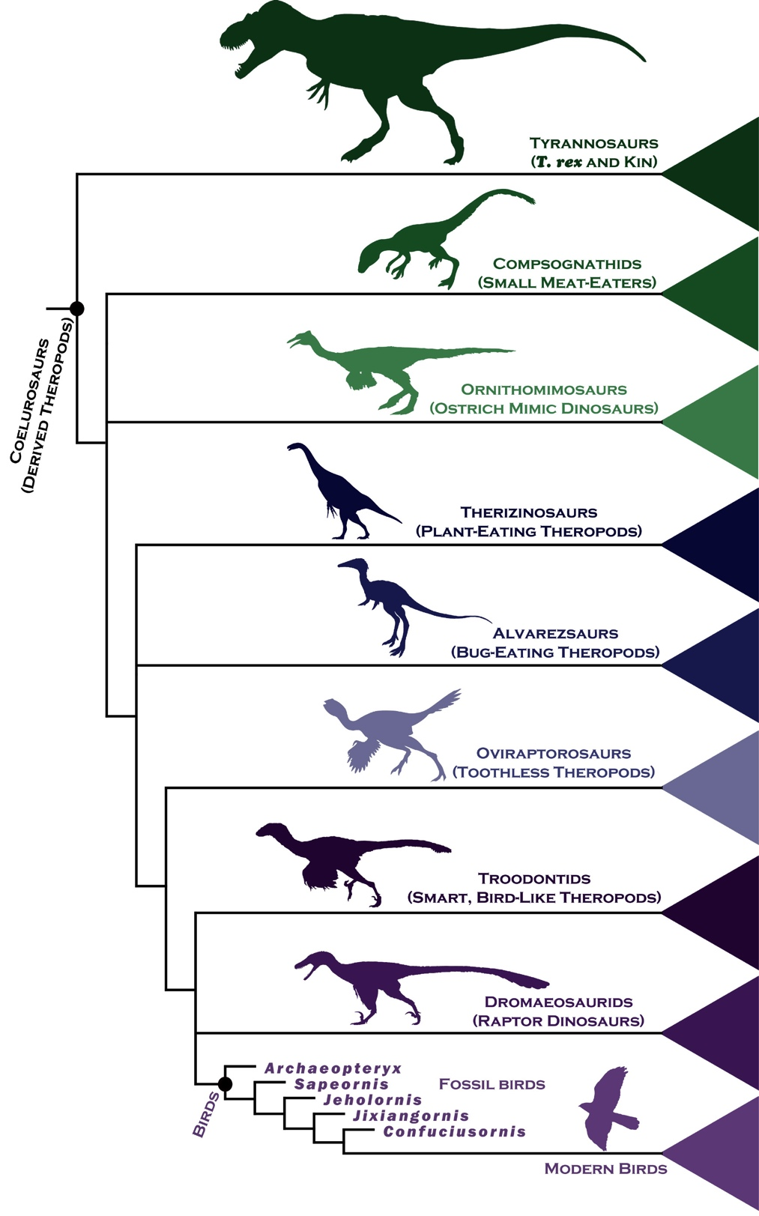
Order of Appearance in
Evolution of Station Specimens
1. Station 4 – Tyrannosaurus Rex
2. Station 3 – Ornithomimus
3. Station 1 – Archaeopteryx
4. Station 7 – Iberomesornis
5. Station 6 – Sinornithosaurus
6. Station 8 – Jeholornis
7. Station 5 – Confuciusornis
8. Station 2 – American Crow
Notes:
Note: Many of these species existed around the same time. For instance, Archaeopteryx appeared 150 million years ago, while Iberomesornis, Sinornithosaurus, Jeholornis, and Confuciusornis all appeared around 100–120 million years ago.

Slide 3
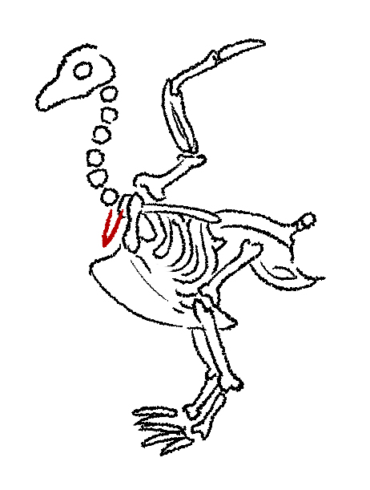
Similar Structures in Dinosaurs and Birds
Wishbones (or furcula)
Notes:
Found in birds and some dinosaur types, the furcula is a forked bone in the chest. In birds, its function is to strengthen the skeleton to enable flight.

Slide 4
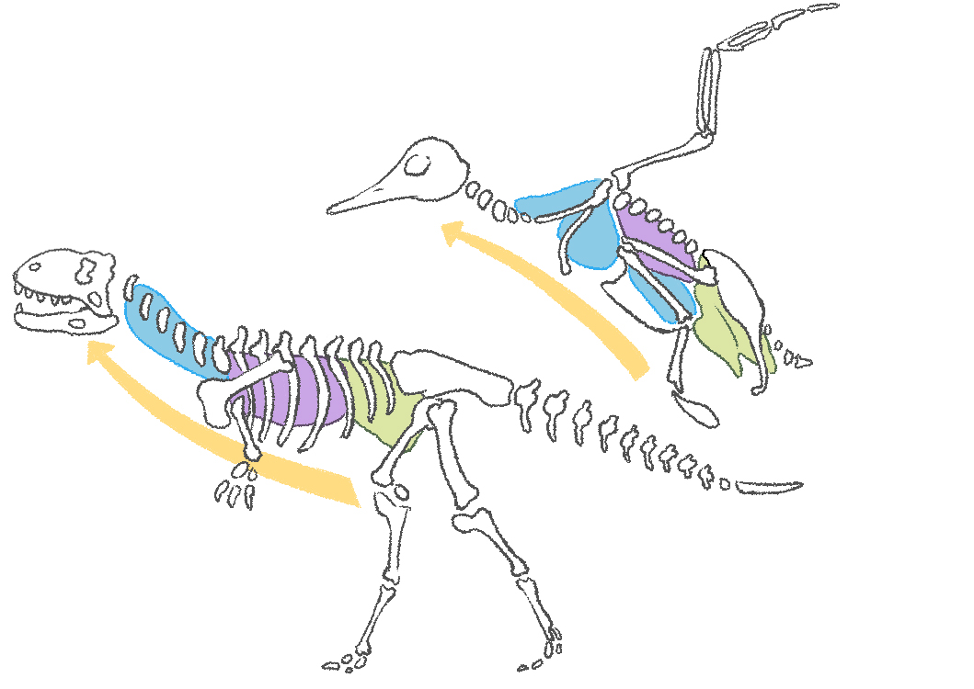
Similar Structures in Dinosaurs and Birds
Air sacs
Bones showing signs of connection to air sac tissue
Lung
Anterior Air Sacs
Anterior Air Sacs
Posterior Air Sacs
Lung
Exhalation
Pathway
Posterior Air Sacs
Notes:
Air sacs let organisms breathe more efficiently, allowing bones to be lighter and so enabling birds to fly.

Slide 5
Similar Structures in Dinosaurs and Birds
Feathers, proto-feathers, and bristles
Notes:
Other similar structures in dinosaurs and birds include:
The size of the brain cavity.
The overall structures (even though the sizes of dinosaurs and modern birds are different)

Slide 6
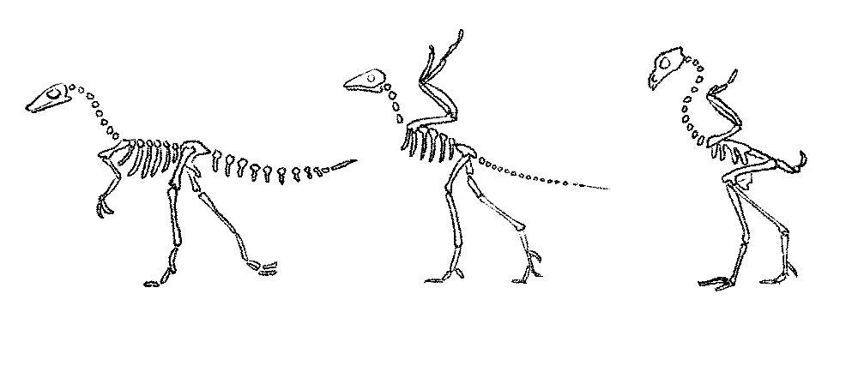
Similar Structures in Dinosaurs and Birds
Compsognathus
(Theropod)
Archeoptryx
Gallus
(Chicken)
3 Clawed Hand
No Teeth
Reptilian Teeth
Long forelimbs
w/ Wing-like proportion
Sharp Teeth
Furcula
(Wishbone)
Short Pygostral
Long Tail
Long Bony Tail
Furcula
(Wishbone)
Short Limbs
Pubis
Theropod-like
Pubis
Pubis Rotated
Backwards
Clawed Hand
Reversed 1st Toe
Fused Metatarsals
Reversed 1st Toe
Metatarsal Not Fused
Reversed 1st Toe
Notes:
Other similarities and differences identified over time:
Differences between reptilian teeth, toothed beaks, and toothless beaks.
Similarity of reversed first toes.
Differences in claws and forelimbs over time.

