Slide 1
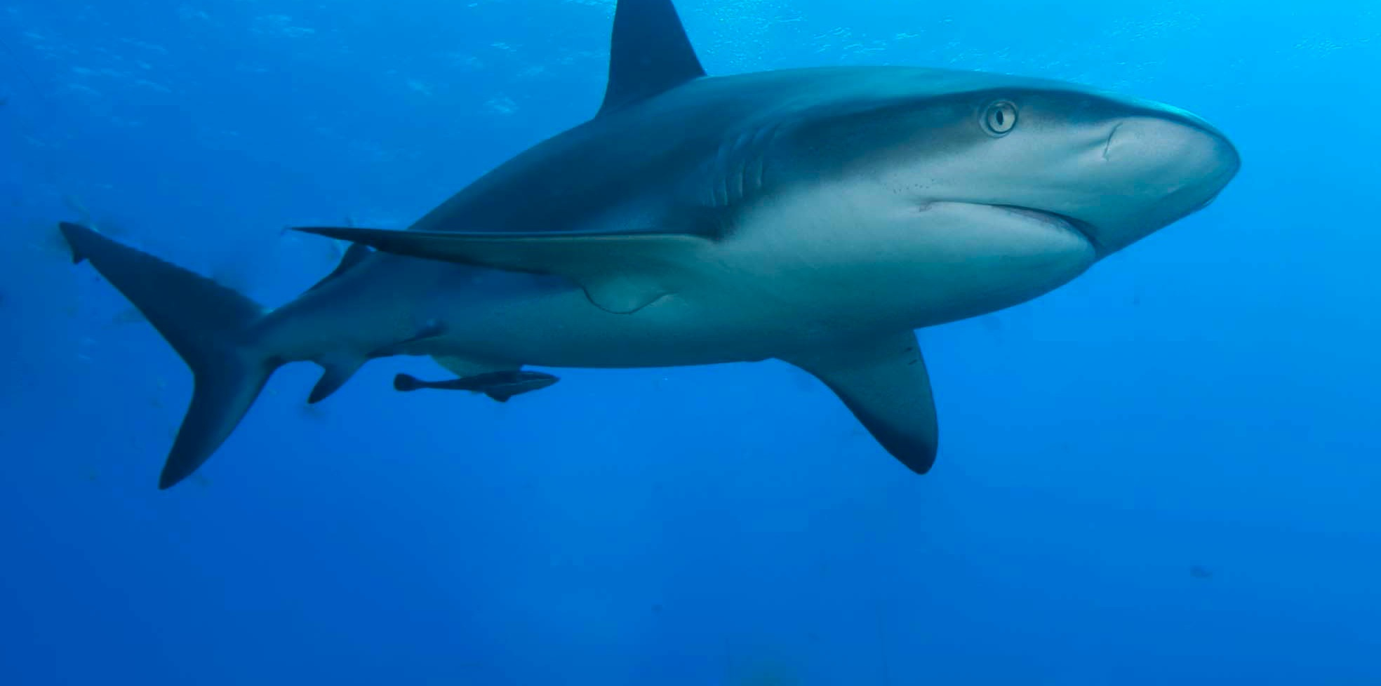
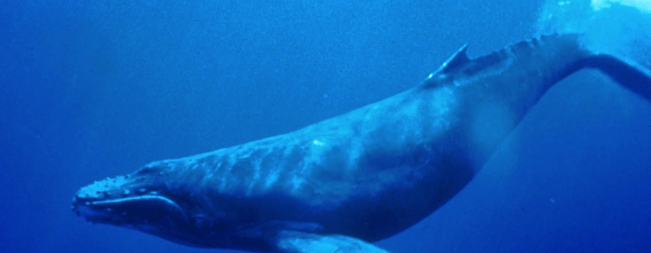
Who is Related to Whom?
Homologous and Analogous Structures

Slide 2
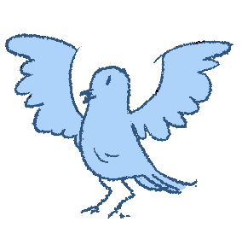
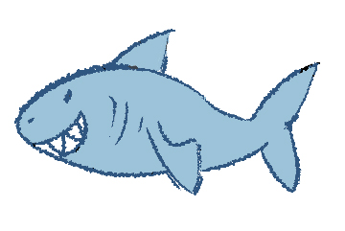
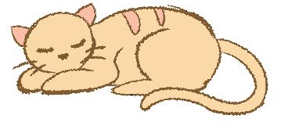
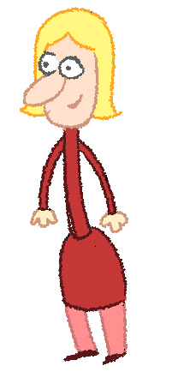
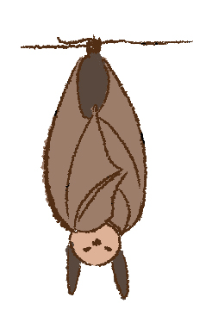
How would you group these animals?
Notes:
Ask students to consider the following scenario: Imagine you are the first scientist to ever try to figure out what groups of animals are related to one another. Given the specimens collected (images on this slide), what groupings could you make?
Have students write down the animals groups and the characteristics they share. Student answers may be based on habitat, wings, fins, number of legs, and so on.

Slide 3
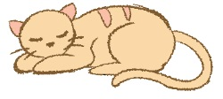
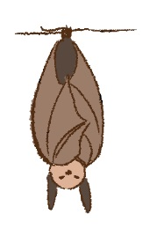
Homologous Structures
Structures in different species with a common ancestor or developmental origin, but it depends how far back you look!
Scientists that study evolution would categorize them by their internal structures (i.e., bones).
Notes:
Homologous structures are those in species species that develop from a common ancestor.
As an evolutionary biologist studying structures, how would you re-categorize these species?

Slide 4
All vertebrates have similar limb structures.
Notes:
Wings, legs, arms, and flippers are built upon the same basic structure in vertebrates. First of all, with backbones!

Slide 5
All mammals have similar forelimb structures.
Notes:
But moving forward in evolutionary history, the mammals have a particular structure in their forelimbs that is different from other classes of organisms. We will look deeper at these connections later in this lesson.

Slide 6
Analogous Structures
Various structures in different species that have the same function, but that evolved separately and thus do not share a common ancestor.
Animals that look similar on the outside may not look the same on the inside.

Slide 7
Analogous Structures
Notes:
At first glance, one may think that sharks and whales are closely related. However, a biologist would need to look at the structures of the organisms. In this case, a comparison of shark fins and whale flippers is particularly revealing.

Slide 8
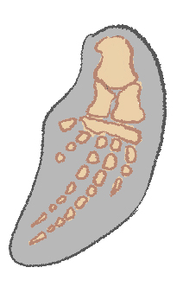
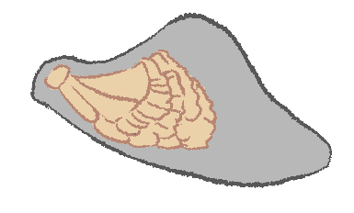
Analogous Structures
Notes:
Though externally similar and used for similar purposes, shark fins and whale flippers have incredibly different internal structures. This is largely because sharks are fish and whales are mammals, meaning they have different evolutionary histories.

Slide 9
Analogous Structures
Notes:
Another example of analogous structures can be found in bat wings and bird wings.

Slide 10
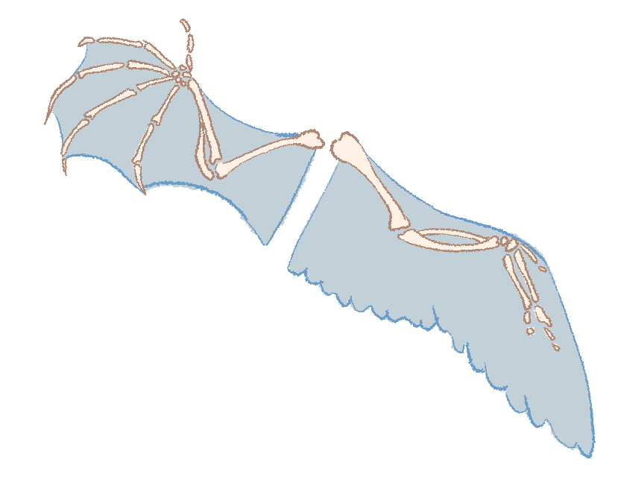
Analogous Structures
Notes:
When closely examining bat wings and bird wings, you will find that they are physically different. The bat wing is made up of flaps of skin between bones of fingers and an arm, while the feathers of a bird extend from the arm (not between the fingers). This is evidence that bats and birds do not have the same common ancestor for these traits. It is a great example of “convergent evolution,” which is when two different forms of evolution provide similar functions.
Additional Information: http://evolution.berkeley.edu/evolibrary/article/evo_09

Slide 11
All mammals have similar forelimb structures.
Notes:
This is a repeat of a previous slide. This lesson will go into detail about the homologous forelimb structures of mammals. Even though these four organisms live disparate lives, their evolutionary history links them through structure.

Slide 12
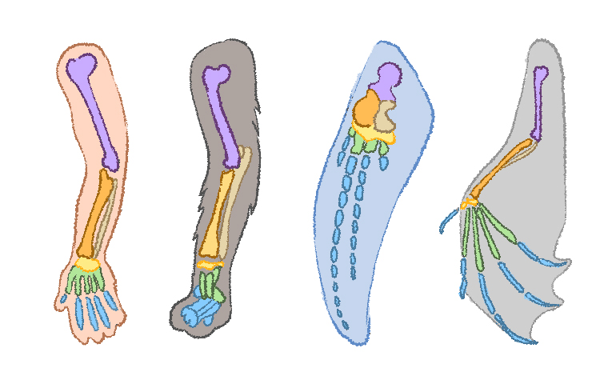
All mammals have similar forelimb structures.
Humerus
Radius
Ulna
Carpals
Metacarpals
Phalanges
Human
Cat
Whale
Bat
Notes:
This is a repeat of a previous slide. This lesson will go into detail about the homologous forelimb structures of mammals. Even though these four organisms live disparate lives, their evolutionary history links them through structure. Leave this picture up during the rest of the class, for the next activity.

