Slide 1
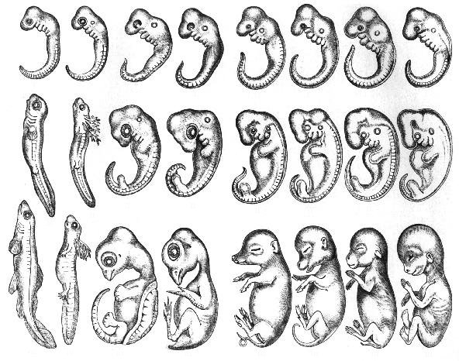
When I Grow Up . . .
Embryonic Development
Notes:
How will you look when you grow up? Your genes can give you a pretty good sense of this.

Slide 2
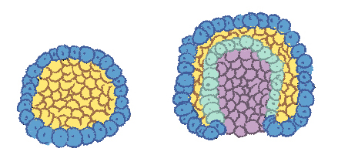
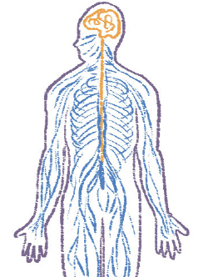
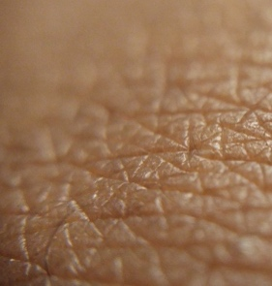
Embryonic Similarities & Differences
Ectoderm
Ectoderm creates:
Nervous System
Skin
Teeth
Lining of the:
- Mouth
- Anus
- Nostrils
Notes:
This slide shows the process of gastrulation. Detail of this process is not necessary for this unit. The image can be explained as the very first divisions of cells of a living thing. This is the first place where the most basic definitions of structure are created.
The important element here is the ectoderm, which is the external "skin" layer at this stage. The ectoderm will later be responsible for creating the nervous system (spine, peripheral nerves, and brain), tooth enamel, and the epidermis (a layer of skin in animals). It also forms the lining of the mouth, anus, nostrils, sweat glands, hair, and nails.
This diagram is color-coded as follows:
Ectoderm = Blue
Endoderm = Green
Blastocoel (the yolk sack) = Yellow
Archenteron (the gut) = Purple

Slide 3
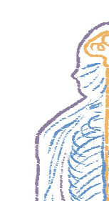
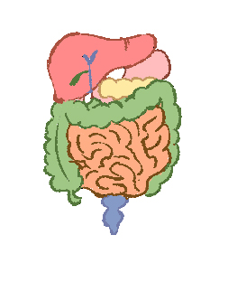
Embryonic Similarities & Differences
Endoderm creates the lining of tubes and glands for the:
Respiratory Tract
Digestive Tract
Notes:
The important element here is the endoderm, which is the innermost layer at this stage.
The endoderm contributes the epithelia and glands of the gastrointestinal tract, respiratory tract, and renal bladder. This layer also contributes to the associated gastrointestinal tract organ development (liver and pancreas).
This diagram is color-coded as follows:
Ectoderm = Blue
Endoderm = Green
Blastocoel (the yolk sack) = Yellow
Archenteron (the gut) = Purple

Slide 4
Embryonic Similarities & Differences
Blastopore
Head at one end + body + anus at the other end = Complex Life. Phew!
Notes:
The important element here is the blastopore. The blastopore is a pit in the side of an embryo through which cells fated to be endodermal flow so that they leave the outer surface of the embryo and create a new inner surface.
This is where organisms begin to define where their body parts will be. Most complex animals have their heads and anuses at separate ends of formation post-gastrola.

Slide 5
Embryonic Similarities & Differences
1
2
3
4
5
6
7
8
Stage 1
Stage 2
Stage 3
Notes:
After those first basic stages of development come the use of more complex regulatory genes, such as the homeobox, or Hox Genes.
This image is a cropped piece of a larger image showing three stages of embryonic development of eight different species. All the species are vertebrates (animals with backbones) that have similar ancestors. Each of these organisms go through a slightly different embryonic development path due to regulatory genes that provide specific instructions on their "master plan."
First, have students identify the similarities and differences between the embryos. Students should identify that they all have some sort of head, eyeball, tail, and lines below their heads (these are gill slits). Differences include, but are not limited to, the following observations:
#1 does not have a dot behind its eye, while all others do.
#4-6 have more bulbous tops of their heads.
#7-8 seem to have more developed dots on their tails.
Have students think about an instruction that genes at this stage would present. All of the organisms would follow it with remarkable similarity. Students answers should resemble the following:
"Create three major segments of the body."
'"Put eyes on the top segment."
"Make gill slits in the middle segment."
"Make a tail at the bottom."
Through this activity, students replicate the actions of Hox Genes.

Slide 6
Embryonic Similarities & Differences
1
2
3
4
5
6
7
8
Stage 1
Stage 2
Stage 3
Notes:
Ask students if they can start to guess what the organisms will be when they fully develop.
Ask students to identify the remaining similarities. Answers may include the following:
Eyes
Tails (though they have changed a bit)
Gill slits
The differences are more pronounced. This is because the genes for various traits are being turned on or off and may have mutated over time through evolution.
Ask students to identify new or more defined differences in the organisms' development. Answers may include the following:
#1 and #2’s body structures have elongated and seem to rely more heavily on tails.
#8 has nearly lost its tail.
#3 and #4 are starting to develop larger heads and eyes.

Slide 7
Embryonic Similarities & Differences
1
2
3
4
5
6
7
8
Stage 1
Stage 2
Stage 3
Notes:
In the third stage of embryonic development, the organisms are not fully developed, but have much more distinct characteristics. Ask students to make guesses about the types of organisms that are present.
Ask again about similarities and differences noted in development. Then, to relate this activity to development as a line of evidence for evolution, ask a question such as the following:
Why are there so many similarities throughout the development of these organisms?

Slide 8
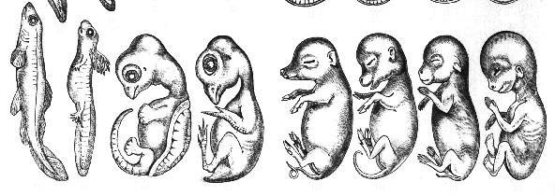
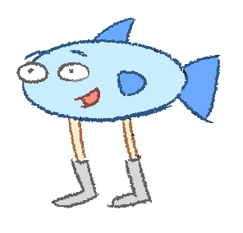
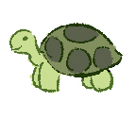
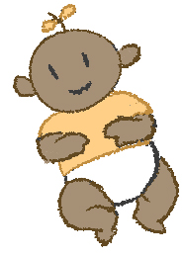
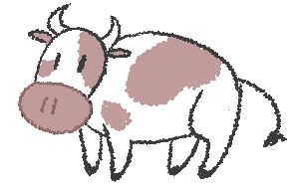
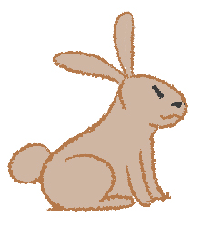
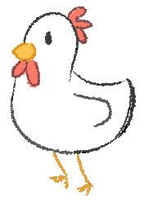
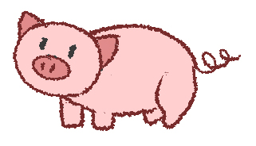
"When I grow up, I want to be . . ."
1
2
3
4
5
6
7
8
Stage 3
Adulthood
Notes:
All of the organisms are vertebrates with the same common ancestor. The original “master plan” is still locked inside the genes of all of these organisms, but, over time, regulatory genes and mutations turn on and off the traits that are visible in adulthood. This is a main line of evidence that supports the theory that there are common ancestors from which vertebrates have evolved.
The following is a key to the organisms’ fully-developed forms:
Fish
Salamander
Tortoise
Chicken
Pig
Cow
Rabbit
Human

