Slide 1
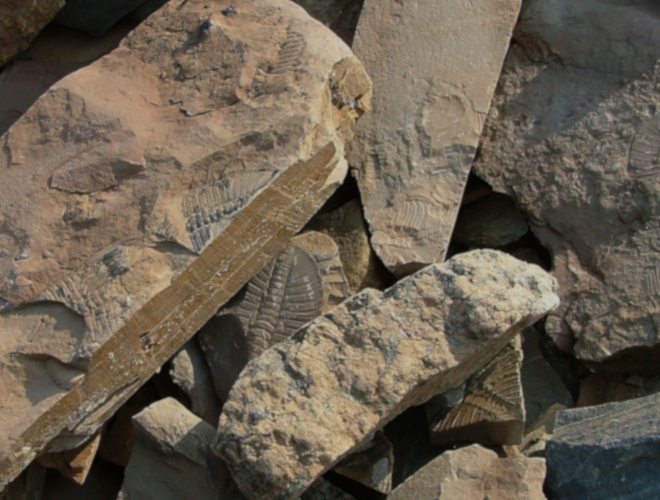
The Fossil Record
Evidence for Evolution

Slide 2
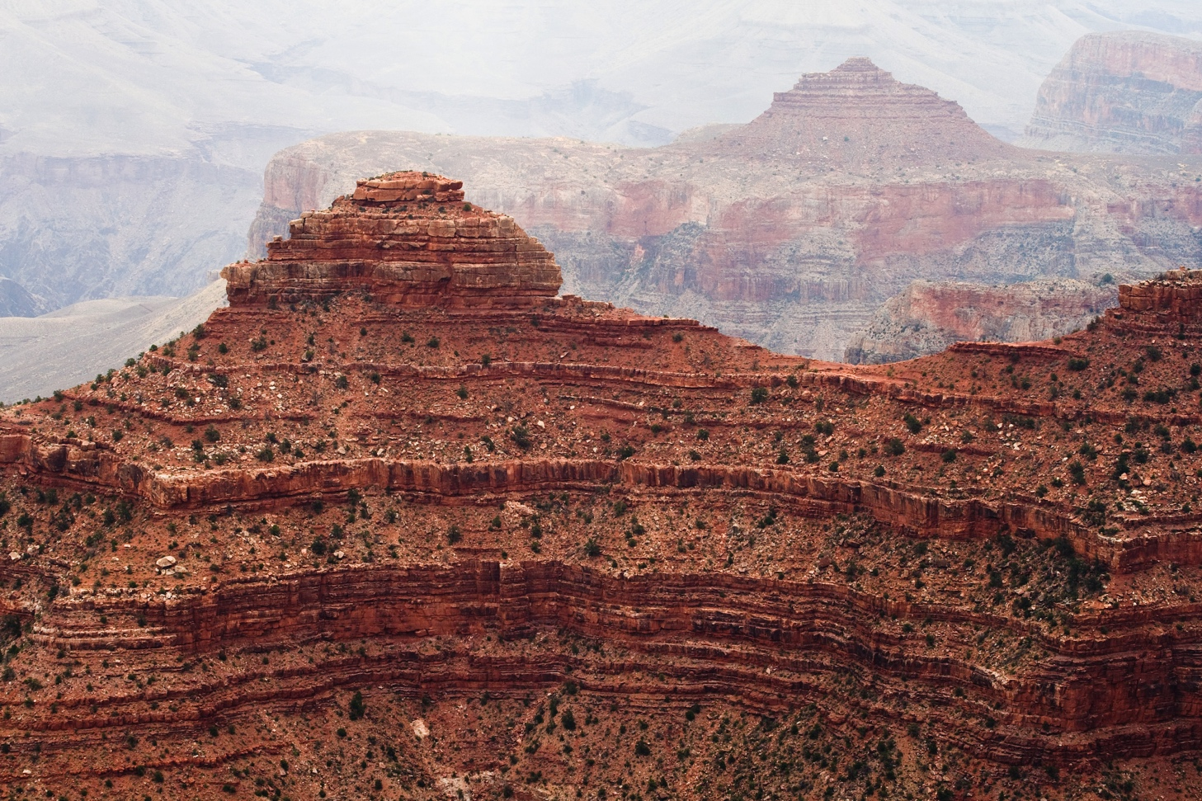
What is the Fossil Record?
The history of life told through rocks
Notes:
Over millions of years, sediments such as sand and silt were laid down and compressed to form sedimentary rock layers. They preserve a record of ancient landscapes, climates, and organisms.
The fossil record is the combination of all known fossil discoveries located along the scale of geologic time (refer to the Timescale Fossil Poster), including the evolution of all life. It explains how we moved from single-celled organisms to fully functioning mammals, amphibians, reptiles, and plants.

Slide 3
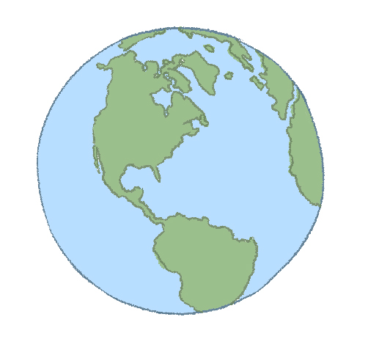
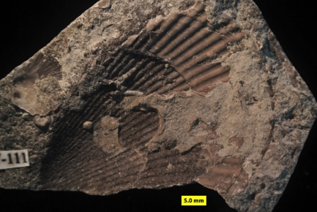
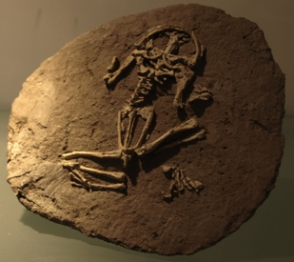
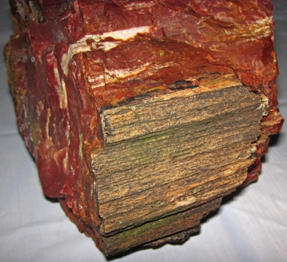
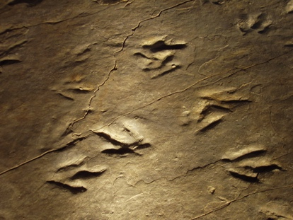
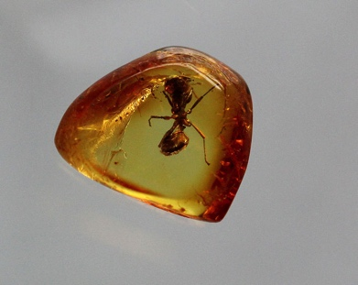
What is the Fossil Record?
All known fossil discoveries . . .

Slide 4
What is the Fossil Record?
. . . can be dated by various methods . . .

Slide 5
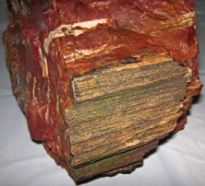
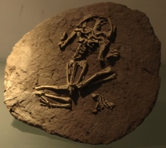
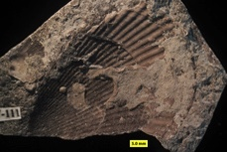
What is the Fossil Record?
. . . and placed in order along a geologic timescale.
Period
Quarternary
Cenozoic
Tertiary
Cretaceous
Mesozoic
Jurassic
Triassic
Permian
Pennsylvanian
Carbon-
iferous
Mississippian
Devonian
Paleozoic
Silurian
Ordovician
Cambrian
Late Proterozoic

Slide 6
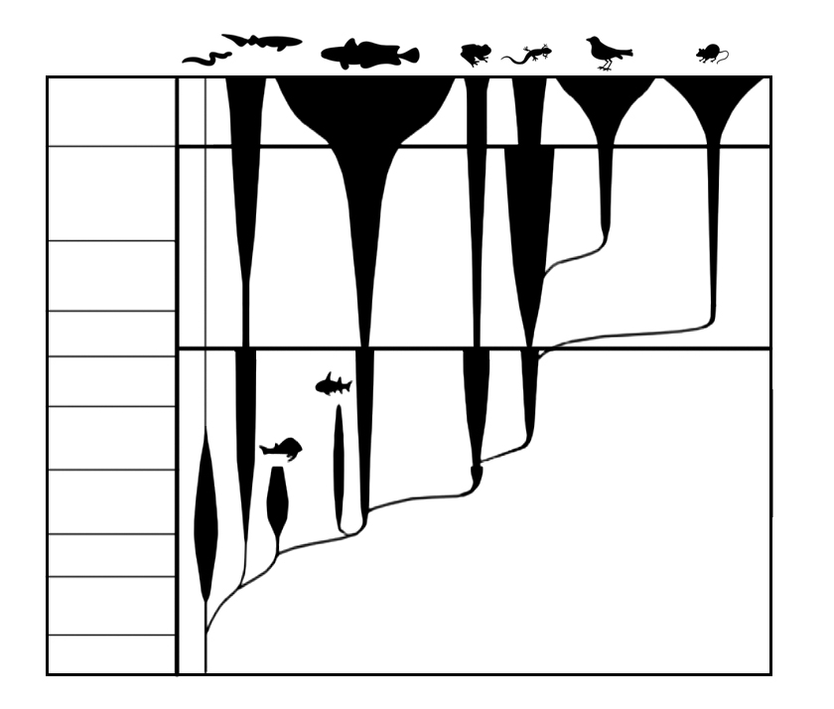
What is the Fossil Record?
It shows clear evidence of evolution in particular types of organisms.
Period
Quarternary
Tertiary
Cretaceous
Mesozoic
Jurassic
Triassic
Permian
Pennsylvanian
Carbon-
iferous
Mississippian
Devonian
Paleozoic
Silurian
Ordovician
Cambrian
Late Proterozoic

Slide 7
What is the Fossil Record?
It displays the evolving complexity and diversity of life over time.
Notes:
This is the ancient history of single-celled and multicellular organisms. Obviously, the multicellular life is more complex and leads to more diversity than the single-celled life does.

Slide 8
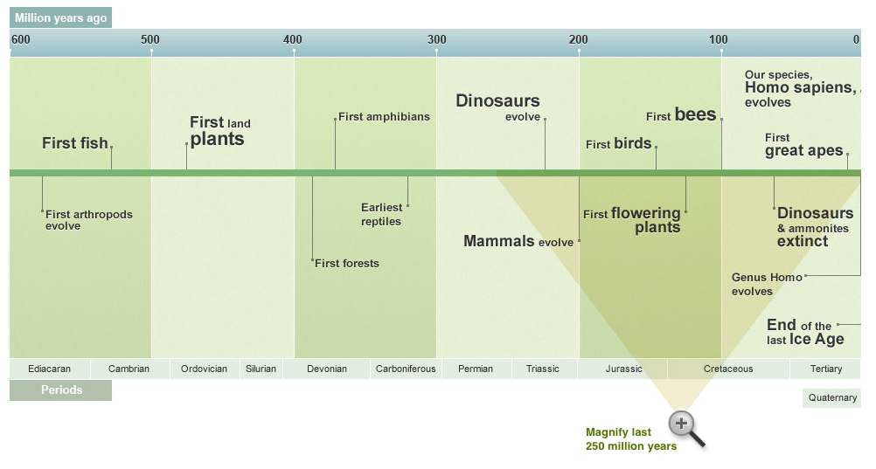
What is the Fossil Record?
It displays the evolving complexity and diversity of life over time.
Notes:
Using the fossil record, we can see that organisms developed more complex characteristics. For example, the development of the first land plants led to the development of the first flowering plants. This was a new, different, and advanced development in the evolution of plants.
The history of life on Earth began about 3.8 billion years ago with single-celled prokaryotic cells, such as bacteria. Multicellular life evolved over a billion years later, and it's only in the last 570 million years that the kind of life forms we are familiar with began to evolve, starting with arthropods. This was followed by fish 530 million years ago, land plants 475 million years ago, and forests 385 million years ago. Mammals didn't evolve until 200 million years ago and our own species, Homo sapiens, only evolved 200,000 years ago; Humans have been around for a mere 0.004% of the Earth's history!

Slide 9
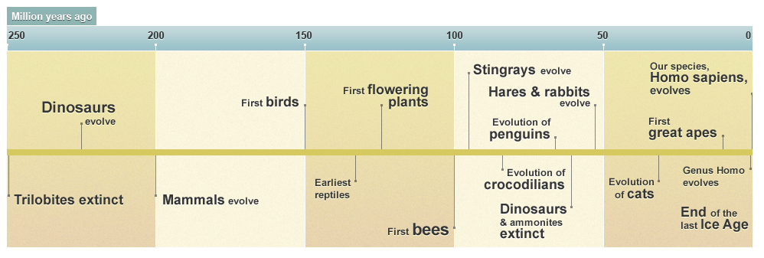
What is the Fossil Record?
It displays the evolving complexity and diversity of life over time.
Notes:
When we zoom in even closer, we can see that there are clear periods of time where particular organisms, such as the dinosaurs, thrived.

Slide 10
What is the Fossil Record?
It documents the extinctions of diverse life and the changes that occurred as a result.
60
Cretaceous Tertiary (K/T)
Extinction
End-Permian
Extinction
End-Ordovician
Extinction
End-Triassic
Extinction
40
Late Devonian
Extinction
Percent Extinction
20
0
0
100
200
300
400
500
Millions of Years Ago
Notes:
Mass extinctions are periods in Earth's history when abnormally large numbers of species die out simultaneously or within a limited time frame. The most severe occurred at the end of the Permian period, when 96% of all species perished. This, along with the K/T, are two of the Big Five mass extinctions, each of which wiped out at least half of all species. Many smaller scale mass extinctions have occurred. Indeed, the disappearance of many animals and plants at the hands of man in prehistoric, historic, and modern times will eventually show up in the fossil record as a mass extinction.
We will go into more detail on the five major extinctions that exist within the fossil record. As a reminder, it’s the students’ job to create stories of the history of life and to develop plans for how to save the planet from the next mass extinction!

