Slide 1
Satellites and Wave Behavior

Slide 2
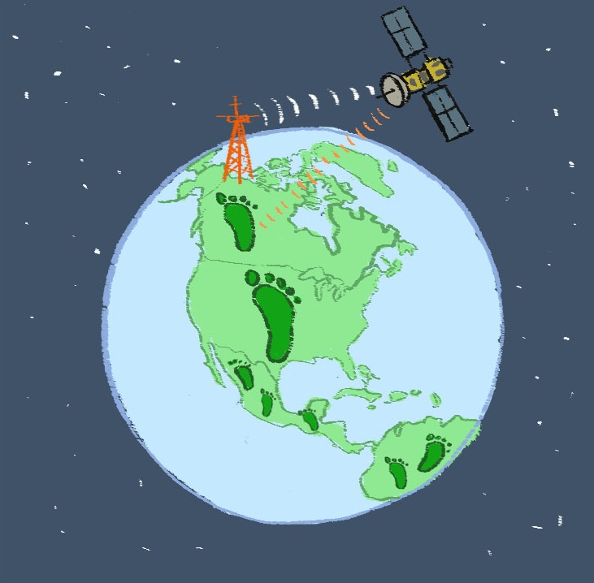
Connecting to the Unit Storyline
CO2
CO2
CO2
CO2
Notes:
Refer to Earth from Space Graphic Organizer worksheet Lesson 9.2a-earth-from-space-graphic-organizer.pdf and use the graphic to highlight where the class is in the unit storyline.
Here is the overview of the storyline: The planet is a big place, and one of the best ways to monitor the state of our planet is by using satellites. Our goal for this unit is to describe the environmental conditions of earth using satellite technology and then offer possible solutions to particular problems.
You’ve used the concept of ecological footprint to study how different countries consume different amounts of resources. Now we are in the middle of learning about satellites, the data they collect and how satellites utilize waves to transmit, collect and receive information. Then you’ll apply satellite technology to investigate a study location and document change caused by humans and offer possible solutions to lessen

Slide 3
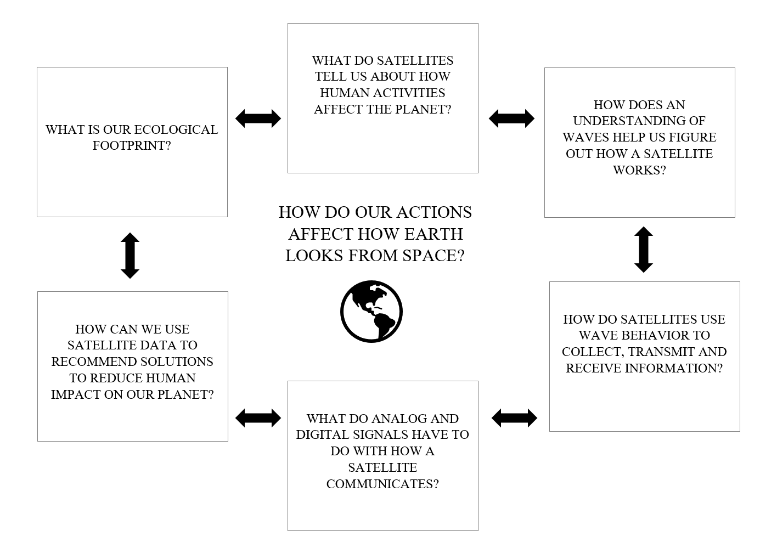
Where Are We In The Unit?
Notes:
Remind them of the major ideas/phenomena.

Slide 4
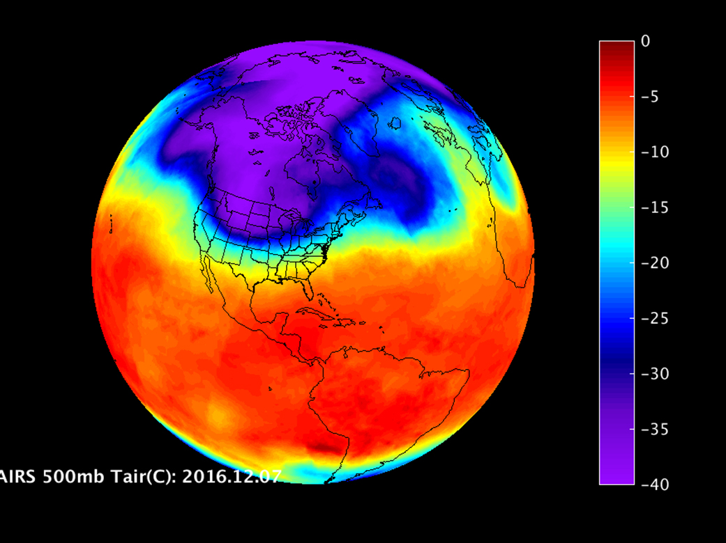
How Do Satellites Help Us Construct Images?
https://www.youtube.com/watch?time_continue=8&v=MbdTvKU5-hs

Slide 5
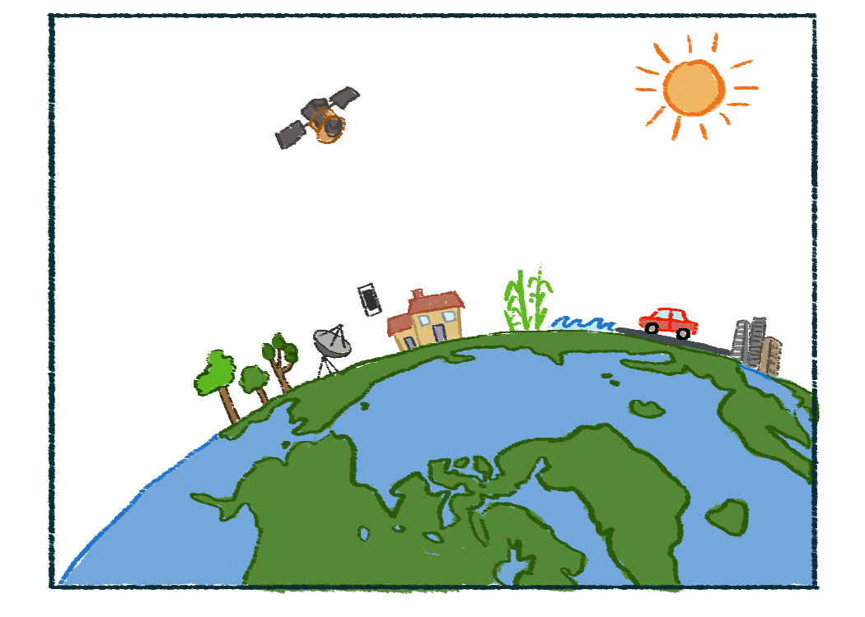
How Do Satellites Work?
Notes:
Give students a minute or two to silently examine this diagram. Pose the questions: What does this diagram show? What do you wonder? Have students think-pair-share and then solicit student ideas.

Slide 6
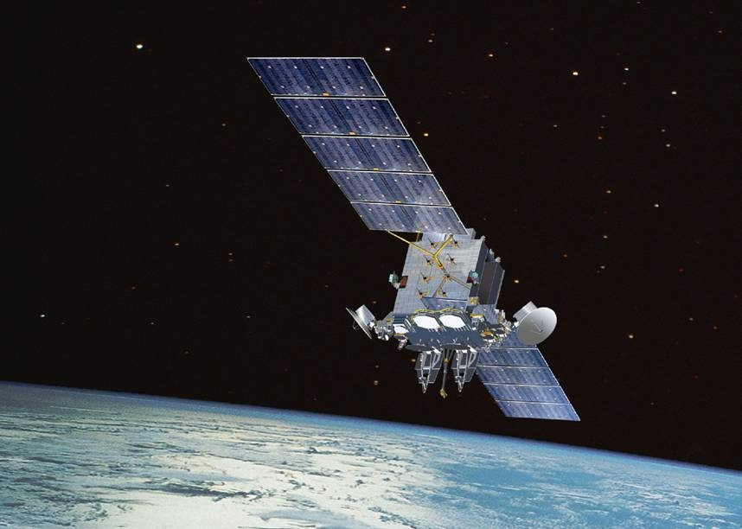
How do waves behave and interact with various materials?
What does this have to do with satellites?
Notes:
Tell students they will be investigating these concepts in the next few lessons.

Slide 7
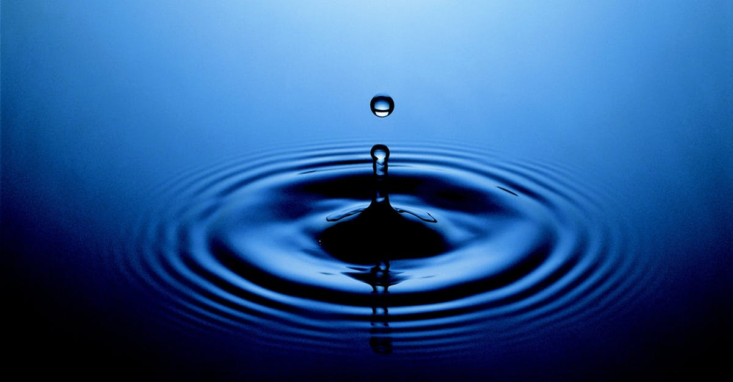
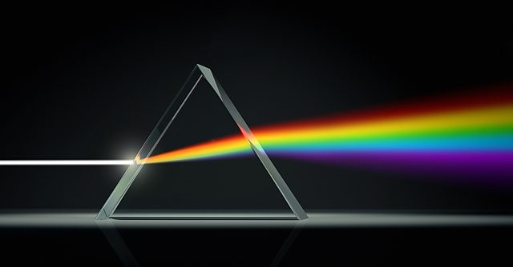
Types of Waves
Mechanical Waves
Electromagnetic Radiation
Require a medium (like air or water)
Don’t require a medium (can travel through space)
Examples:
Sound waves Water waves
Examples:
Visible light, Microwaves,
Radio waves, X-rays, Ultraviolet rays
Notes:
For the next few lessons, students will need to distinguish between mechanical waves and electromagnetic radiation. This is really a big concept, so we’ll need to come back to this many times.

