Slide 1
Light in the Ocean

Slide 2
What do you notice about all of these deep sea animals?
Vampire Squid
Notes:
Note. You can flip through the next few slides of the deep sea animals, stop on the image of fangtooth and ask what patterns in the deep sea animals coloration do the students notice (all red) and why do they think that.

Slide 3
Spiny Crab
Notes:
Spiny Crab

Slide 4
Bloodybelly Comb Jelly
Notes:
Bloodybelly Comb Jelly

Slide 5
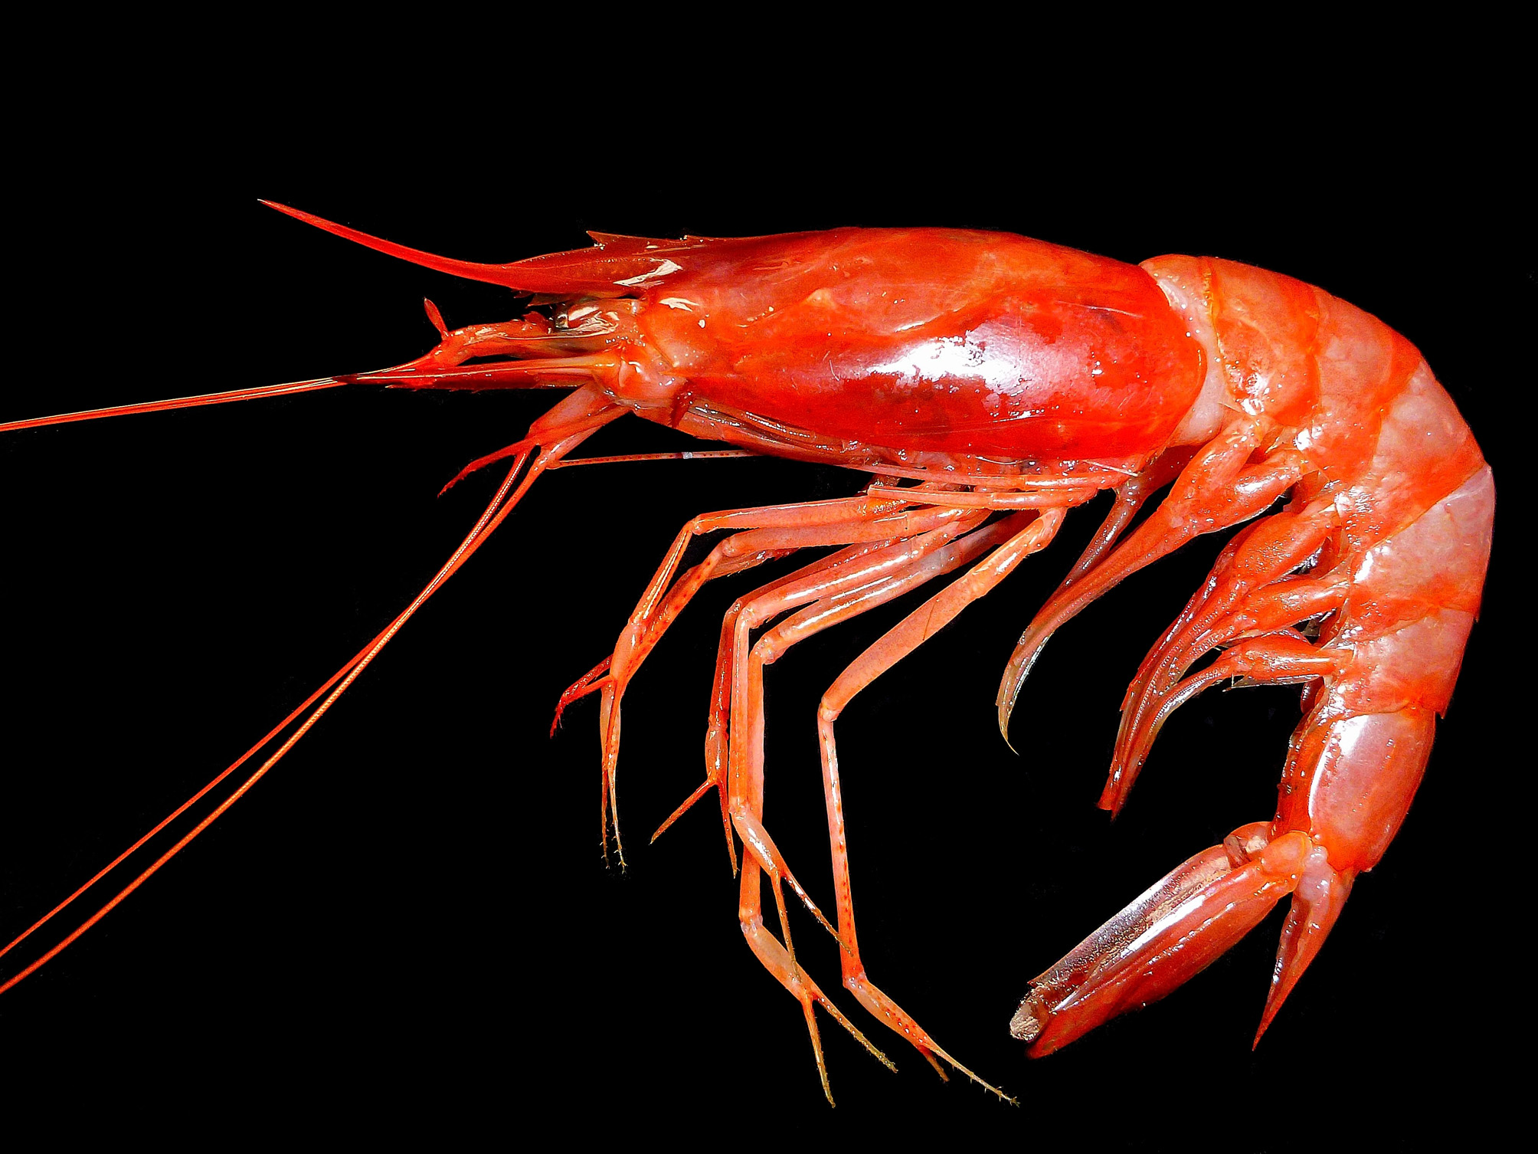
Deep-sea Red Prawn
Notes:
Deep-sea Red Prawn

Slide 6
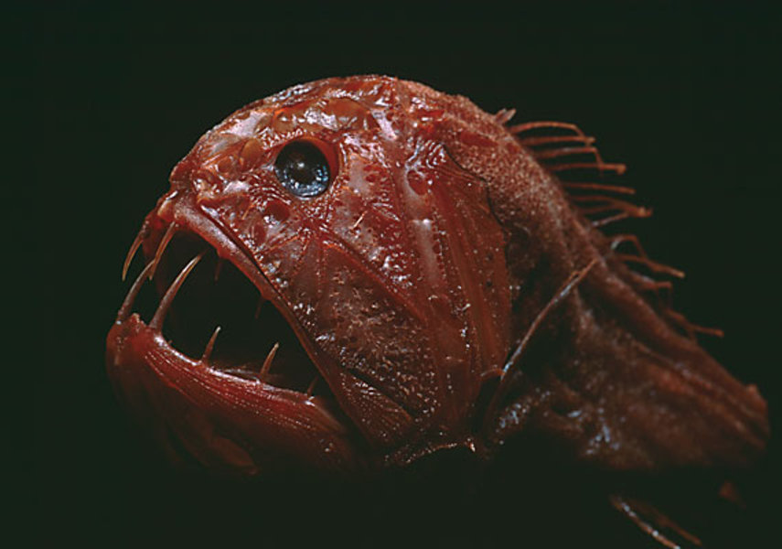
Fangtooth
Notes:
Note: You can STOP ON THIS SLIDE and pass out Light in the Ocean worksheet ({{ID}}b-light-in-the-ocean-worksheet.pdf)
Once students have 30 minutes to do the activities on the worksheet, come back and advance to the next slide.
The common fangtooth, or Anoplogaster cornuta, is a small, deep-sea fish with some of the largest teeth in the ocean, proportional to its size.

Slide 7
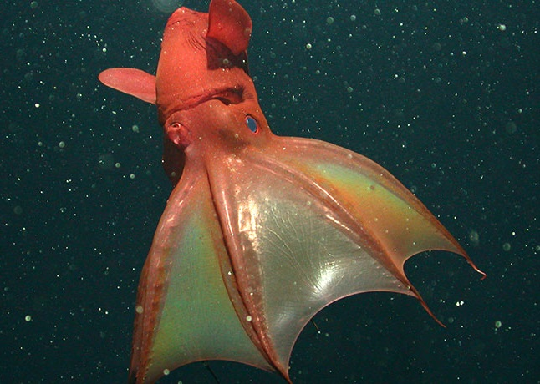
Why are some deep sea animals red?
Vampire Squid
Notes:
Ask some students to share their claims about why deep sea animals are red.
This is not an easy question for students to answer, but it’s a great opportunity for students to use claim-evidence-reasoning methods to think about such a question.
If students appear to be stuck, as students to think about what protective features such animals would have. Although having fangs or being a fast swimmer may be good, ultimately being invisible would be best. Ask students if they’ve ever wished they could be invisible? As students start to think about what it means to be invisible, this might help them realize (as described later in these slides) that because red color doesn’t get transmitted to the deep ocean, that animals that are red in color appear somewhat invisible. See if students can come up with this after the next set of slides.

Slide 8
Because of the way light waves travel in the ocean
Notes:
Why are some deep sea animals red?
It has to do with how light waves travel in the ocean.
The deep sea is the world’s largest habitat. It stretches from 200 meters (660 feet) below the ocean surface to an average of 3,800 meters (12,500 feet) to the ocean floor. The deepest part of the ocean is the Marianas Trench, 11,033 meters (36,201 feet) below the surface. A defining characteristic of the deep sea is darkness since light waves are unable to penetrate below 1,000 meters (3,300). Animals here have a variety of survival strategies.

Slide 9
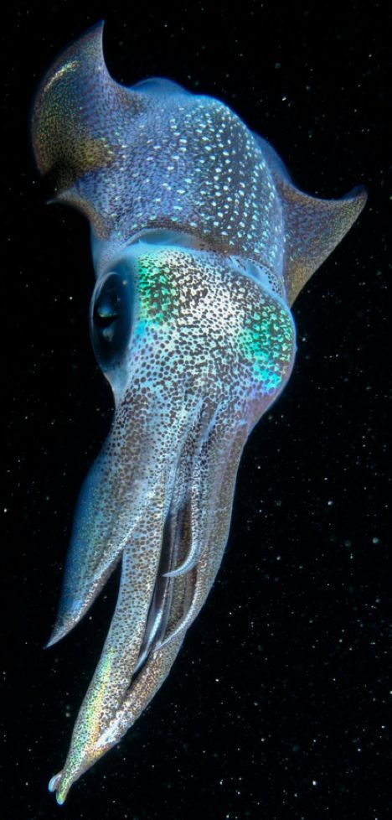
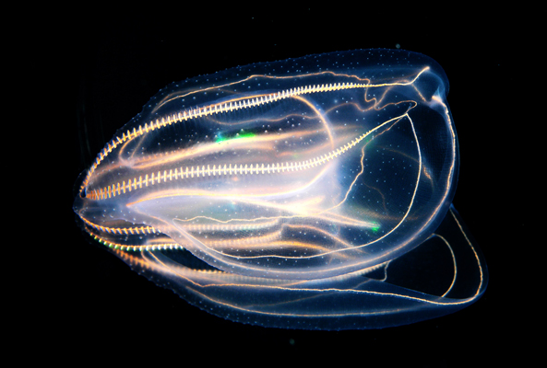
Deep sea is the largest habitat on Earth.
Comb Jellyfish
Animals living there have a variety of adaptations.
Squid
Notes:
Some organisms produce their own light, called bioluminescence. Some are transparent and can blend into their surroundings. Many are small in order to conserve energy in the very cold and less productive region. Many are red.

Slide 10
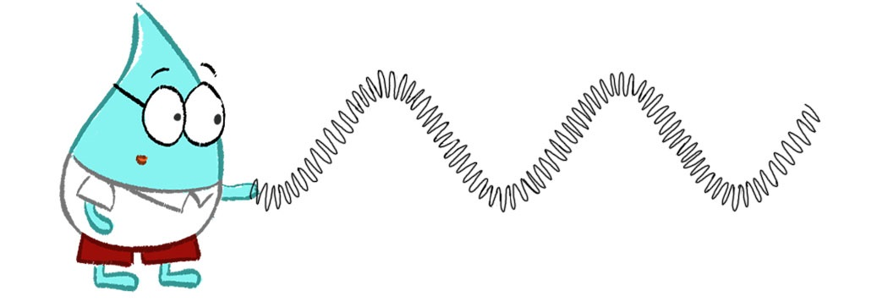
Light, like sound and water waves, is energy that travels in waves.
Crest
Trough
Wavelength
Only it’s different because it doesn’t need a medium to travel in.
Notes:
Light travels in waves but is different from mechanical waves like light and water waves because it doesn’t need a medium, or matter, to travel. Light can travel in space which is a vacuum.

Slide 11
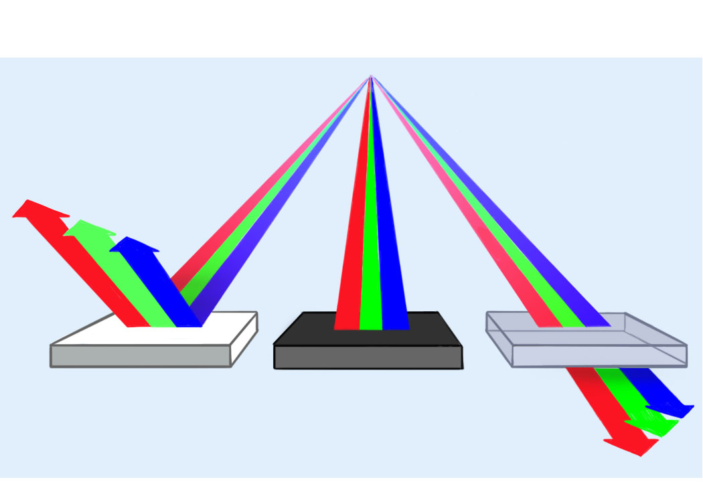
Wave Behavior
Reflected
Absorbed
Transmitted
Notes:
Light waves do share characteristics with sound and water waves. All can be measured by amplitude and wavelength and have crests and troughs. They also behave the same. When waves come into contact with matter, they can be reflected, absorbed, or transmitted.
Reflection- when a wave hits a new medium that acts like a barrier and bounces off
Transmission- when a wave passes all the way through a medium
Absorption- when a wave encounters a medium and causes the medium’s molecules to vibrate and move. This vibration absorbs or takes some of the energy away from the wave and less of the energy is reflected.

Slide 12
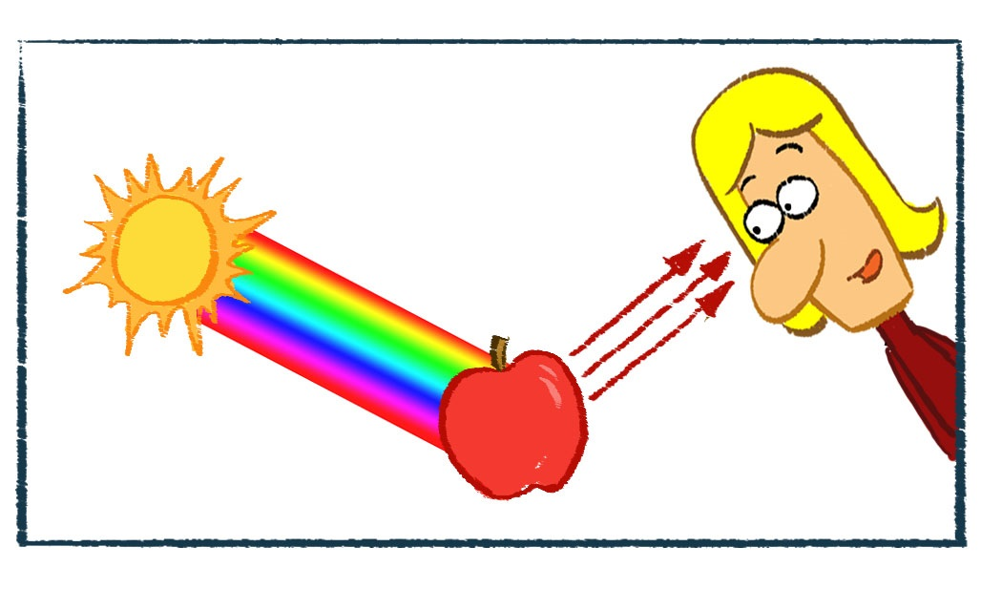
Which colors are absorbed and which are reflected?
3
1
2
Notes:
Light wave behavior is what allows us to see colors. Sunlight contains all the wavelengths of the visible light spectrum (red, orange, yellow, green, blue, indigo and violet or ROY G BIV). Together all of these colors appear white. When light strikes an apple, it appears red because it reflects red light and absorbs all the other colors. At the ocean surface, a red fish will appear red for the same reasons. However, as it dives deeper under the water, it will appear less red.

Slide 13
Visible Light Region of the Electromagnetic Spectrum
0.7 μm
0.6 μm
0.5 μm
0.4 μm
Infrared
Ultraviolet
Notes:
That’s because all the red wavelengths of light are being absorbed or scattered by the water. Here you can see how each color has a different wavelength. Each wavelength will behave differently when it interacts with water molecules.

Slide 14
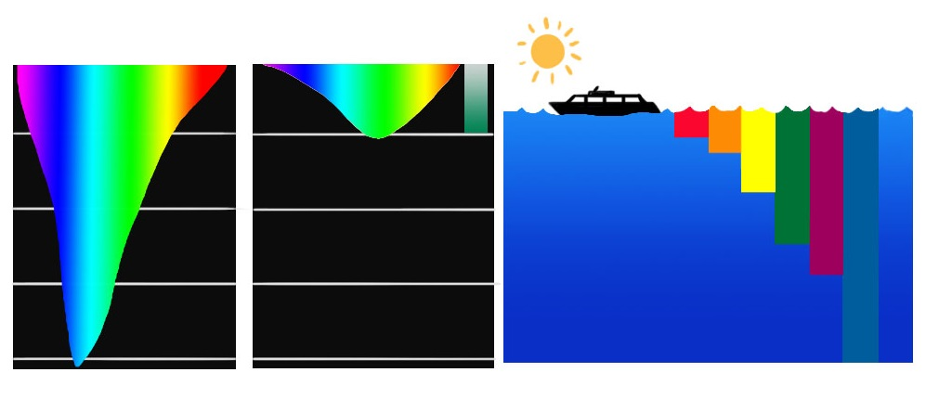
Light Penetration in the Ocean
Light Penetration
In Open Ocean
Light Penetration
In Coastal Waters
Depth in
meters
50
30 ft
10 m
100
60 ft
20 m
90 ft
20 m
150
120 ft
40 m
200
Notes:
Colors with shorter to medium wavelengths like blue and green penetrate the deepest in water. Red is one of the first color wavelengths to be absorbed or scattered so it never reaches the deep sea. So anything colored red in the deep sea blends in to the surroundings because it can’t be seen. Some deep sea animals that are transparent even have red stomachs because if they eat something, the red color will hide it from view.

Slide 15
Deep sea animals are sometimes red because of the way light waves travel in the ocean.
Notes:
What are the wave behaviors that allow us to see certain colors and not others? (transmission, reflection, absorption)

