Slide 1
Earth From Space
Making Meaning

Slide 2
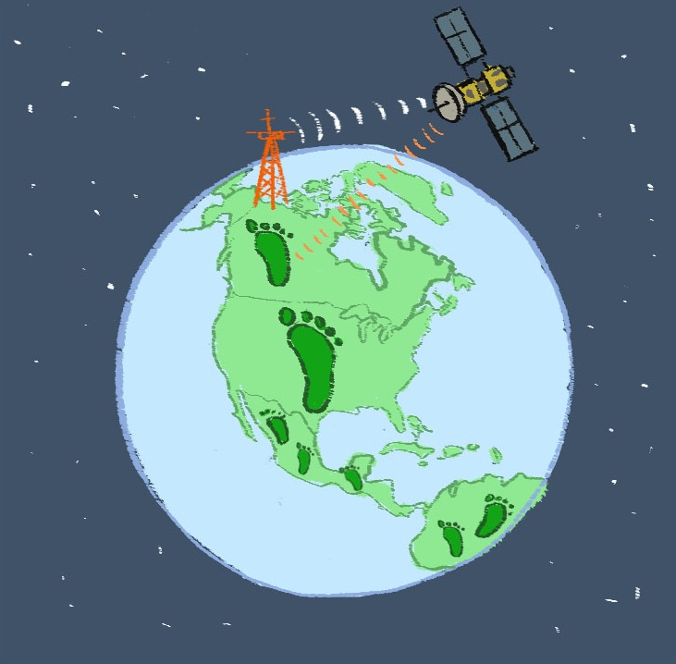
Earth From Space: Where Are We?
CO2
CO2
CO2
CO2
Notes:
You can reference Earth from Space Graphic Organizer worksheet Lesson 9.2a-earth-from-space-graphic-organizer.pdf that students received in Lesson 2 Examining Satellite Images.
Remind students of where they are within the unit and storyline.

Slide 3
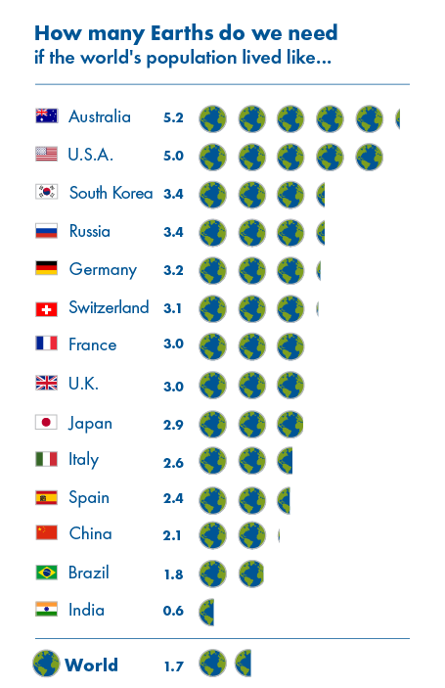
Phenomenon: Countries consume different amounts of resources.

Slide 4
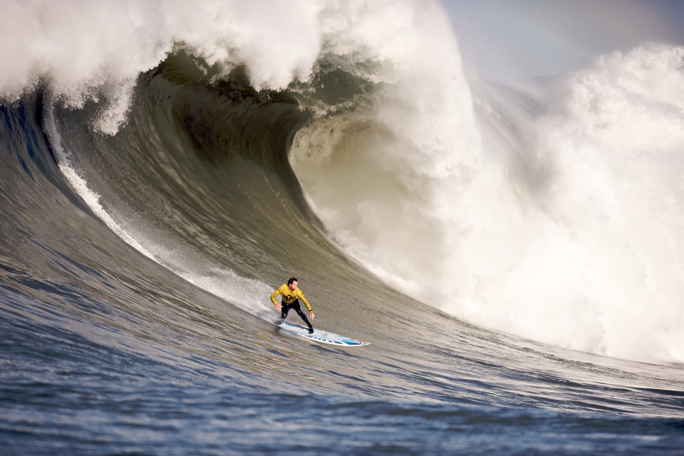
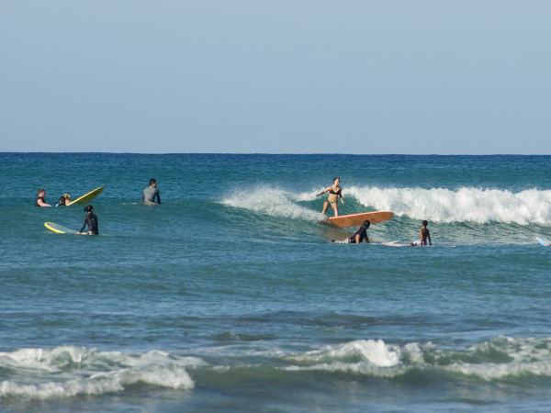
Phenomenon: Waves carry energy.
Notes:
Give students time to consider this…

Slide 5
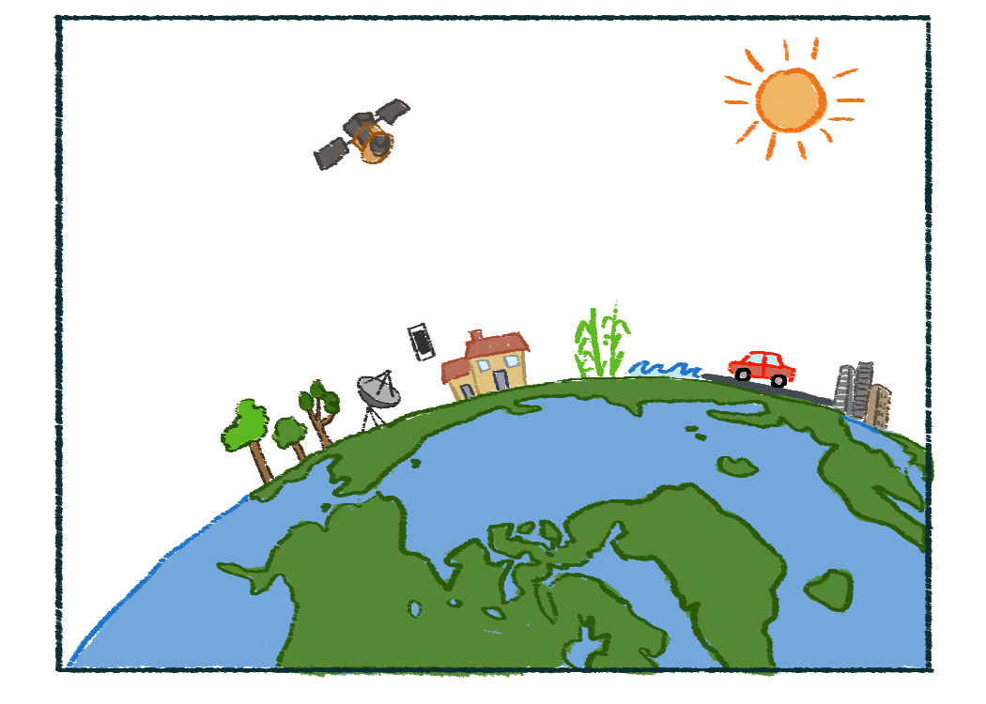
Phenomenon: Satellites gather light from the ground.
Notes:
Give students a minute or two to silently examine this diagram. Pose the questions: What does this diagram show? What do you wonder? Have students think-pair-share and then solicit student ideas.

Slide 6
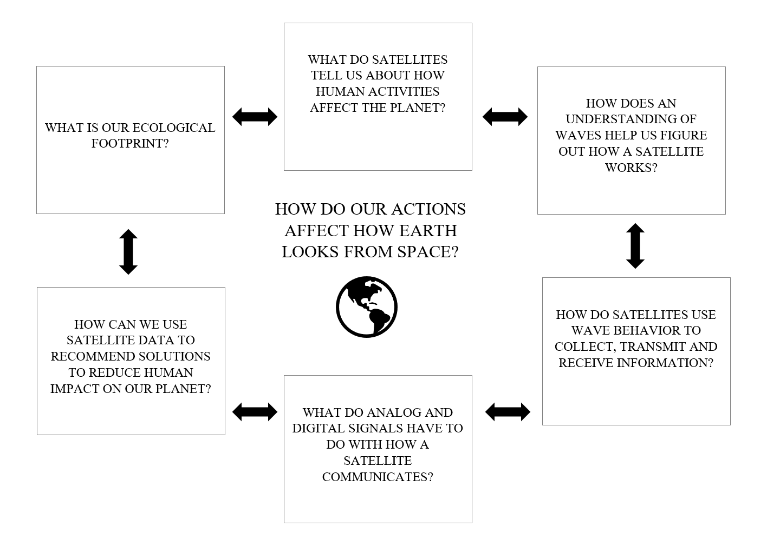
Earth From Space Unit Concept Map
Notes:
Point out where the class is within the unit (circled in red, the one in dashed red the class is still investigating). Now introduce the gallery walk.

