Slide 1
Satellites Help Us See the Unseen

Slide 2
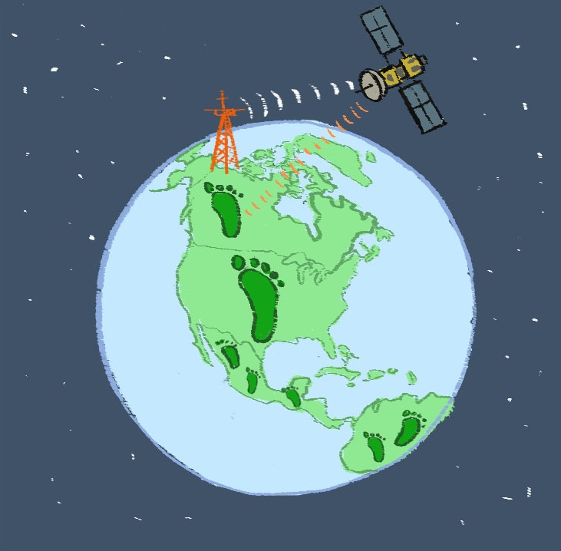
Connecting to the Unit Storyline
CO2
CO2
CO2
CO2
Notes:
Refer to Earth from Space Graphic Organizer worksheet Lesson 9.2a-earth-from-space-graphic-organizer.pdf and use the graphic to highlight where the class is in the unit storyline.
Here is the overview of the storyline: The planet is a big place, and one of the best ways to monitor the state of our planet is by using satellites. Our goal for this unit is to describe the environmental conditions of earth using satellite technology and then offer possible solutions to particular problems.
You’ve used the concept of ecological footprint to study how different countries consume different amounts of resources. Now we are in the middle of learning about satellites, the data they collect and how satellites utilize waves to transmit, collect and receive information. Then you’ll apply satellite technology to investigate a study location and document change caused by humans and offer possible solutions to lessen

Slide 3
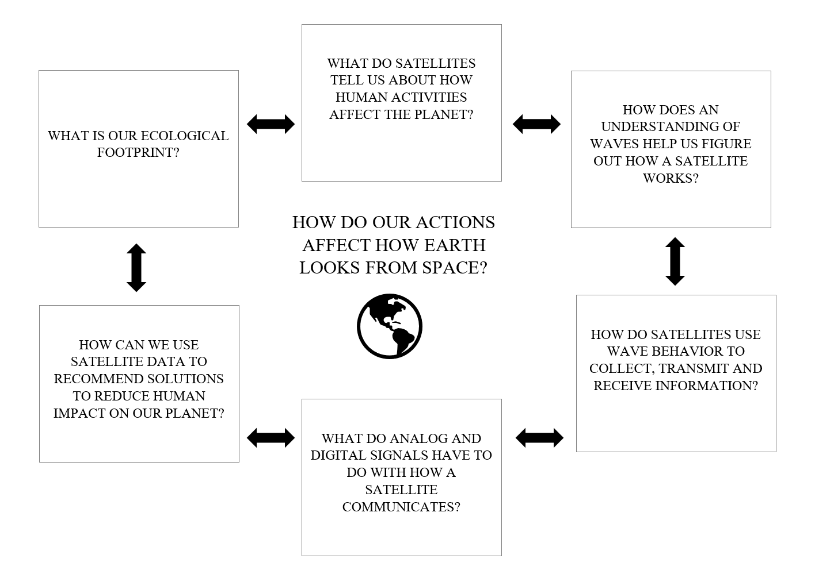
Where Are We In The Unit?
Notes:
The checked boxes are those students have explored already. Although we have seen a little bit about what satellites tell us about human activities, we are going to explore that idea more and then shift into how we can use it to come up with solutions in the culminating experience.

Slide 4
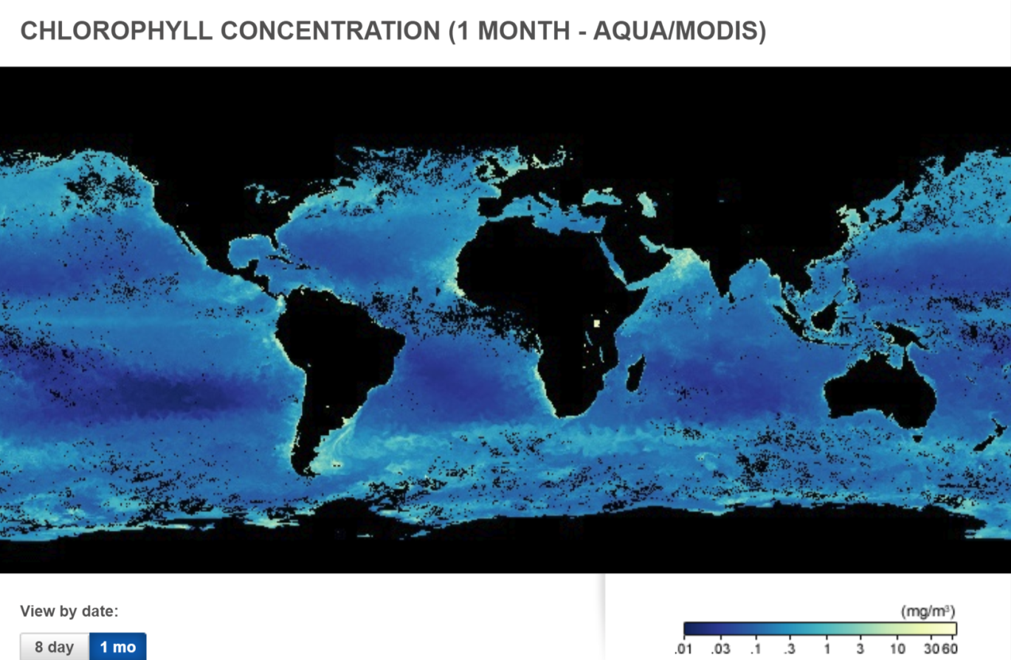
How Do Satellites Help Us “See the Unseen?”
This map shows where phytoplankton (tiny, floating plants) lived in the ocean in Feb 2018.
Phytoplankton contain a photosynthetic pigment called chlorophyll that lends them a greenish color.
Phytoplankton are carbon sinks and produce an estimated 70% of our atmospheric oxygen.
The black areas (besides land masses) show where the satellite could not measure phytoplankton.
Notes:
This introduces the idea that satellites help us “see the unseen.” It would be nearly impossible for scientists to create an accurate and comprehensive map of phytoplankton with data collected in situ.
Give students a minute or two to silently examine this image. Have students generate some questions about what they notice and wonder.

