Slide 1
Earth from Space Introduction

Slide 2
What do you notice or wonder about this image?
Notes:
Before 1972, we had no idea what our planet looked like in full.
Apollo 17 gave us the first full photo of Earth in 1972, and the world was never the same again.
Since then, various satellites and craft have taken Blue Marble-style photos. The last notable one was on January 12, 2012, from the VIIRS (Visible/Infrared Imager Radiometer Suite) instrument aboard Suomi NPP, NASA’s Earth-observing satellite. The Suomi NPP satellite was launched October 2011 and renamed last week after Verner Suomi, commonly deemed the father of satellite meteorology. The composite was created from the data collected during four orbits of the robotic satellite taken earlier this month and digitally projected onto the globe.

Slide 3
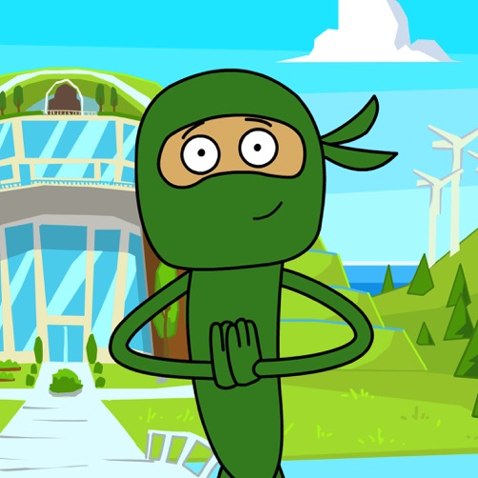
Message from Green Ninja
Hello Team!
In this unit, we are going into space to learn more about creating a sustainable planet. Satellites orbiting our planet give us a never-before-seen view of Earth from space. While interesting weather phenomena, beauty, and an abundance of life are part of this view, so is evidence of human consumption, such as deforestation and extreme development. Besides measuring carbon emissions in our environment, scientists can also measure our ecological footprint.
In this unit, your challenge is to use satellite data, together with computational thinking, to reduce humanity’s ecological footprint.
Let’s get started with this video.
– Green Ninja
Notes:
Read the Message from Green Ninja aloud to introduce students to the Green Ninja world. They will be faced with a challenge for each unit.
Hyperlink: https://greenninja.org/Green_Ninja_Show/31

Slide 4
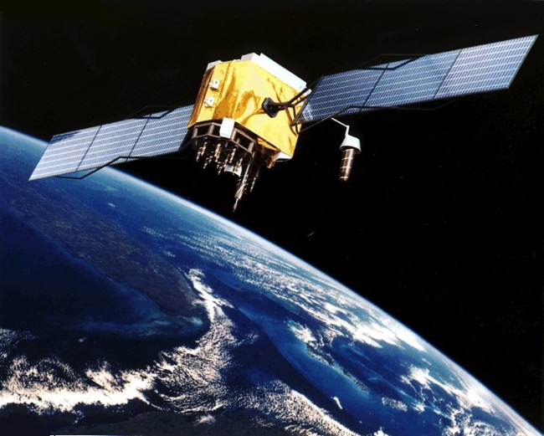
How do our actions affect how the Earth looks from space?
Examine the following satellite images using these questions to structure your analysis:
What technologies are used to capture images of Earth from above?
What do these images depict?
How can images like this be used?
Who might use them?
What do these images tell you about human activity?

Slide 5
Grand Canyon, April 3, 2017
Taken by the student-controlled Sally Ride EarthKAM on board the International Space Station. Orbit Height: 249 miles
Speed of Orbit: 4.76 miles/second
Launch Date: November 20, 1998
Notes:
On April 3, 2017, the student-controlled EarthKAM camera aboard the International Space Station captured this photograph of a favorite target—the Grand Canyon—from low Earth orbit. The camera has been aboard the orbiting outpost since the first space station expedition began in November 2000 and supports approximately four missions annually. Mission 58 begins in fall 2017, and interested middle school students and teachers can sign up at the EarthKAM website.
The Sally Ride Earth Knowledge Acquired by Middle School Students (Sally Ride EarthKAM) program provides a unique educational opportunity for thousands of students multiple times a year. EarthKAM is an international award-winning education program, allowing students to photograph and analyze our planet from the perspective of the International Space Station. Using the Internet, students control a special digital camera on the orbiting laboratory to photograph Earth's coastlines, mountain ranges and other interesting geographical topography.
Image from the Sally Ride EarthKAM
Max Speed: 17,150 miles per hour
Orbital Period: 1.5 hours

Slide 6
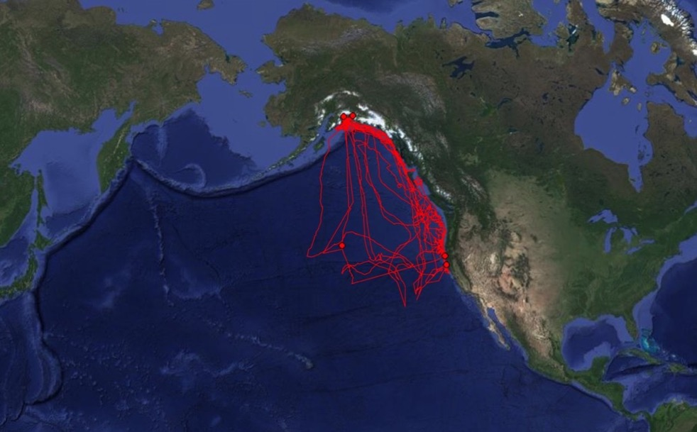
Salmon Shark Tracks, August 2015 to July 2017
Salmon sharks were tagged with Smart Position and Temperature (SPOT) and Pop-up Satellite Archival (PSAT) tags. Every time a shark surfaces, their SPOT tag sends a variety of measurements, such as temperature, salinity, and depth, to a satellite.
Notes:
Salmon Shark Tracks, August 2015 to July 2017

Slide 7
Dadaab Refugee Camp, Kenya
This is the largest refugee camp in the world, with an estimated population of 400,000. Most of these refugees are Somali, with the second largest group being South Sudanese. This satellite image is provided by Digital Globe, a private company.
Notes:
Hagadera, seen here on the right, is the largest section of the Dadaab refugee camp in northern Kenya and is home to 100,000 refugees. To cope with the growing number of displaced Somalis arriving at Dadaab, the UN has begun moving people into a new area called the LFO extension, seen on the left. Dadaab is the largest refugee camp in the world with an estimated total population of 400,000.

Slide 8
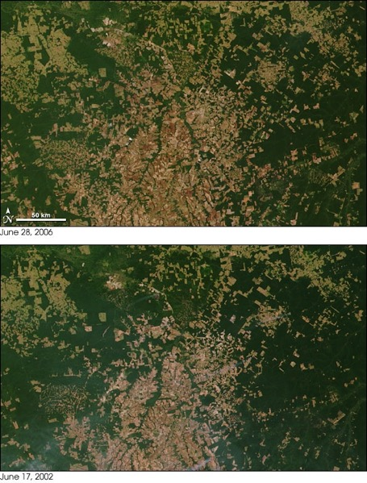
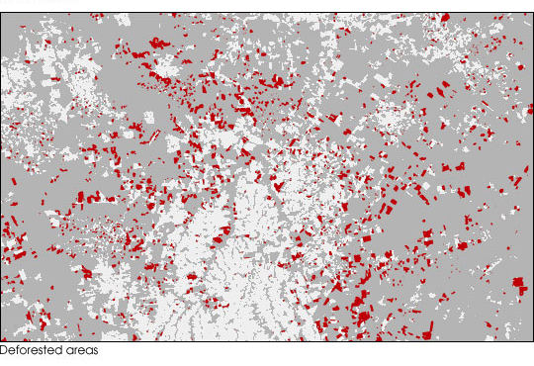
Amazon Rainforest, Mato Grasso, Brazil
Deforestation captured by NASA’s Moderate Resolution Imaging Spectroradiometer (MODIS) on NASA’s Terra satellite in 2006 and 2002. These images show where 48% deforestation occurred in 2003 and 2004.

Slide 9
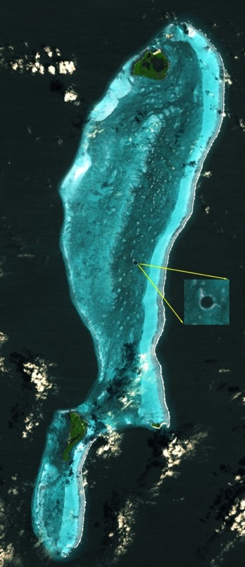
Great Blue Hole, Belize
This image was captured in March 2006 by the Advanced Spaceborne Thermal Emission and Reflection Radiometer (ASTER), a Japanese instrument. ASTER is on board NASA’s Terra spacecraft.
The Great Blue Hole is protected as a Belize National Monument and World Heritage Site.

Slide 10
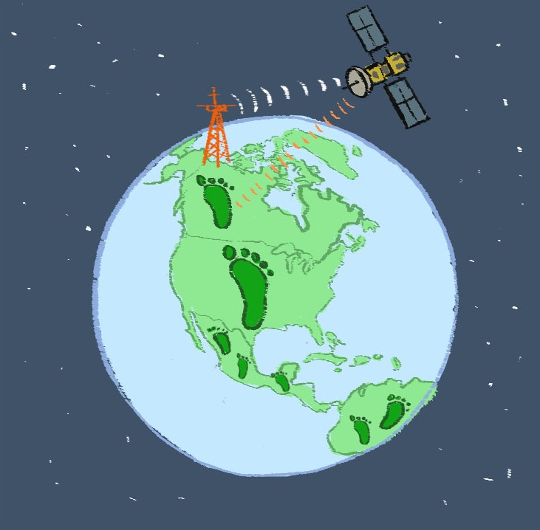
Earth From Space Unit Overview
CO₂
CO₂
CO₂
CO₂
Notes:
This is the Earth from Space Graphic Organizer worksheet (2 pages) that students will receive in a later lessons. Go over it quickly with the class.
Give them an overview of the storyline using this graphic: The planet is a big place, and one of the best ways to monitor the state of our planet is by using satellites. Our goal for this unit is to describe the environmental conditions of earth using satellite technology and then offer possible solutions to particular problems.
First you will use the concept of ecological footprint to study how different countries consume different amounts of resources. Then you will learn about satellites, the data they collect and how satellites utilize waves to transmit, send and receive information. Then you’ll apply satellite technology to investigate a study location and document change caused by humans and offer possible solutions to lessen human impact.

Slide 11
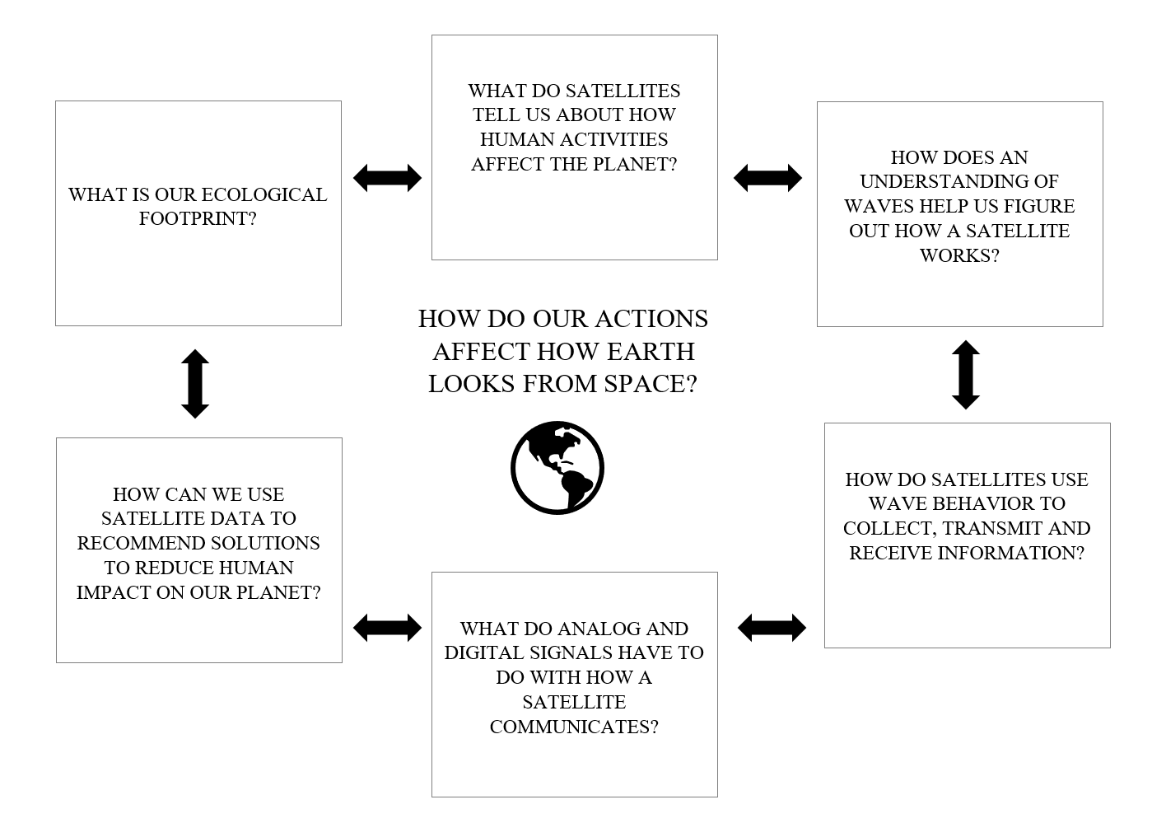
Earth From Space Unit Concept Map
Notes:
Read over these questions that students will be investigating over the course of the unit. Students will reference the previous graphic and this concept map throughout the unit.

