Slide 1
Focus on Landsat

Slide 2
Satellites: Earth from Space

Slide 3
Google Earth Satellite Image
Note: If you don’t have access to Google Earth or Google Maps in the classroom, insert a screenshot of your school and its neighborhood here.
Notes:
Use your school and its surroundings to walk through the following tips for examining a satellite image:
Look for a scale
Look for patterns, shapes, and textures
Define the colors (including shadows)
Find north
Consider your prior knowledge (do you recognize any landmarks?)

Slide 4
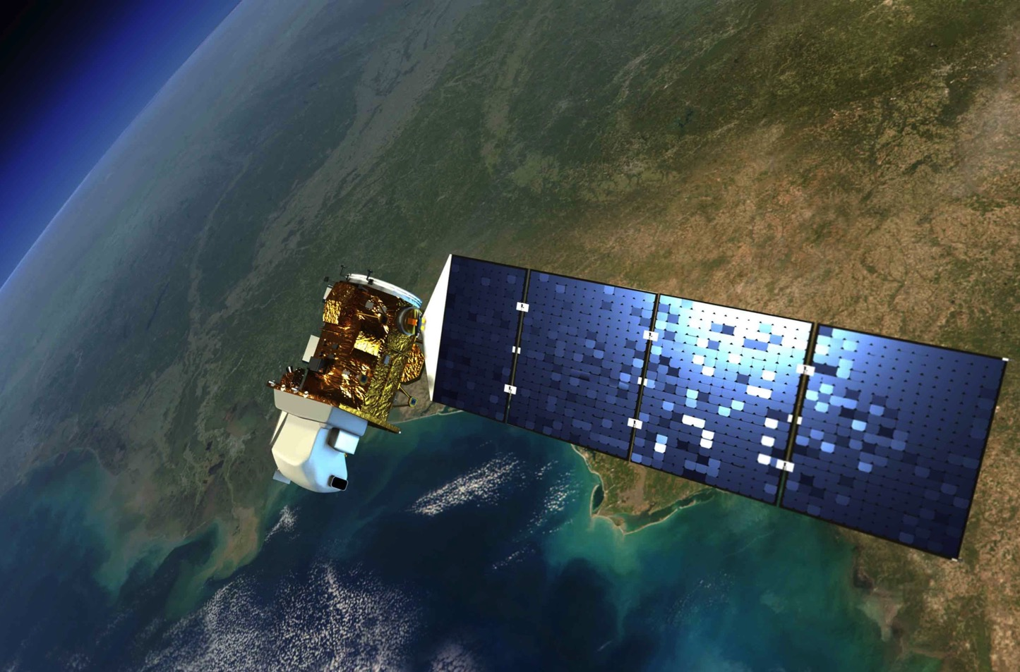
Case Study: Landsat
Primary mission: map Earth’s land surface
Data consistent since 1972
16-day repeat
30-meter resolution
Data publicly available at no cost thanks to USGS
Notes:
Tell students that they examined images created by the Landsat satellite and that now they will learn more about both the satellite and the images. They will use the knowledge gained from this lesson and the previous lesson to construct animations of how satellites use waves in Scratch, a cloud-based computer program.

Slide 5
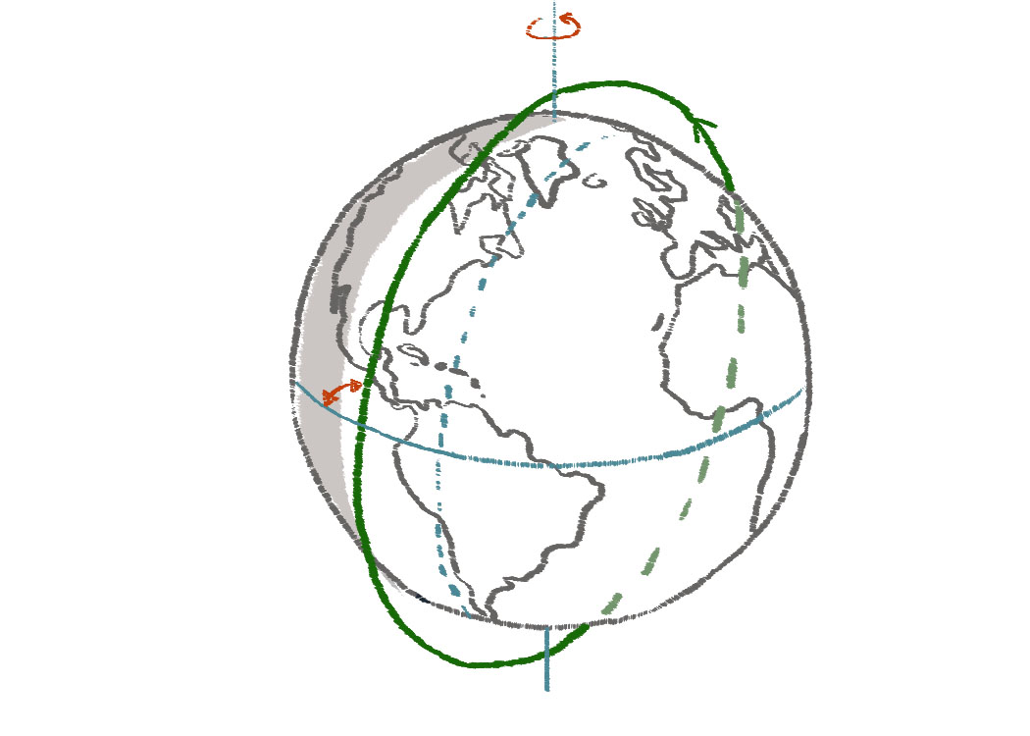
Low-Earth Orbit
Landsat satellites orbit the Earth 705 kilometers above its surface.
Altitude = 705 km (Nominal)
Inclination = 98.2°
Equator
Time of day = 9:45 A.M.
(Local)
Ground track
Orbit period = 98.9 min
Satellite orbit

Slide 6
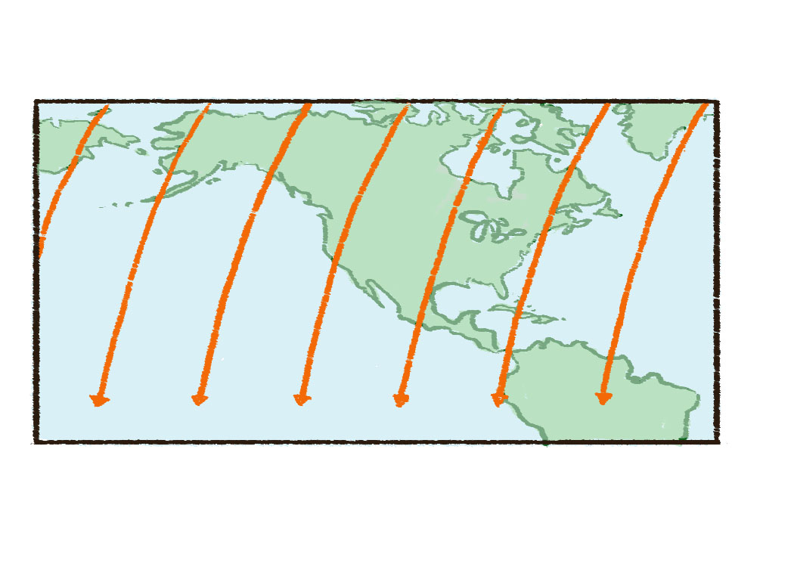
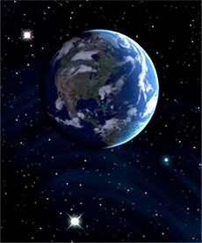
Polar Orbit
Landsat orbits from pole to pole (north to south) as the Earth turns under it.
Equator
6
5
4
3
2
1
Sensor Swath
(185 km)
2752 km
Spacing between adjacent Landsat-4 or -5 orbit tracks at the equator.
The earth revolves 2752 km to the east at the equator between passes.

Slide 7
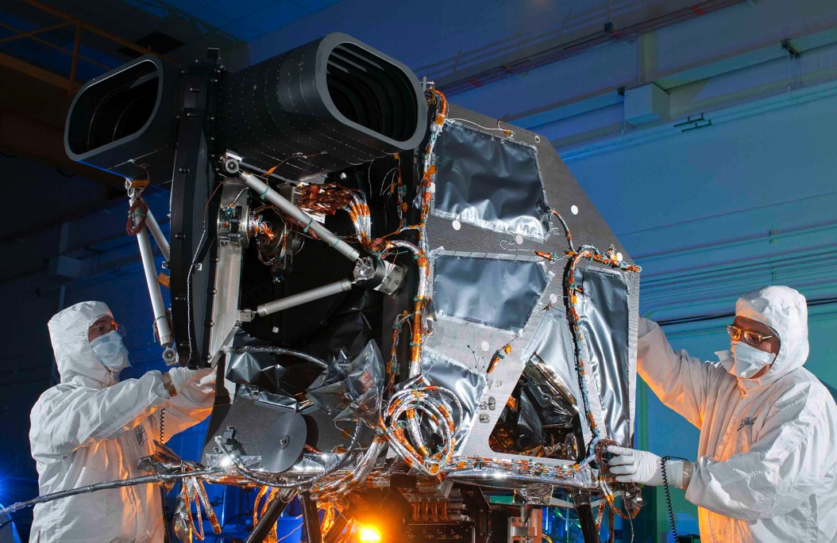
Sensors Onboard
Landsat instruments are designed to detect visible and infrared wavelengths.
The Operational Land Imager (OLI) under construction

Slide 8
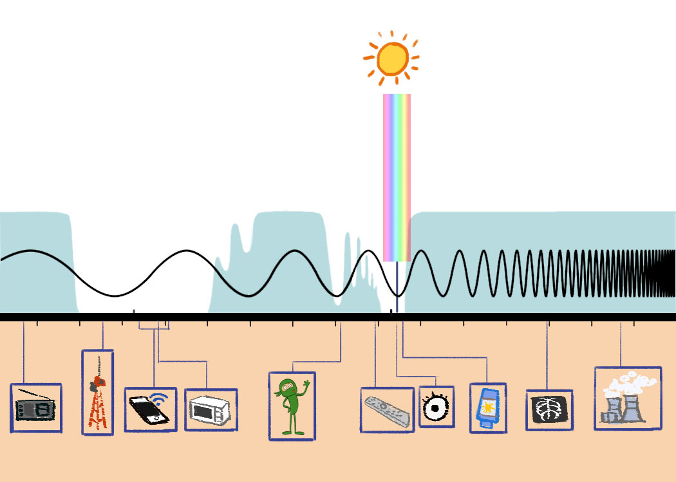
Atmospheric Windows
Visible light
Atmosphere Opaque to Wavelengths
Atmosphere Opaque to Wavelengths
Atmosphere Opaque to Wavelengths
Optical
Window
Radio Window
10⁶ (Hertz)
10⁹ Hz
10¹² Hz
10¹⁵ Hz
10¹⁸ Hz
10²¹ Hz
Radio Waves
Microwaves
Infrared
Ultraviolet
X-rays
Gamma Waves
10² (meters)
10¹ m
10⁰ m
10⁻¹ m
10⁻² m
10⁻³ m
10⁻⁴ m
10⁻⁵ m
10⁻⁶ m
10⁻⁷ m
10⁻⁸ m
10⁻⁹ m
10⁻¹⁰ m
10⁻¹¹ m
10⁻¹² m
(1µm)
(1nm)
Wavelength=
Length of a football field
Wavelength=
Length of a football field
Wavelength=
Thickness of paper
Wavelength=
Width of a water molecule
Wavelength=
Size of atomic nuclei
AM radio
FM radio
Cell Phone
And Wi-fi
Microwave
Oven
Human bodies
radiate heat
Remotes
Visible Light
Sunburn
Medical X-rays
Nuclear Power
Notes:
These are the wavelengths that can pass through or be transmitted to the Earth’s surface without being absorbed by gases in the atmosphere (examples include infrared and visible light, as well as radio waves and microwaves).

Slide 9
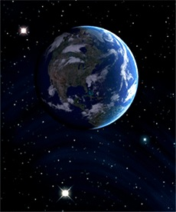
Passive (Not Active) Instruments
Landsat instruments primarily measure light that is reflected from the Earth’s surface.

Slide 10
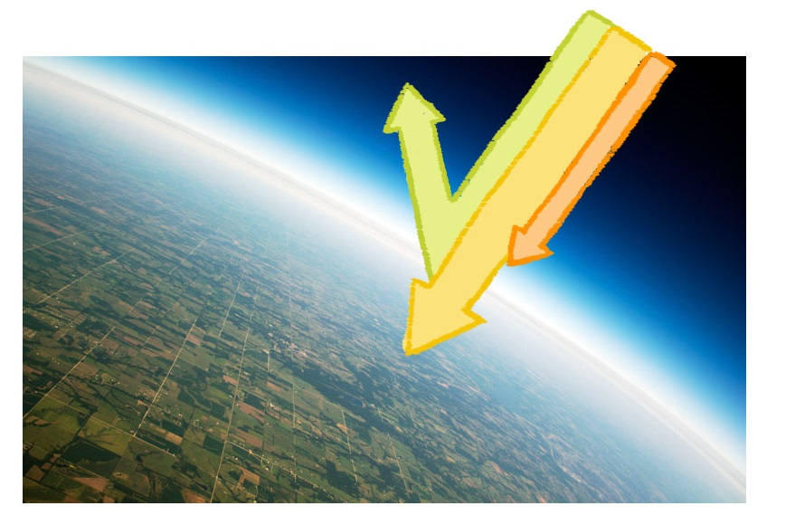
Wave Behavior
About 25 percent of the Sun’s energy is absorbed by the atmosphere, about 50 percent is absorbed by the Earth’s surface, and about 30 percent is reflected. space
Incoming solar radiation (340 W/m ³)
Reflected
29%
23%
Absorbed in the atmosphere
Absorbed in the surface
48%

Slide 11
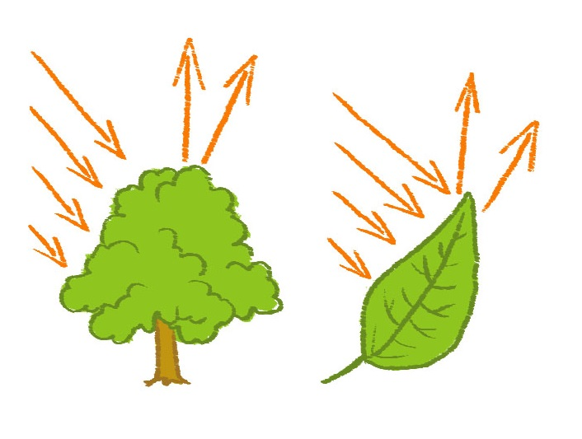
Remember Light in the Ocean?
Consider a tree and its leaves.
Red, green, blue, and infrared light from the Sun hit the tree and its leaves.
Infrared and green light are reflected from the tree. Red and blue light are absorbed by the tree.
In this picture:
IR is infrared light
R is red light
G is green light
B is blue light
G
IR
IR
G
R
IR
IR
R
G
G
B
B
B
R
Notes:
Color in Leaves: A chemical compound in leaves called chlorophyll absorbs radiation from the red and blue wavelengths, but reflects green wavelengths. Leaves appear "greenest" to us in the summer, when chlorophyll content is at its maximum. In autumn, there is less chlorophyll in the leaves, so there is less absorption and proportionately more reflection of the red wavelengths, making the leaves appear red or yellow (yellow is a combination of red and green wavelengths). The internal structures of healthy leaves act as excellent diffuse reflectors of near-infrared wavelengths. If our eyes were sensitive to near-infrared, trees would appear extremely bright to us at these wavelengths. In fact, measuring and monitoring the near-IR reflectance is one way that scientists can determine the health of vegetation.

Slide 12
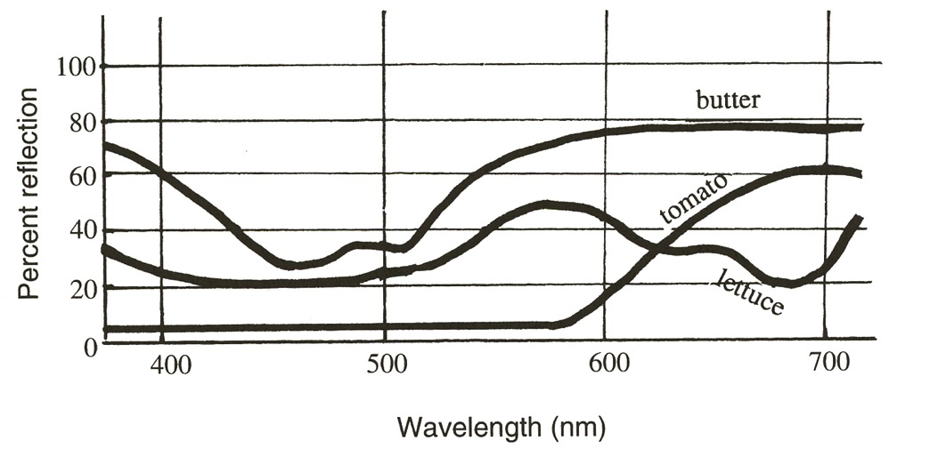
Spectral Signatures
Every surface has its own spectral signature, which is somewhat like a fingerprint.
Butter reflects weakly in blue and strongly in yellow to red. Tomatoes reflect weakly in blue and strongly in red..

Slide 13
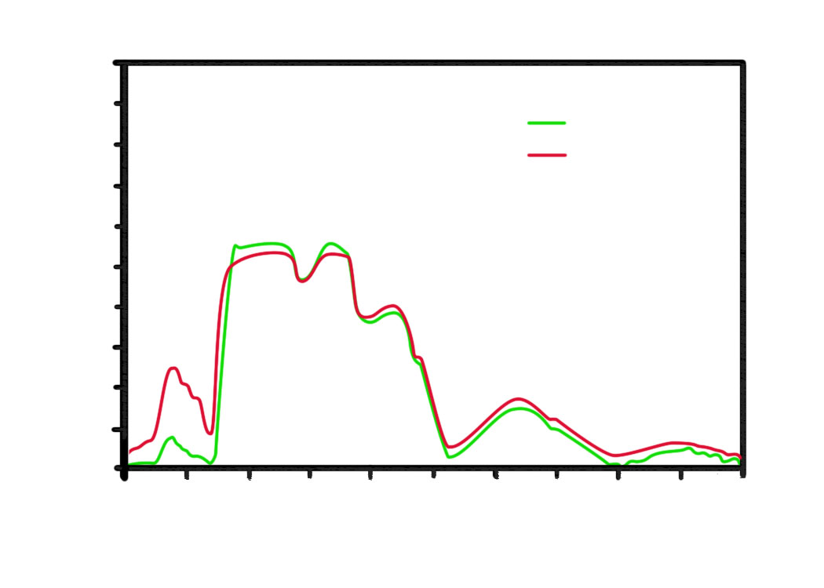
Spectral Signatures are Useful in Many Ways
Farmers can use remote sensing to tell which of their sugar beet fields are healthy and which are not if they know the spectral signature.
1
0.9
0.8
Healthy Sugar Beets
Stressed Sugar Beets
0.7
0.6
0.5
Reflectance
0.4
0.3
0.2
0.1
0
400
600
800
1000
1200
1400
1600
1800
2000
2200
2400
Wavelength (nm)
If a farmer were designing a sensor solely to measure the health of her/his sugar beets, what wavelength range would she/he want the sensor to detect?

Slide 14
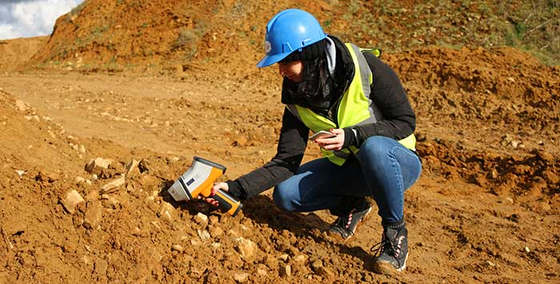
Understanding the Big Picture
Scientists measure the spectral signatures of different surfaces on the ground. Then, when they look at the spectral signature of a surface in a satellite image, they can tell what kind of surface the satellite was looking at.
Researcher with handheld spectrometer

Slide 15
How Does It Work?
Landsat 8 observes the Earth in 11 ranges (or bands) of the electromagnetic spectrum.
Examples of Bands and What they Detect
Band | Wavelength (um) | Useful for mapping
Band 1-Coastal Aerosol | 0.435-0.451 | Coastal and aerosol studies
Band 2-Blue | 0.452-0.512 | Ocean floor mapping, soil versus plants
Band 3-Green | 0.533-0.590 | Health of plants
Band 4-Red | 0.636-0.673 | Slope (steepness) where plants grow
Band 5-Near Infrared (NIR) | 0.851-0.879 | Plant types and shorelines
Band 6-Shortwave Infrared | 1.566-1.651 | Amount of moisture in plants and soil, passes through clouds
Notes:
Note: “um,” or micrometer, is a unit of measurement equal to the length of one millionth of a meter (or a tenth the size of a droplet of fog or mist)
Source for spectral bands: https://landsat.usgs.gov/what-are-best-spectral-bands-use-my-study, https://landsat.usgs.gov/what-are-band-designations-landsat-satellites

Slide 16
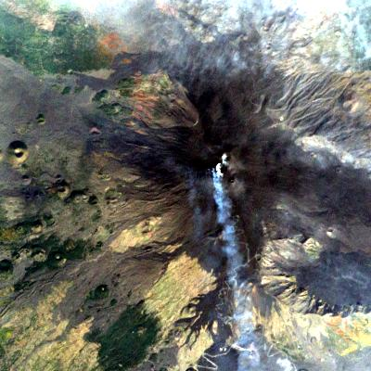
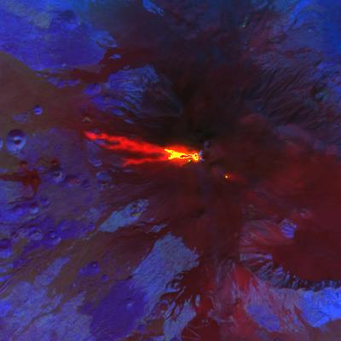
Same Scene, Different Wavelengths
By making images with different spectral band combinations, we can see more than we otherwise could.
Visible Wavelengths
Infrared Wavelengths
2017 Eruption of Mt. Etna, Italy
Notes:
These images of Mt. Etna erupting show some of the value of using more than one kind of spectral band combination. We couldn't possibly accomplish this “color compositing” in a timely fashion if we had to do it manually. Image processing software, including MultiSpec, generates a satellite image using three spectral bands (wavelength ranges) of data (chosen by the user) and combines them to create a color composite image.
A satellite image is much more than a picture. Each pixel has a numeric representation for the amount of energy reflected in each of three selected wavelengths. This information can be used to make numerous measurements.
Possible exercise: By adding up the number of pixels or squares in a grid overlay on an image, students can calculate the area of land cover type in a scene. For example, if red represents vegetation, students can count the number of red pixels and multiply that number by the area of each pixel to determine the total area covered with vegetation.

Slide 17
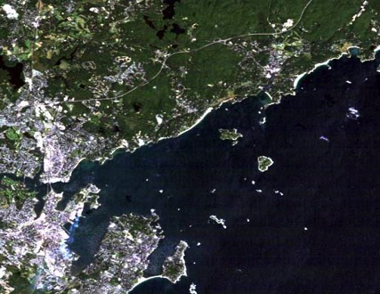
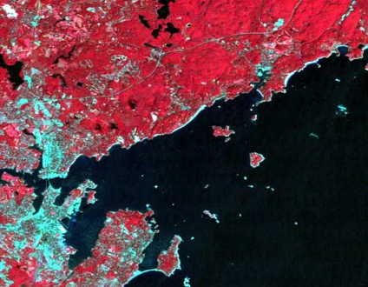
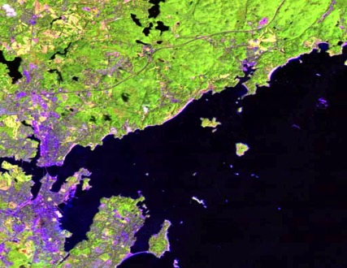
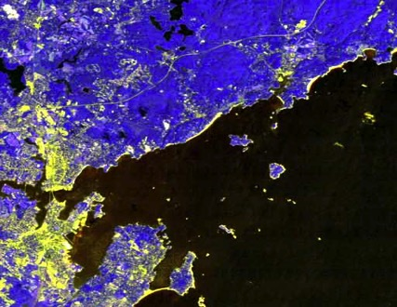
Colors Represent Different Data
People can choose red, green, or blue to represent any wavelength range they want to observe.
There are lots of color combinations available (these images are of Beverly, MA).

Slide 18
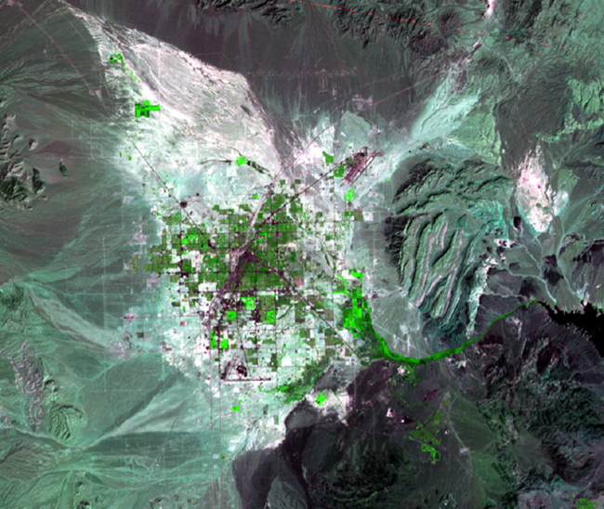
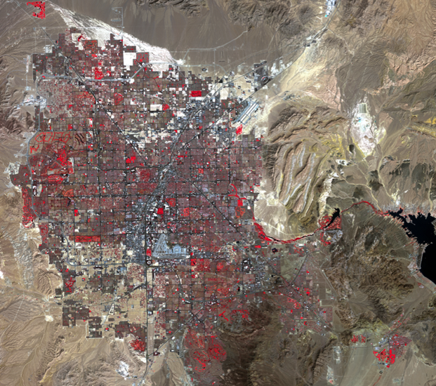
Landsat Images: Las Vegas, Nevada
1972
2015
What story do these images tell?
Notes:
Read more at https://earthshots.usgs.gov/earthshots/Las-Vegas#ad-image-18
Las Vegas, Nevada is one of the fastest growing metropolitan areas in the United States. Las Vegas grew from a population of 1,375,765 in 2000 to 1,951,269 in 2010, a 41.8% increase, or the third highest in the country for that decade. These images show the rapid growth of the city. The tip of Lake Mead is visible east of the city (the dark area), where Hoover Dam impounds the Colorado River. In each image, bright red indicates actively growing vegetation. This makes golf courses easy to spot, and their development can be tracked along with the residential areas that surround them. The desert landscape gradually becomes covered with streets, highways, and development as time goes on. A plot of very light tan can sometimes be seen right before a new residential area is built. This indicates the land being cleared.
Other natural bright areas appear around the urban development. The bright reflection indicates the presence of salts, minerals, and clays in the sediment. Water once settled in these flat, lower-elevation areas, and these minerals remained. The brown-tan regions surrounding the city are likely steeper slopes where flowing water rinsed out the minerals. Darker tones indicate coarser material, and lighter tones are fine material, such as clays, that have a higher reflectance.

Slide 19
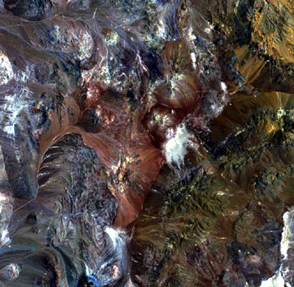
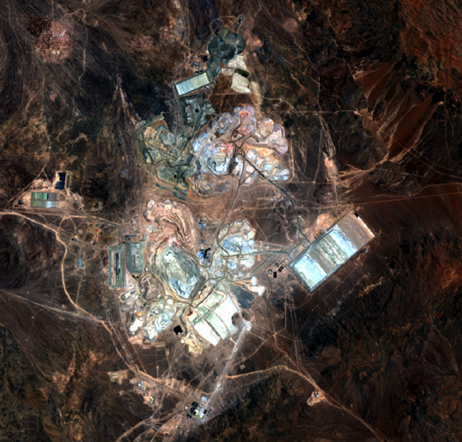
Landsat Images: Atacama Desert, Chile
1972
2015
What story do these images tell?
Notes:
Read more at https://earthshots.usgs.gov/earthshots/node/58#tabs-1
Isolated in Chile’s northern Atacama Desert, the open-pit Escondida Mine is the world’s largest source of copper.
Escondida means “hidden” in Spanish, and hidden it was. The copper ore was buried under hundreds of meters of rock. The only way it was found was by drilling along a line of other known copper finds that stretched hundreds of kilometers.
Copper represents a substantial part of Chile’s economy. In 2013, copper mine production was valued at just over $30 billion. Chile is the world’s leading producer of copper, accounting for nearly 32% of world copper production. Production in the Escondida Mine began in 1990. In 2012, Escondida produced just over 1 million tons of copper. Chile has approximately 24% of the world’s known copper reserves. A multi-billion dollar expansion is planned at the Escondida Mine, which will boost production to 1.3 million tons per year and keep it at that level for the rest of the decade.
These images make it easy to see the extent to which the open-pit mining operation is expanding. However, it’s harder to appreciate how deep the pits are. The main pit at Escondida is 645 meters deep. If you could stack two Eiffel Towers inside the pit, the top one would just barely peek over the edge.
To conserve water and minimize environmental impacts, Escondida created a tailings impoundment that has expanded along with its mining operations. The tailings material is left over after the majority of the valuable metals have been removed from the ore. This copper-bearing waste is poured into the impoundment area as a liquid (dark region at the bottom of the 2011, 2013, and 2015 images); it dries to the lighter-toned spoil seen in the images. The spoil is held behind a retaining dam, just more than 1 kilometer long, visible in the 2011, 2013, and 2015 images as a straight line on the northwest corner of the pond.

Slide 20
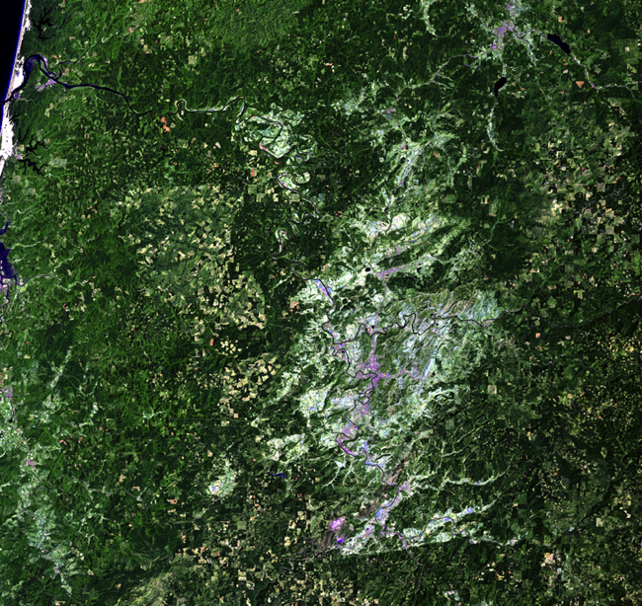
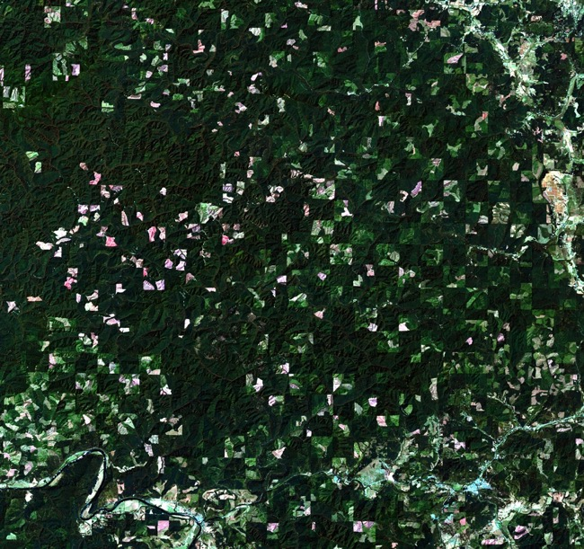
Landsat Images: Forests of Oregon
1984
2017
What story do these images tell?
Notes:
Read more at https://earthshots.usgs.gov/earthshots/node/89#ad-image-0
Every year, it takes one tree, 16 inches in trunk diameter and 100 feet tall, to meet each American’s need for paper, packaging, and lumber products. If that tree was harvested in Oregon, it was logged using strict environmental protections.
In Oregon, the goal is sustainable forestry. The logging industry there works to meet current societal needs for forestry products, while ensuring that future generations will be able to enjoy the same benefits from abundant forest resources that we do today. Much of Oregon has been heavily logged in the past, but in western Oregon, where these Landsat images were taken, nearly 1 million acres of intact, old growth forests remain, and almost all land in Oregon that is logged is reforested.
The close-up Landsat images that accompany this section show an obvious checkerboard pattern in the forest. These lands are known as “O&C” lands, which stands for Oregon and California Railroad. Land granted to O&C in 1866 was given in every other square mile, forming the checkerboard pattern seen in the images. This land now belongs to the federal government and is managed by the Bureau of Land Management (BLM).
In these images, the squares that remain dark green are generally land that belongs to the BLM. In some of those squares, there is clearcutting and regrowth taking place in this time frame. Adjacent squares, however, have a more noticeable change in tan or white spots, indicating more frequent clearcuts in the logging/reforestation cycle.
A closer look at the Landsat images shows the progression of clearcutting and regrowth. The colors in most of these images are a patchwork of tan, white, and various shades of green. First, notice that the landscape changes a lot during this time. How can you ensure that this series of close-up images is the same exact area? Identify features, such as rivers, that do not change throughout the series.
Next, notice the difference between the shades of light green and dark green. How would these two areas look if you were standing on the ground? Dark green indicates taller trees and an older forest. Light green areas are only beginning to recover from past logging, so the young trees in these areas are not very tall yet.
The tan areas are fresh clearcuts. Using the infrared wavelengths of light that Landsat can detect helps show these areas more clearly.

Slide 21
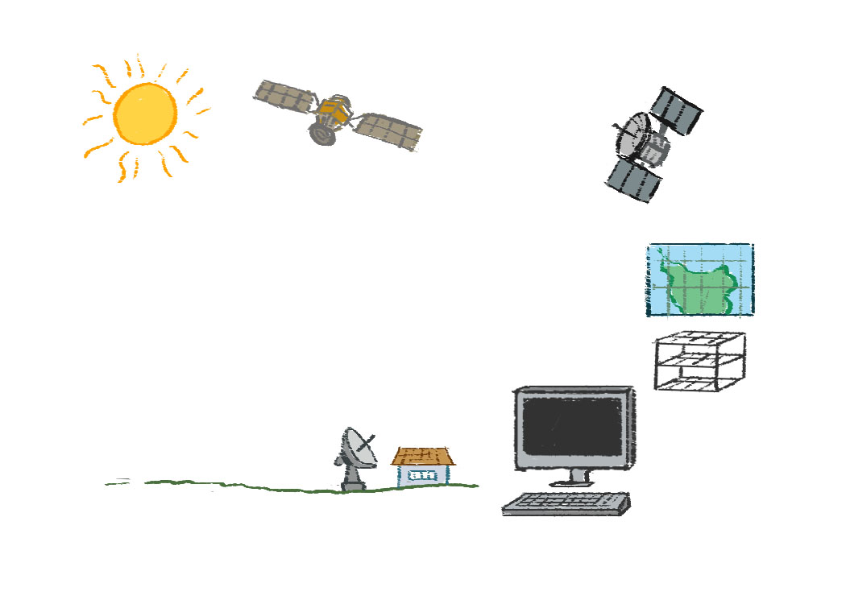
Waves move from the Sun to the ground and are then reflected to Landsat, transmitted to relay stations, and sent to computers for analysis.
How Landsat Uses Waves
D
A
C
E
F
G
B
Notes:
Recap how Landsat utilizes waves (this will be useful for students when storyboarding their animations in Scratch). The letters demonstrate the order the waves travel in (A=waves from sun to ground, B=some waves being absorbed into Earth’s surface, C=waves being reflected into atmosphere and collected by satellites, D=satellites transmit to relay stations on ground and sometimes to other satellites in atmosphere, E=other satellites transmit to ground, F=transmitted to computers, G=used to construct images for practical use)

Slide 22
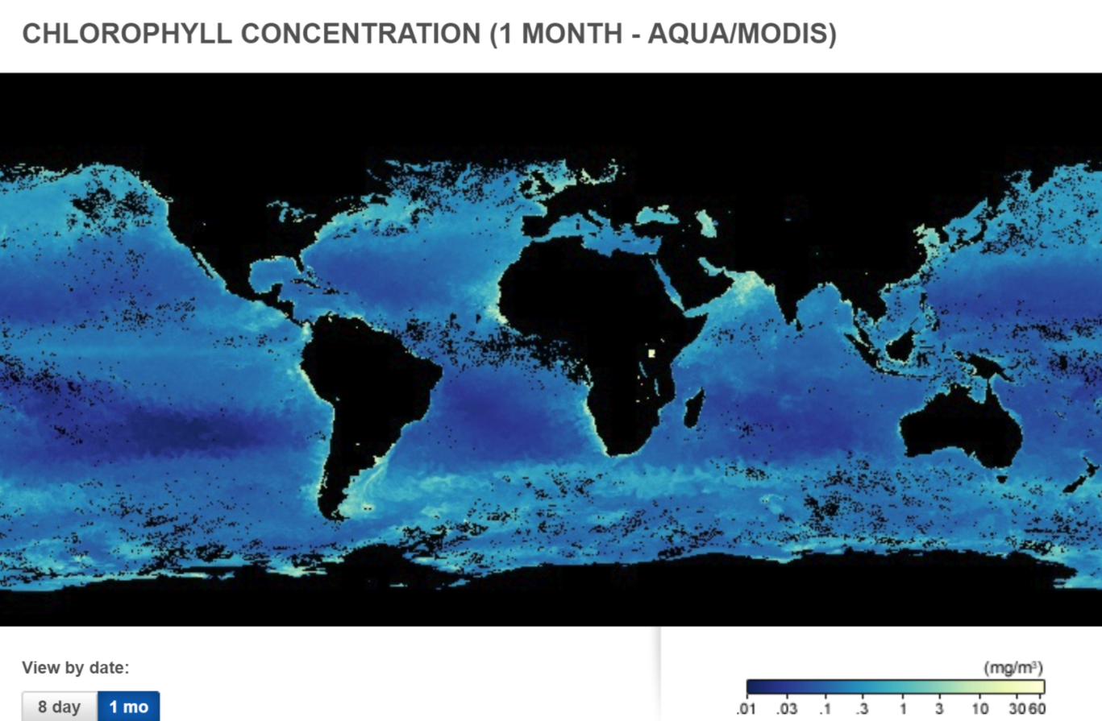
How Do Satellites Help Us “See the Unseen?”
What kinds of data might satellites gather that inform us about our ecological footprint?
How might we use satellite data to help reduce human impact on the planet?
What else do you wonder or have questions about?
Notes:
Revisit the phenomenon from lesson 19. Have students think-pair-share again about how satellites help us see the unseen. What other kinds of data

Slide 23
Extension: How Do Satellites Use Waves?
Watch one of the following videos:
How to yell across a solar system https://spaceplace.nasa.gov/x-ponder/en/
NASA’s Earth Minute: Why Does NASA Study Earth? https://www.youtube.com/watch?v=f9F7yDjSdNA&list=PL9TFrgFq75552g7qVa-iTOeuo7Fy11o5f&index=10
NASA’s Tour of the EMS 03 - Microwaves https://www.youtube.com/watch?v=UZeBzTI5Omk

