Slide 1
Reducing Our Ecological Footprint
Using Effective Infographics

Slide 2
Letter from the Green Ninja
Hello Team!
You’ve gained great skills and knowledge as you’ve
successfully completed many missions to find solutions
to climate change. However, there is much more work
to do.
Satellites orbiting our planet give us never-before-seen
views of Earth from space. While interesting weather
phenomena, beauty, and abundant life are part of this
view, so is evidence of human consumption, such as
deforestation and extreme development.
Besides measuring carbon emissions in our environment, scientists can also measure our ecological footprint. An ecological footprint is how fast we consume resources and generate waste compared to how fast nature can absorb our waste and generate new resources. Humans have needs and wants, but how can we use less and give nature a chance to recover from our consumption?
Notes:
Review the Green Ninja’s message.

Slide 3
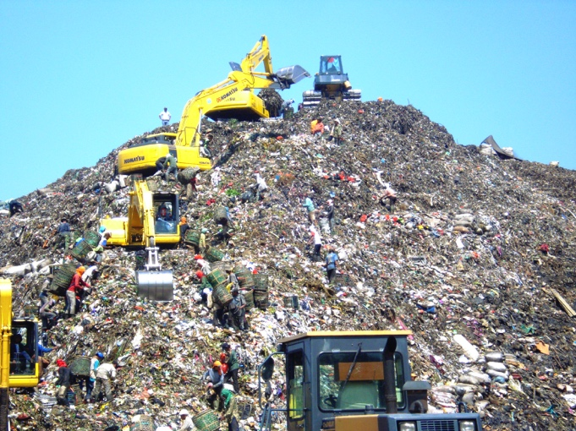
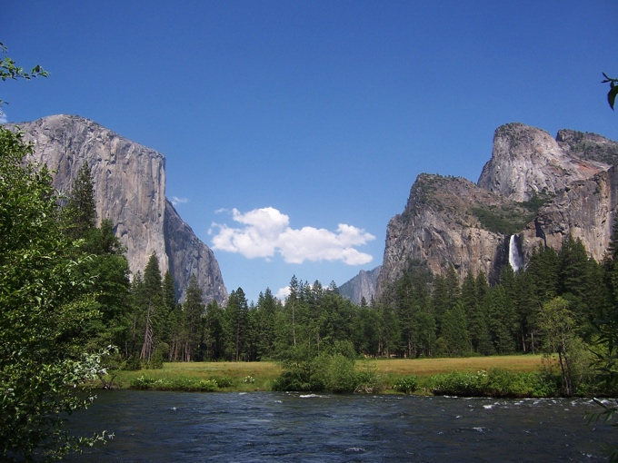
Letter from the Green Ninja
We live in an amazing time. Each day, advanced satellites, sensors, and computers produce mountains of high-resolution images of our planet. None of these detailed images would exist without the help of mysterious things called waves. After we learn more about waves, we will use our new knowledge to inspire others to help us protect our planet.
So let’s begin!
–Green Ninja
Less of this
More of this!
This Photo by Unknown Author is licensed under CC BY-SA

Slide 4
What Have We Learned So Far?
Waves:
What are wave characteristics?
How do waves behave?
How do we use waves?
How do digital and analog signals compare?
Consumption:
How do patterns of human consumption affect Earth’s landscape?
How can we reduce our consumption?

Slide 5
How Can We Use Satellite Imagery and Effective Communication to Reduce Humanity’s Ecological Footprint?
Notes:
This is the unit challenge!

Slide 6
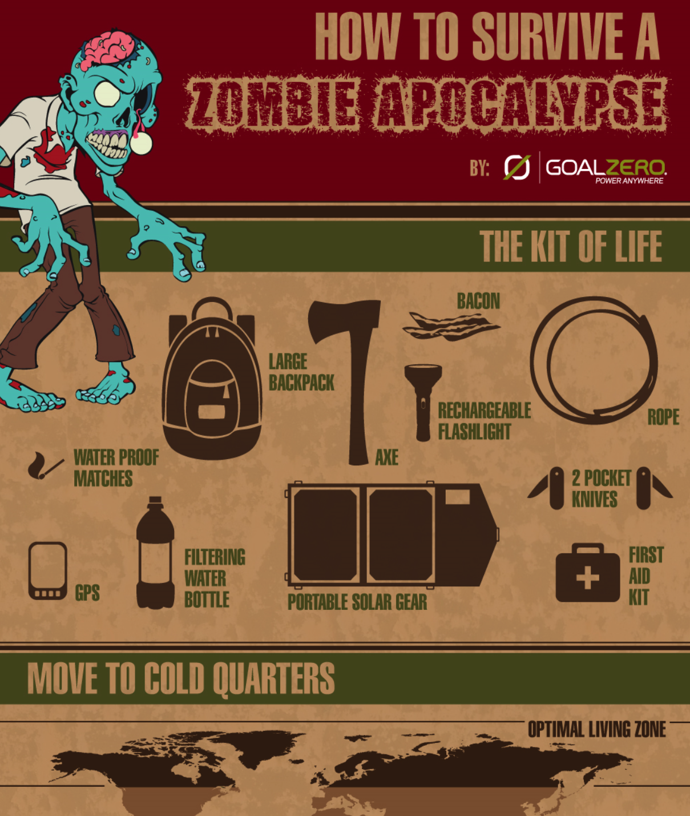
Infographics
Notes:
Tell students they will be creating infographics to motivate and inspire people to reduce humanity’s ecological footprint. You may also want to tell students which program they will design their infographics in—PowerPoint, Google Slides, or another infographic creator.

Slide 7
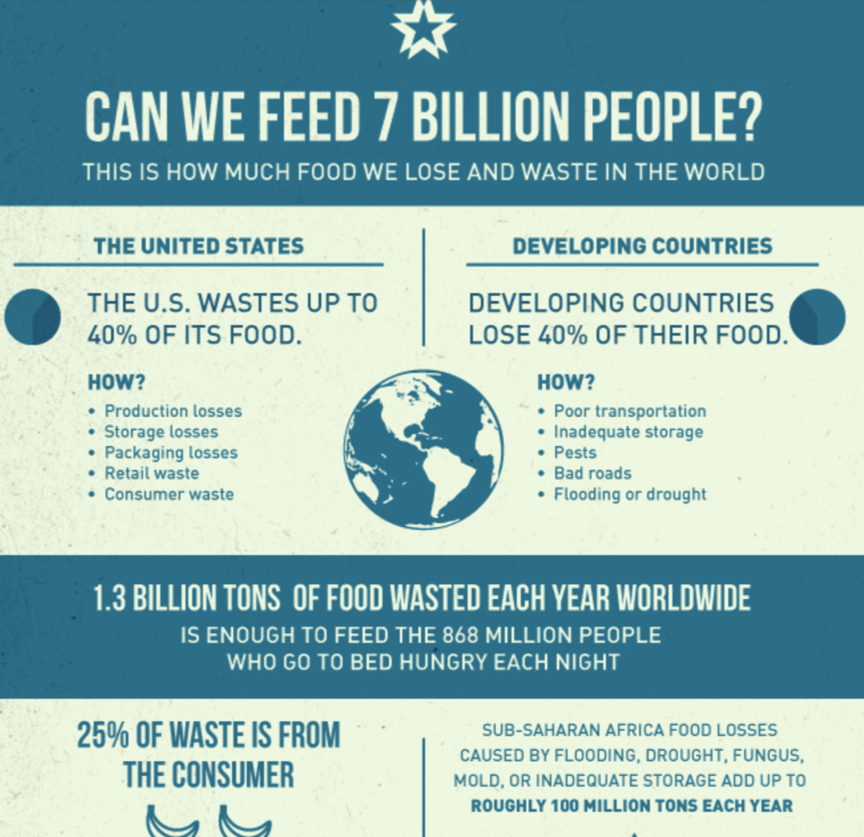
An infographic uses VISUALS (sometimes supported by text) to represent information or DATA, often with the aim of EDUCATING or informing an audience.
Notes:
Pass out the Elements of Effective Infographics worksheet, and go over it briefly. Then proceed to the next slide for examples.

Slide 8
Elements of Effective Infographics
How to Survive a Zombie Apocalypse (http://www.nerdgraph.com/how-to-survive-a-zombie-apocalypse/)
Don’t Let Mumps Spoil Your Fun (https://www.cdc.gov/mumps/infographics/mumps-mmr.html)
Consumerism Stats (https://visual.ly/community/infographic/environment/consumerism-stats)
The Lifespan of Your Waste (http://infographicjournal.com/the-lifespan-of-your-waste)
Notes:
Project a variety of infographics like the ones included on this slide. Have students use the Elements of Effective Infographics worksheet to guide their observations:
What is the title or topic?
Who is the intended audience?
What visuals do they use to support the topic?
What is their conclusion or call to action?
Is this an effective infographic? Why or why not?

