Slide 1
Designing Effective Infographics

Slide 2
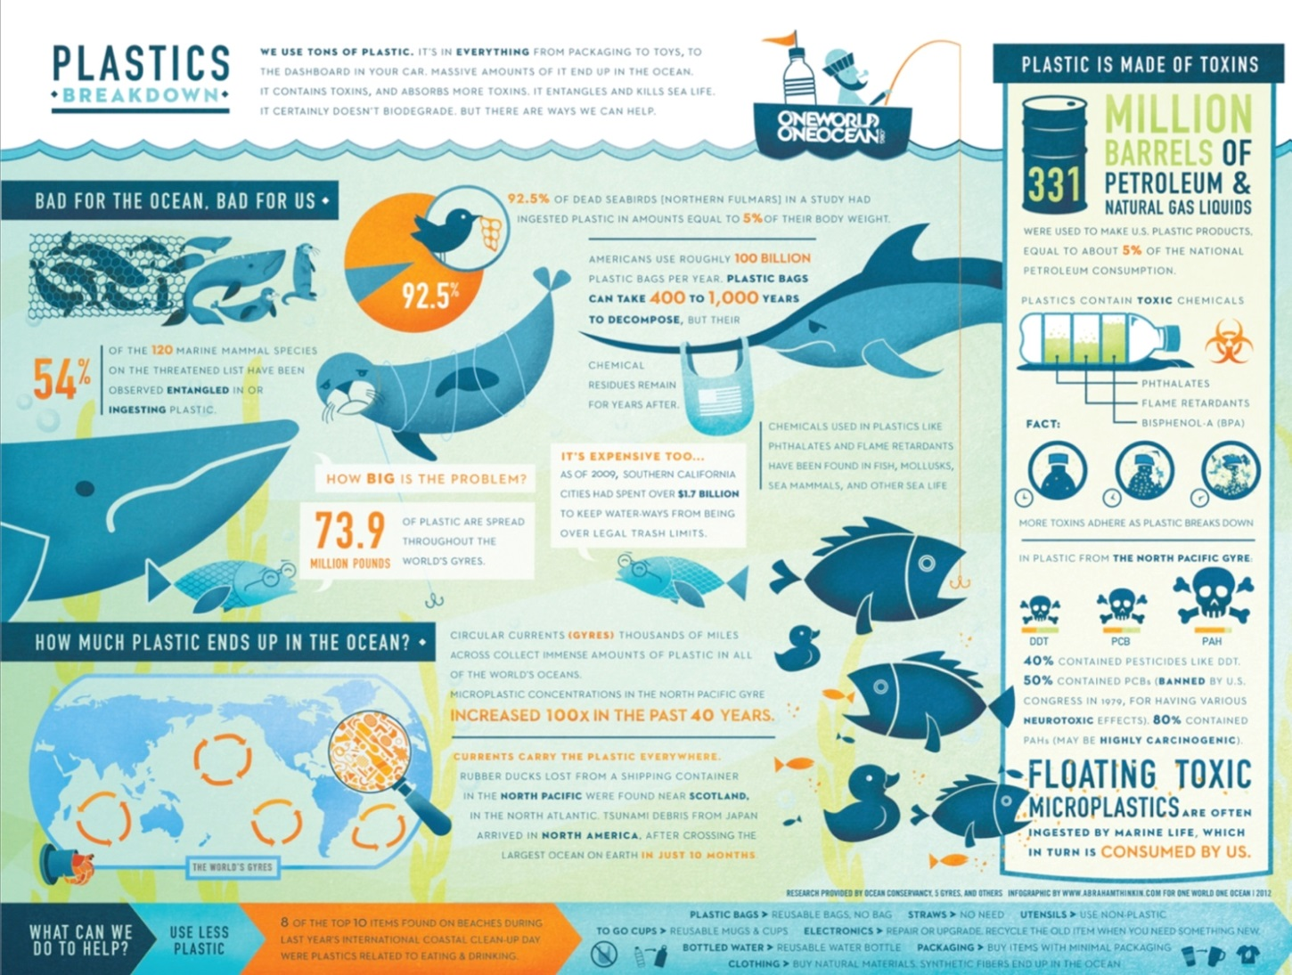
Your infographic needs to
1. Make a well-supported argument about why we need to reduce our consumption
2. Include a minimum of one recommended way to do so
Notes:
What does this infographic suggest we do to reduce our consumption? How?

Slide 3
Keep It Simple
Effective Visuals
Meaningful Data

Slide 4
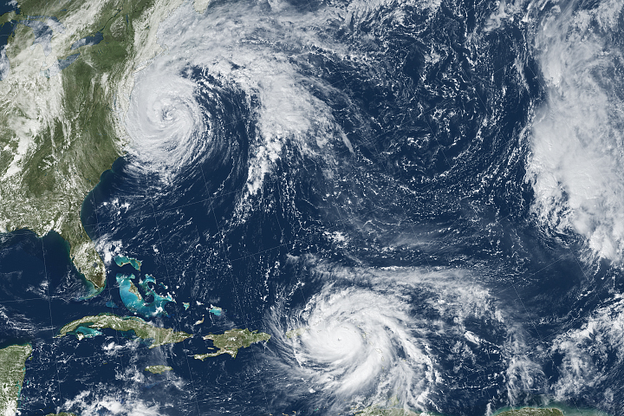
Effective Visuals
Simple
Understandable
(keys, captions)
Permission to Use (creative commons in “advanced search”)
In September 2017, Hurricane Irma (upper left) and Hurricane Maria (lower left) slammed into the Caribbean and Florida, causing catastrophic damage.
Notes:
Add captions and sources for images. Icons are also often used in infographics and are simple and generally self-explanatory.

Slide 5
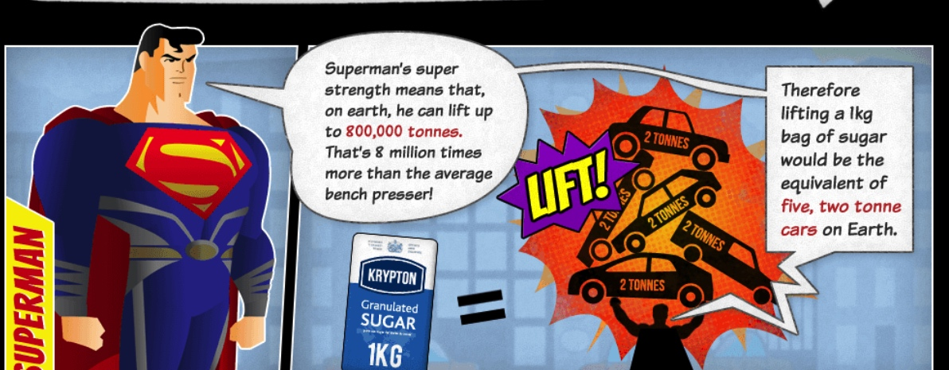
Meaningful Data
Social math uses data to tell a story.
Notes:
What is the example here?

Slide 6
How? Social math translates, or breaks down, statistics and other data so that they become interesting and meaningful to the audience.
“Most people in Africa support their entire families on the equivalent of what Americans spend on pet food.”
“Did you know that each day we use 500 million straws—enough disposable straws to fill over 46,400 large school buses per year?”
“A sea otter consumes about 25% of its body weight every day. That’s like eating 50 quarter-pound cheeseburgers daily!
“Community residents near a gasoline refinery noted that the plant emits 6 tons of pollutants per day—or 25 balloons full of toxic pollution for each school child in the town.”
Notes:
Social math should:
Use accurate, reliable, and cited data.
Be used to create a familiar and relevant story.
Use a story to inspire the audience to action.
Examples are from the following links:
https://www.marketing-partners.com/conversations2/changing-minds-social-math-stories-and-framing
https://www.asist.org/publications/bulletin/junejuly-2016/social-math/

Slide 7
Find Examples of Effective Visuals and Social Math
Halloween By the Numbers (https://www.columnfivemedia.com/work-items/infographic-halloween-by-the-numbers)
Can We Feed 7 Billion People? (http://www.sustainableamerica.org/blog/can-we-feed-7-billion-people/)
Shark Attacks (http://ripetungi.com/shark-attack/)
Notes:
Examine these infographics. What examples of social math do you observe? Are they effective? Why or why not?

