Slide 1
Satellites and Waves

Slide 2
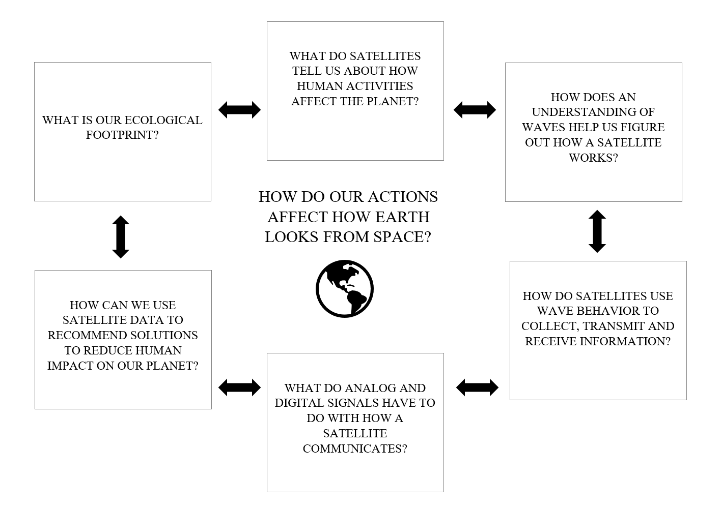
Where Are We In The Unit?
Notes:
Read over these questions that students will be investigating over the course of the unit. Students will reference the previous graphic and this concept map throughout the unit.

Slide 3
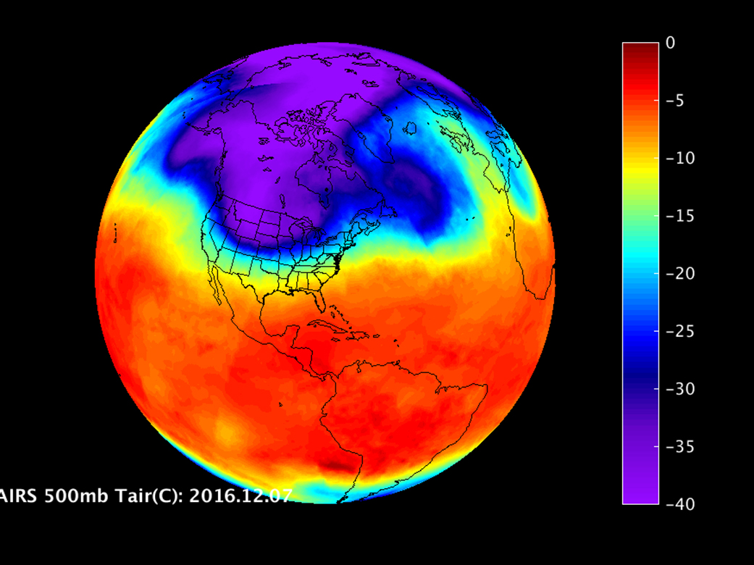
What Do These Images Tell Us?
https://www.youtube.com/watch?time_continue=8&v=MbdTvKU5-hs
Notes:
Have students think on their own and jot their answers down on scratch paper. Then take student ideas.
The first image shows land masses versus oceans, the planet isn’t flat, it’s an orb/circular, cloud cover, and so on.
The second image is of the world’s temperature on Dec 11, 2016. Play the ten-second video for students and it shows the temperature changing over an 11-day period.
Make the point that both of these are satellite images. Different satellites can take or construct different images to give us different insights.

Slide 4
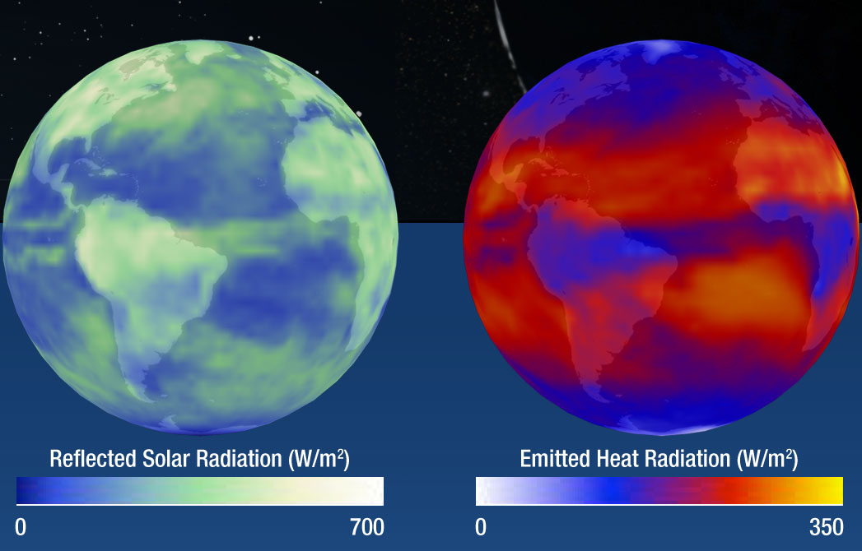
Satellites Make the Invisible Visible.
Notes:
Satellite technology helps us see and observe things beyond the visible light spectrum.
More background on these images (excerpt from https://science.nasa.gov/ems/13_radiationbudget) For scientists to understand climate change, they must also determine what drives the changes within the Earth's radiation budget. The Clouds and the Earth's Radiant Energy System (CERES) instrument aboard NASA's Aqua and Terra satellites measures the shortwave radiation reflected and longwave radiation emitted into space accurately enough for scientists to determine the Earth's total radiation budget. Other NASA instruments monitor changes in other aspects of the Earth's climate system—such as clouds, aerosol particles, and surface reflectivity—and scientists are examining their many interactions with the radiation budget.

Slide 5
Photos from NOAA’s weather satellite, GOES-16 (2017)
Satellites Use Characteristics and Behaviors of Waves to Help Us See the Invisible.
Notes:
These images and knowledge comes from satellite technologies utilization of wave characteristics and behavior.
This 16-panel image shows the continental United States in the two visible, four near-infrared and 10 infrared channels on the Advanced Baseline Imager (ABI). These channels help forecasters distinguish between differences in the atmosphere like clouds, water vapor, smoke, ice and volcanic ash. (NOAA/NASA)

Slide 6
What is a Wave?
Notes:
Give students time to consider this and then move into the second activity examining various photographs and determining which involve waves or not.

