Slide 1
Making Waves
Waves and wave characteristics

Slide 2
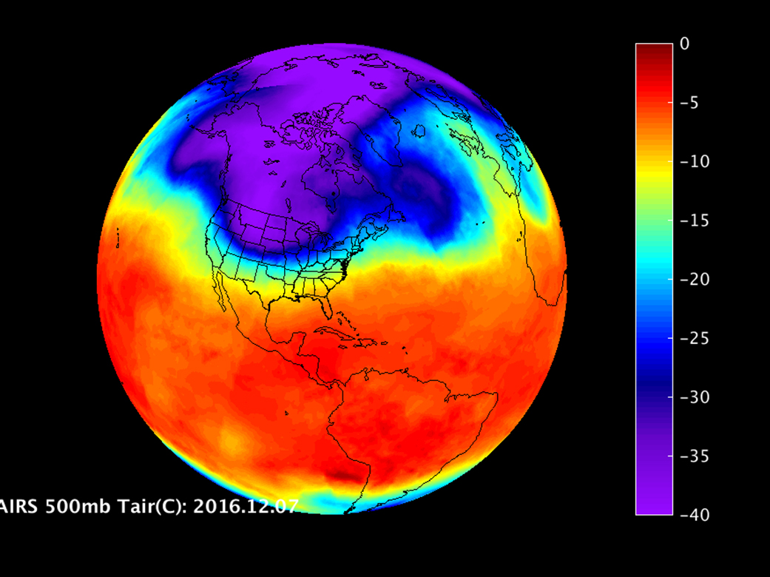
Waves Used to Construct These Images Share the Same Characteristics and Behaviors as…

Slide 3
…These.
What do you notice or wonder about these waves?
Notes:
Give students time to consider this…

Slide 4
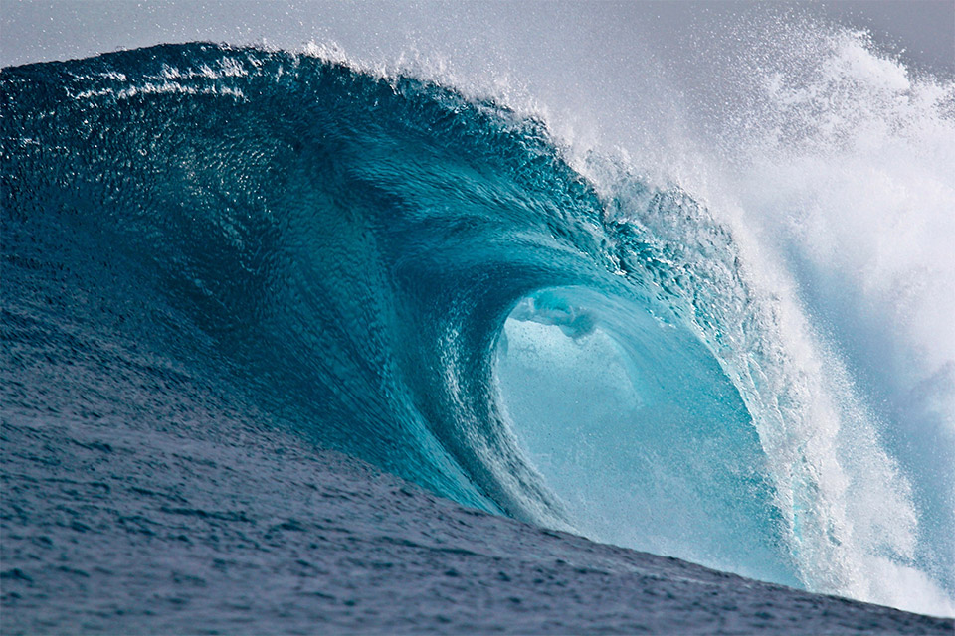
What is a wave?
https://upload.wikimedia.org/wikipedia/commons/5/55/Large_breaking_wave.jpg
Notes:
Ask students “what is a wave?” and have them share their ideas based upon their claims, evidence, and reasoning.
A wave is the movement of energy, not matter. A wave carries energy from one location to another. Some waves are mechanical and move through matter (again, waves don’t carry matter), like water, a slinky, dominoes, or a jump rope. Other waves don’t need matter to move (note: your students will get there in future lessons with visible light and other electromagnetic radiation).
What transfers energy to the ocean to create the wave in this photo? Wind energy from the air.

Slide 5
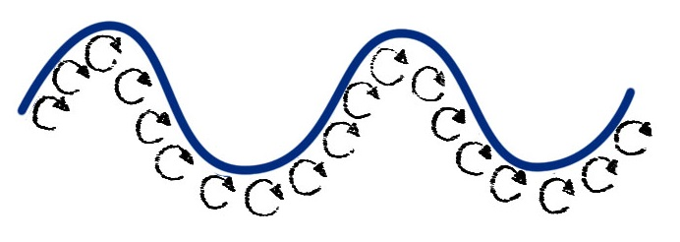
Types of waves
Transverse
Longitudinal
Surface
Wavelength
Compression
Expansion
Wavelength
Notes:
Waves come in many shapes and forms. While all waves share some basic characteristic properties and behaviors, some waves can be distinguished from others based on some observable (and some non-observable) characteristics. It is common to categorize waves based on these distinguishing characteristics.
(Note: have a couple of students use a slinky to demonstrate each wave type for the class)
These categories are based upon direction of energy transport.
Transverse: a wave in which particles of the medium move in a direction perpendicular to the direction that the wave moves
Longitudinal: a wave in which particles of the medium move in a direction parallel to the direction that the wave moves
Surface: a wave in which particles of the medium undergo a circular motion. Surface waves are neither longitudinal nor transverse.

Slide 6
Transverse
Crest
Trough
Wavelength
Notes:
Crest-highest point of a transverse wave
Trough-lowest point of a transverse wave
Examples (e.g., water waves)

Slide 7
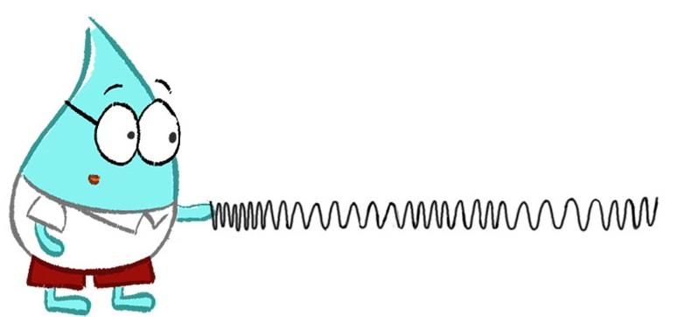
Longitudinal
Compression
Expansion
Wavelength
Notes:
Compression-densest part of a longitudinal wave
Rarefication/Expansion-least dense part of a longitudinal wave
Examples: Sound waves

