Slide 1
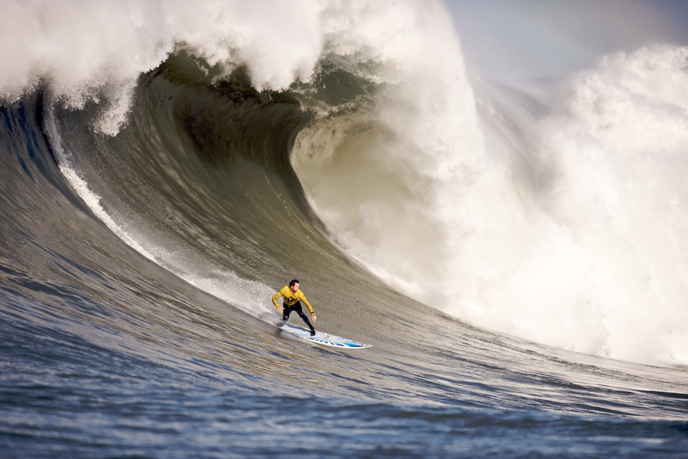
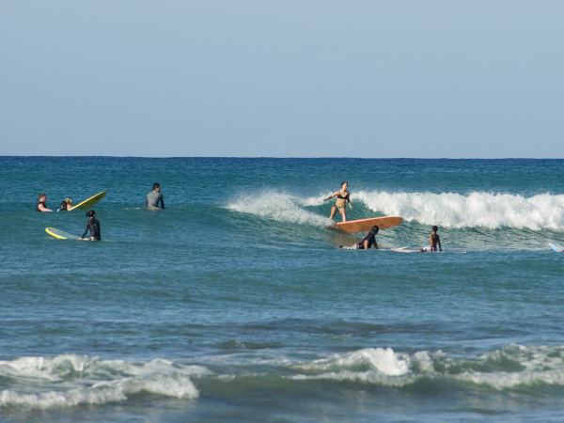
How might you describe the similarities and differences between these waves?
How might you describe amplitude?

